Slide 1
A BREAKDOWN OF LEADERSHIP
Micah 3

Slide 2
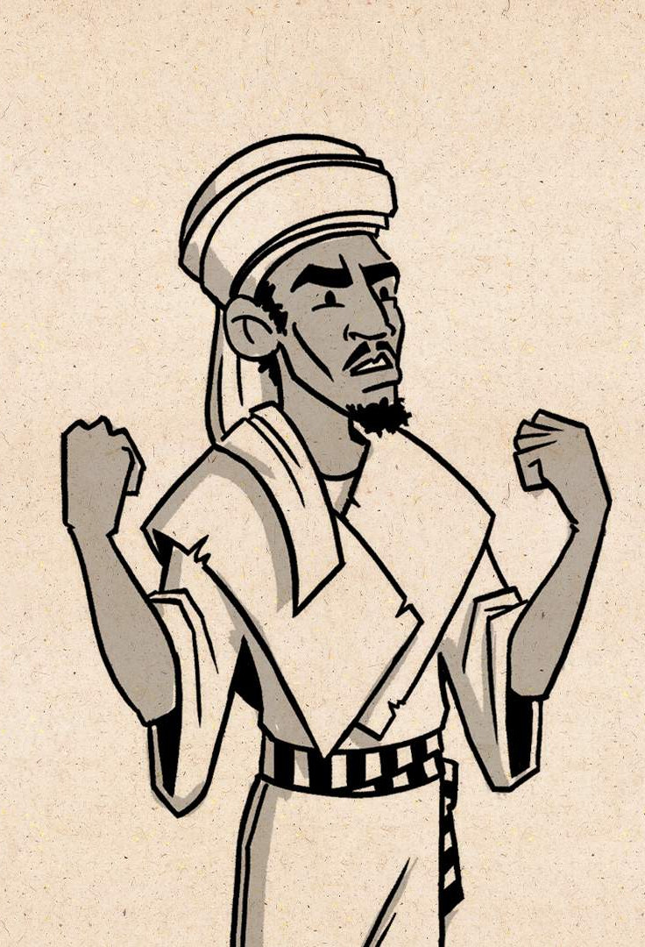
Micah
From Judah
Name means: “Who is like Yahweh?”
The 6th book of the Minor Prophets
Prophesied during the reigns of Jotham, Ahaz, and Hezekiah
Book written within 10 years of 687 B.C.

Slide 3
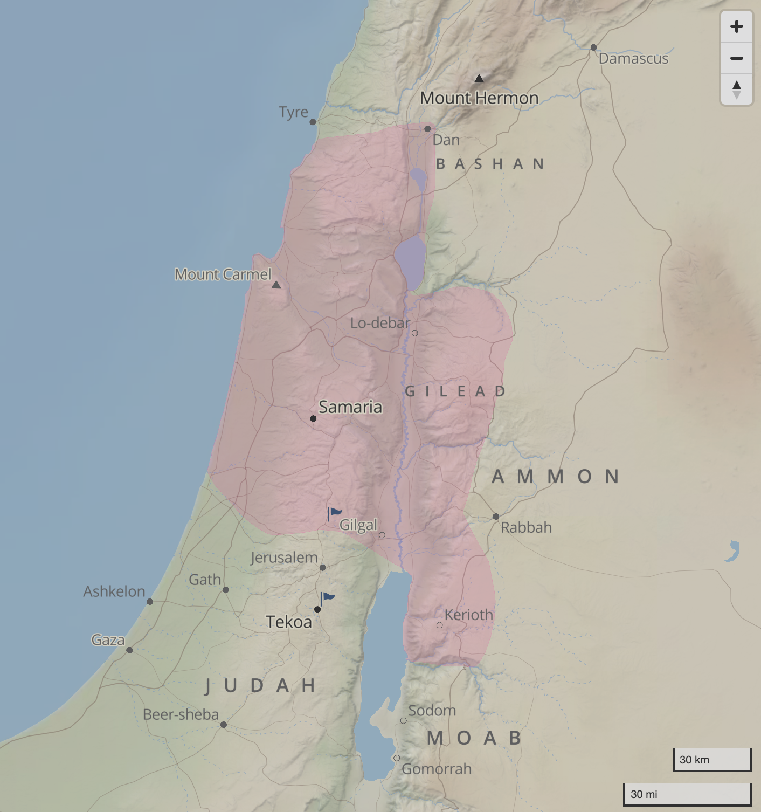
Who was Micah speaking to?
Micah Interchanges the words Jacob and Israel when referring to all of Israel. Micah also had Judah in mind along with the Northern Kingdom of Israel as he spoke of ”Zion” and “Jerusalem”.
ISRAEL

Slide 4
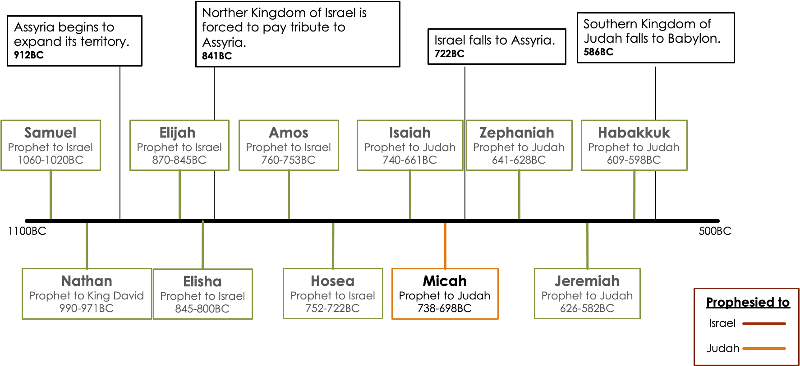
Prophet Timeline

Slide 5
¹ And I said: Hear, you heads of Jacob and rulers of the house of Israel! Is it not for you to know justice?—
Micah 3:1 (ESV)

Slide 6
ENTRUSTED LEADERS: Expectations
Prophets
Designated by God; Responsible for delivering messages of truth; to speak forth for God
Priests
Heralds or proclaims usually by delivering a discourse on a text of Scripture; advise to the King
Kings
Responsible for ensuring God’s Will was done among the people; deliver the people from their enemies; lead them in right paths.

Slide 7
¹ And I said: Hear, you heads of Jacob and rulers of the house of Israel! Is it not for you to know justice?—² you who hate the good and love the evil, who tear the skin from off my people and their flesh from off their bones, ³ who eat the flesh of my people, and flay their skin from off them, and break their bones in pieces and chop them up like meat in a pot, like flesh in a cauldron. ⁴ Then they will cry to the Lord, but he will not answer them; he will hide his face from them at that time, because they have made their deeds evil.
Micah 3:1–4 (ESV)

Slide 8
Notes:
STOP AT 3:06
START AT 6:08
START AT 9:46
START AT 12:00

Slide 9
Far Fetched Description?
“Each individual term referring to your political outgroup increased the odds of that post being retweeted or shared by 67%.”
“They’re super charging a 100 or 1000 times to 1, the worst parts about ourselves.”
Notes:
Leaders are figuratively devouring the poor, defenseless people

Slide 10
⁵ Thus says the Lord concerning the prophets who lead my people astray, who cry “Peace” when they have something to eat, but declare war against him who puts nothing into their mouths. ⁶ Therefore it shall be night to you, without vision, and darkness to you, without divination. The sun shall go down on the prophets, and the day shall be black over them; ⁷ the seers shall be disgraced, and the diviners put to shame; they shall all cover their lips, for there is no answer from God. ⁸ But as for me, I am filled with power, with the Spirit of the Lord, and with justice and might, to declare to Jacob his transgression and to Israel his sin.
Micah 3:5–8 (ESV)

Slide 11
⁹ Hear this, you heads of the house of Jacob and rulers of the house of Israel, who detest justice and make crooked all that is straight, ¹⁰ who build Zion with blood and Jerusalem with iniquity. ¹¹ Its heads give judgment for a bribe; its priests teach for a price; its prophets practice divination for money; yet they lean on the Lord and say, “Is not the Lord in the midst of us? No disaster shall come upon us.” ¹² Therefore because of you Zion shall be plowed as a field; Jerusalem shall become a heap of ruins, and the mountain of the house a wooded height.
Micah 3:9–12 (ESV)

Slide 12
“Selfish leaders are weak people-pleasers focused on self preservation”
- Pastor Dave Sumrall, iTown Church

Slide 13
ENTRUSTED LEADERS: Actions
Prophets
Prophesied for cash
Priests
Taught for hire
Kings
Judged for reward
Notes:
The nation was ready to collapse, and the princes and priests were responsible for its fall
Blinded by greed; focused only on actions that benefitted themselves; leaving those they led astray.
Pleasure
Payment
Self-Promotion

Slide 14
What should we expect from our leaders?
How should we lead?

Slide 16
Leading
Responsibility
Integrity
Vision
Someone you aspire to be like
Energies that are pushing you up
Inspiring confidents
It’s about the team
The whole is greater than the sum of the parts
Someone who’s willing to fight
Walking the talk
Do as I do
Qualities
Leading conversations or ideas
Eye to humanities problems
Part of the motion of humanities
Brave
Make a difference
Inspirational
Changing peoples lives for the better
Notes:
When looking at this list of traits we often probably think of leadership guru’s like Simon Sinek, Jocko Willink, John Maxwell, David Goggins, or maybe Tony Robinson

Slide 17
JESUS
Greatest Of All Time

Slide 18
Skills
Character
Holy
Righteous
Good
Faithful
Just
Obedient
Zealous
Humble
Merciful
Compassionate
Loving
Self-Denying
Forgiving
Integrity
Patient
Selfless

Slide 19
PEOPLE
popularity
product
profit

Slide 20
If you want to be used by God, seek the anointing of His Spirit. Be committed to God’s people, and learn to trust God for great things. Cultivate loyalty to all your commitments and especially within your marriage; place the pursuit of money on the altar and determine to receive whatever God gives you gladly. Be crystal clear in your convictions regarding the central truths of the gospel, and feed on the Word of God every day. Ask for the grace and help of God to live a life that is worthy of the calling that God has given you in Christ Jesus.
Gabriel Kofi Boahen Nsiah
Leading as Jesus Led: Christ Models of Leadership

Slide 21
Christian Leadership In Action
Seeks the Lord in prayer & reading
Commits to the individual
Trusts the Lord in all things
Depicts loyalty and Integrity; starting at home
Works for the Lord, not for money
Stands firm in your faith

Slide 22
Skills
Character
Holy
Righteous
Good
Faithful
Just
Obedient
Zealous
Humble
Merciful
Compassionate
Loving
Self-Denying
Forgiving
Integrity
Patient
Selfless

Slide 23
JESUS
Greatest Of All Time

Slide 24
THE END

Slide 25
Notes

Slide 26
L | oyalty
D | uty
R | espect
S | elfless Service
H | onor
I | ntegrity
P | ersonal Courage

Slide 27
https://www.inc.com/lee-colan/4-powerful-leadership-lessons-from-jesus.html
Great leaders have integrity.
Great leaders are great communicators.
Great leaders are great servants.
Great leaders forgive (balance conviction with compassion)

Slide 28
https://www.ministrymagazine.org/archive/2010/11/jesus-leadership-a-model-for-ministry
Empowered Others:
Integrity
Principles
Vision
Love and Action
Jesus set the vision, preached the message, and demonstrated the vision through miraculous healings

Slide 29
Jesus said several times, “Come, follow me.” His was a program of “do what I do,” rather than “do what I say.” His innate brilliance would have permitted him to put on a dazzling display, but that would have left his followers far behind. He walked and worked with those he was to serve. His was not a long-distance leadership. He was not afraid of close friendships; he was not afraid that proximity to him would disappoint his followers. The leaven of true leadership cannot lift others unless we are with and serve those to be led.
Jesus was a listening leader. Because he loved others with a perfect love, he listened without being condescending. A great leader listens not only to others, but also to his conscience and to the promptings of God.

Slide 30
7 Qualifications of a King
Anointed by God: Deuteronomy 17:14–15
Belong to God’s People: Deuteronomy 17:15
Exercise Faith: Deuteronomy 17:16
Loyal: Deuteronomy 17:17
Ready to Sacrifice: Deuteronomy 17:17
Know Scripture: Deuteronomy 17:18–19
Example of Obedience: Deuteronomy 17:20

Slide 31
“Positive leaders are demanding but are not demeaning”
- Jon Gordon

Slide 32
7 Qualifications
King must be anointed: “If God did not approve the king, there was no hope whatever of him advancing God’s purpose.” (Deuteronomy 17:14–15)
Belong to God’s people: ““He must be from among your own brothers. Do not place a foreigner over you, one who is not a brother Israelite” ~ Deuteronomy 17:15
Must exercise faith: “The king is to model faith. He is to put his trust in the living God.” (Deuteronomy 17:16)
Loyal to one wife: (Deuteronomy 17:17)
Ready to sacrifice: (Deuteronomy 17:17) “He must not be greedy, but must use his power for the benefit of the people. “
Must know scripture: (Deuteronomy 17:18–19) “Leadership is to be given into the hands of people who know the Word of God and will lead the people in it.”
Example of Obedience: “not consider himself better than his brothers and turn from the law to the right or to the left” ~ Deuteronomy 17:20
“The king could not say to the people, “Do as I say, not as I do.” The most powerful man in the land must be the first to model commitment to the Law of God. “

Slide 33
Kings (melek) Responsibilities
1 Samuel 8 – have to remember who appointed Kings to understand their intent
“The king would have the responsibility of making sure that God’s will was done among the people. He was to deliver the people from their enemies and to lead them in right paths. This is a high calling, and God’s people needed to be very careful about selecting a person who could be trusted with this kind of authority.”
7 Qualifications
King must be anointed: “If God did not approve the king, there was no hope whatever of him advancing God’s purpose.” (Deuteronomy 17:14–15)
Belong to God’s people: ““He must be from among your own brothers. Do not place a foreigner over you, one who is not a brother Israelite” ~ Deuteronomy 17:15
Must exercise faith: “The king is to model faith. He is to put his trust in the living God.” (Deuteronomy 17:16)
Loyal to one wife: (Deuteronomy 17:17)
Ready to sacrifice: (Deuteronomy 17:17) “He must not be greedy, but must use his power for the benefit of the people. “
Must know scripture: (Deuteronomy 17:18–19) “Leadership is to be given into the hands of people who know the Word of God and will lead the people in it.”
Example of Obedience: “not consider himself better than his brothers and turn from the law to the right or to the left” ~ Deuteronomy 17:20
“The king could not say to the people, “Do as I say, not as I do.” The most powerful man in the land must be the first to model commitment to the Law of God. “

Slide 34
Kings (melek)
Word mentioned over 2000 times in the OT
Hebrew Monarchy Kings had Priestly Functions
King was expected to further religion but not to act as its priest
Kings came to be regarded as divine beings; true of Egypt and further taken over by the Greek empore of Alexander the great and later the Romans
Earliest king mentioned in the Bible is King Nimrod (Gen 10:8-12)
Samuels Warnings against kings 1 Sam 8:5, 22; 19:19, 24; 12:1-25; Hosea 13:10)
Failures:
King Saul
David
Solomon
Kings of Israel

Slide 35
Accusations
Rulers Judged for Reward
Priests Taught for Hire
Prophets Divined for Money
Pleasure, Payment, Self-Promoting
Blinded by greed their prophets were like Influencers – Self-promoting; not

Slide 36
Priests (kohen)
650 times in the OT
To those aurthorized to perform the rites of Israelite religion

Slide 37
https://openthebible.org/article/christian-leadership-what-did-god-want-in-a-king/

