Slide 1
Action
Mark 6:30-44
Notes:
How are we putting to action God’s plan for our live? Are we being obedient?

Slide 2
The Gospels
Name | Occupation | Wrote To | Description
Matthew | Tax Collector and Disciple of Jesus | Jewish Christians | Matthew's Gospel is the longest and most detailed of the four Gospels. It emphasizes Jesus' fulfillment of Old Testament prophecies and his Messiahship.
Mark | Unknown and Disciple of Peter | Gentile (Non-Jewish) Christians, specifically Romans | Mark's Gospel is the shortest and most fast-paced of the four Gospels. It focuses on Jesus' actions and miracles, and it is written in a simple and direct style.
Luke | Physician and Disciple of Paul | Gentile (Non-Jewish) Christians, Greeks, Theophilus | Luke's Gospel is the most literary of the four Gospels. It is written in a polished and flowing style, and it emphasizes Jesus' compassion for the poor and marginalized.
John | Fisherman and Disciple of Jesus | Christians in Asia Minor; All Christians | John's Gospel is the most theological of the four Gospels. It emphasizes Jesus' divinity and his relationship with the Father.
Notes:
Synoptic Gospels: Matthew Mark, and Luke
Good News
Mark: The Time is fulfilled; God’s kingdom has come near – God’s Kingdom is coming
God Created a World > Created a humanity to rule over it > we keep failing > God is committed > God won’t give up (prophets said) > He wants all creation to know > Kingdom of God > Jesus is bringing this Kingdom > Jesus is liberating people from death and disease > Jesus is inviting us to live in God’s good world
Not to just know of God’s Kingdom; they want them to become a part of it
Persuade us; to trust and follow Jesus; so we can participate in the new creation that He began.
----
Gospel is …
a Plan for eternity: As per the Bible
An Event: Christ Died
An Achievement: Sins were paid for; righteousness as achieved
An offer: Extended in an offer to the world that is free
The Application: By faith I am forgiven, by faith I am justified
God: 1 Peter 3:18; to bring us to God – God is the end

Slide 3
Who is Mark?
Son of a women named Mary – thought to be the owner of the upper room for Jesus’ last supper
Young man that fled naked on the night of Jesus’ arrest (Mark 14:51-52)
“John whose other name was Mark” ~ Acts 12:12
His Gospel is thought to be the earliest of the Gospels; written between 60-70 AD
Mark focuses what Jesus did rather what Jesus said
Mark is moving fast; “immediately” used 41 times
Stories are written as Mark remembers and hears them from Paul
Written as a Drama – To be spoken, not just read
Notes:
Was not a disciple
Was there the night Jesus was arrested
Also known as John Mark
Son of a woman named Mary
His Gospel is thought to be the earliest
Max Mclean – Mark dramatized max
In Acts 12:12, ‘When this had dawned on him, he went to the house of Mary the mother of John, also called Mark, where many people had gathered and were praying’
Forgiveness is possible. So are second chances. Paul forgave Mark and gave him a chance to prove his worth. Peter was so taken with Mark he considered him like a son.
Paul made his first missionary journey to Cyprus, accompanied by Barnabas and John Mark. When they sailed to Perga in Pamphylia, Mark left them and returned to Jerusalem. No explanation is given for his departure, and Bible scholars have been speculating ever since.
According to Coptic tradition, John Mark is the founder of the Coptic Church in Egypt. Copts believe Mark was tied to a horse and dragged to his death by a mob of pagans on Easter, 68 A.D., in Alexandria.
A young man, wearing nothing but a linen garment, was following Jesus. When they seized him, he fled naked, leaving his garment behind. (Mark 14:51-52, NIV)
John Mark is mentioned in Acts 12:23-13:13, 15:36-39; Colossians 4:10; 2 Timothy 4:11; and 1 Peter 5:13.

Slide 4
Detail | Matthew 14:13-21 | Mark 6:30-44 | Luke 9:10-17 | John 6:1-15
Where did it take place? | A desolate place | A desolate place | Bethsaida | The other side of the sea of Galilee – Sea of Tiberias
How did Jesus feel toward the crowd? | He had compassion on them | He had compassion on them, like sheep without Shepard | He welcomed them
What did He do with the crowd? | Healed their sick | Taught them many things | Spoke to them of the kingdom of God and cured their sick
What did He say to the disciples? | You give them something to eat | You give them something to eat | You give them something to eat | Where are we going to buy bread so these people can eat?
How did the disciples respond? | We only have… | Go buy 200 Denarii worth of bread and give it to them? | We only have…unless we’re going to go buy food | 200 denarii would not be enough. Simon Peter’s brother…
How much food did they have on hand? | Five loaves and two fish | Five loaves and two fish | Five loaves and two fish | A boy with fives loaves and two fish
How did he bless the food? | He looked up to heaven and said a blessing | He looked to the heavens and said a blessing | He looked up to heaven and said a blessing | He gave thanks
Where did they sit? | Sit in the grass | Green grass sat in 50’s and 100’s | Sit in groups of 50 | Much grass in the place
How many ate? | 5,000 men besides women and children | 5,000 men | 5,000 men | The men sat down, about 5,000 in number
Did everyone eat enough? | All Ate and were satisfied | All ate and were satisfied | All ate and were satisfied | As much as they wanted; eaten their fill
How much food was left over? | 12 baskets full | 12 baskets full | 12 baskets | Filled 12 baskets
What did they want to do next? |  |  |  | They were about to come and take him by force to make him King
Notes:
PRAY

Slide 5
³⁰ The apostles returned to Jesus and told him all that they had done and taught. ³¹ And he said to them, “Come away by yourselves to a desolate place and rest a while.” For many were coming and going, and they had no leisure even to eat. ³² And they went away in the boat to a desolate place by themselves.
Mark 6:30–32 (ESV)
Notes:
Jesus understood the need for rest.

Slide 6
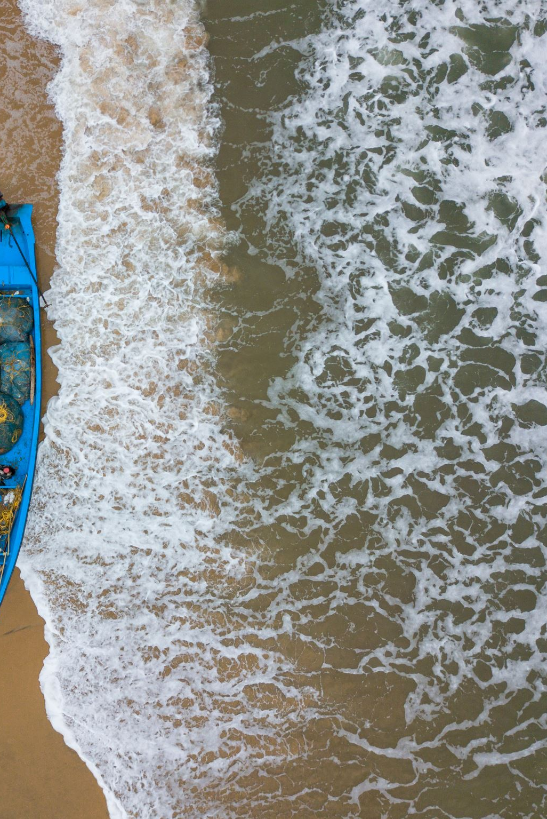
Mark 4:37–41 (ESV)
³⁷ And a great windstorm arose, and the waves were breaking into the boat, so that the boat was already filling. ³⁸ But he was in the stern, asleep on the cushion. And they woke him and said to him, “Teacher, do you not care that we are perishing?” ³⁹ And he awoke and rebuked the wind and said to the sea, “Peace! Be still!” And the wind ceased, and there was a great calm. ⁴⁰ He said to them, “Why are you so afraid? Have you still no faith?” ⁴¹ And they were filled with great fear and said to one another, “Who then is this, that even the wind and the sea obey him?”
Notes:
Jesus knew what it meant to be tired.

Slide 8
2 Thus the heavens and the earth were finished, and all the host of them. ² And on the seventh day God finished his work that he had done, and he rested on the seventh day from all his work that he had done. ³ So God blessed the seventh day and made it holy, because on it God rested from all his work that he had done in creation.
Genesis 2:1–3 (ESV)
Notes:
Exodus 20:8-11 - "Remember the Sabbath day, to keep it holy. Six days you shall labor, and do all your work, but the seventh day is a Sabbath to the Lord your God. On it you shall not do any work, neither you, nor your son or daughter, nor your male or female servant, nor your livestock, nor the sojourner who is within your gates. For in six days the Lord made the heavens and the earth, the sea, and all that is in them, but he rested on the seventh day. Therefore the Lord blessed the Sabbath day and made it holy."
Leviticus 23:3 - "Six days shall you labor, but on the seventh day is a sabbath of solemn rest, a holy convocation. You shall do no work—it is a sabbath to the Lord throughout your territory."
Deuteronomy 5:12-15 - "Observe the Sabbath day by keeping it holy, as the Lord your God has commanded you. Six days you shall labor and do all your work, but the seventh day is a sabbath to the Lord your God. On it you shall not do any work—neither you, nor your son or daughter, nor your male or female servant, nor your ox, nor your donkey, nor any of your livestock, nor the alien resident in your towns, so that your male and female servants may rest, as you do. Remember that you were slaves in Egypt and the Lord your God brought you out of there with a mighty hand and an outstretched arm. Therefore the Lord your God commanded you to observe the Sabbath day."
Isaiah 58:13-14 - "If you turn back your foot from the sabbath, from doing your pleasure on my holy day, and call the sabbath a delight and the Lord's holy day honorable; if you honor it, not going your own ways or seeking your own pleasure or talking idly; then you shall delight yourself in the Lord, and I will lift you up on the heights of the land and feed you with the heritage of Jacob your father, for the mouth of the Lord has spoken."

Slide 9
³³ Now many saw them going and recognized them, and they ran there on foot from all the towns and got there ahead of them. ³⁴ When he went ashore he saw a great crowd, and he had compassion on them, because they were like sheep without a shepherd. And he began to teach them many things.
Mark 6:33–34 (ESV)

Slide 10
³⁵ And when it grew late, his disciples came to him and said, “This is a desolate place, and the hour is now late. ³⁶ Send them away to go into the surrounding countryside and villages and buy themselves something to eat.” ³⁷ But he answered them, “You give them something to eat.” And they said to him, “Shall we go and buy two hundred denarii worth of bread and give it to them to eat. ³⁸ And he said to them, “How many loaves do you have? Go and see.” And when they had found out, they said, “Five, and two fish.”
Mark 6:35–38 (ESV)
Notes:
Lacking Trust…

Slide 11
³⁹ Then he commanded them all to sit down in groups on the green grass. ⁴⁰ So they sat down in groups, by hundreds and by fifties. ⁴¹ And taking the five loaves and the two fish, he looked up to heaven and said a blessing and broke the loaves and gave them to the disciples to set before the people. And he divided the two fish among them all. ⁴² And they all ate and were satisfied. ⁴³ And they took up twelve baskets full of broken pieces and of the fish. ⁴⁴ And those who ate the loaves were five thousand men.
Mark 6:39–44 (ESV)
Notes:
God’s precision -> everyone were satisfied; back then people didn’t eat like that unless it was some sort of wedding
What was left? 12 baskets, one for each one of the disciples. God’s precisions.
He fed 5000 which was more likely 20-
Con25k
Convicting questions

Slide 12
Do you believe Jesus worked a miracle?

Slide 13
Have you ever been concerned about provisions for your future?
Notes:
Retirement, rent, food, etc.

Slide 14
Then what does it matter if you believe He performed a miracle?
Notes:
If Yes, then…

Slide 15
²⁶ Look at the birds of the air: they neither sow nor reap nor gather into barns, and yet your heavenly Father feeds them. Are you not of more value than they? ²⁷ And which of you by being anxious can add a single hour to his span of life?
Matthew 6:26–27 (ESV)

Slide 16
⁷ “Ask, and it will be given to you; seek, and you will find; knock, and it will be opened to you. ⁸ For everyone who asks receives, and the one who seeks finds, and to the one who knocks it will be opened.
Matthew 7:7–8 (ESV)

Slide 17
Faith
Faith is believing and acting.
Example: James 2:14-17
ACTION
DOING!
Wisdom
Learning
Wisdom is seeing the world and your circumstances through God’s eyes and then acting accordingly.
Example: Hosea 14:9
Learning is being in the same circumstance but taking different actions.
Example: Romans 5:3-4

Slide 18
Actions We Can Take
Rest
Compassion
Trust
Notes:
My prayer is that you learn from this. Tomorrow when you are in that same circumstance, you act differently.

Slide 19
The End

Slide 20
What posture should I have to receive to receive God’s provision?
Notes:
All ate and were satisfied.

Slide 21
God will use what you wouldn’t choose.
God will use what you’re willing to lose.

Slide 22
Jesus Feeds the Five Thousand
³⁰ The apostles returned to Jesus and told him all that they had done and taught. ³¹ And he said to them, “Come away by yourselves to a desolate place and rest a while.” For many were coming and going, and they had no leisure even to eat. ³² And they went away in the boat to a desolate place by themselves. ³³ Now many saw them going and recognized them, and they ran there on foot from all the towns and got there ahead of them. ³⁴ When he went ashore he saw a great crowd, and he had compassion on them, because they were like sheep without a shepherd. And he began to teach them many things. ³⁵ And when it grew late, his disciples came to him and said, “This is a desolate place, and the hour is now late. ³⁶ Send them away to go into the surrounding countryside and villages and buy themselves something to eat.” ³⁷ But he answered them, “You give them something to eat.” And they said to him, “Shall we go and buy two hundred denarii worth of bread and give it to them to eat?” ³⁸ And he said to them, “How many loaves do you have? Go and see.” And when they had found out, they said, “Five, and two fish.” ³⁹ Then he commanded them all to sit down in groups on the green grass. ⁴⁰ So they sat down in groups, by hundreds and by fifties. ⁴¹ And taking the five loaves and the two fish, he looked up to heaven and said a blessing and broke the loaves and gave them to the disciples to set before the people. And he divided the two fish among them all. ⁴² And they all ate and were satisfied. ⁴³ And they took up twelve baskets full of broken pieces and of the fish. ⁴⁴ And those who ate the loaves were five thousand men.
Mark 6:30–44 (ESV)

