Slide 1
Is He Risen?
Mark 16:1-14

Slide 2
The Resurrection
16 When the Sabbath was past, Mary Magdalene, Mary the mother of James, and Salome bought spices, so that they might go and anoint him. ² And very early on the first day of the week, when the sun had risen, they went to the tomb. ³ And they were saying to one another, “Who will roll away the stone for us from the entrance of the tomb?” ⁴ And looking up, they saw that the stone had been rolled back—it was very large. ⁵ And entering the tomb, they saw a young man sitting on the right side, dressed in a white robe, and they were alarmed. ⁶ And he said to them, “Do not be alarmed. You seek Jesus of Nazareth, who was crucified. He has risen; he is not here. See the place where they laid him. ⁷ But go, tell his disciples and Peter that he is going before you to Galilee. There you will see him, just as he told you.” ⁸ And they went out and fled from the tomb, for trembling and astonishment had seized them, and they said nothing to anyone, for they were afraid.
Mark 16:1–18 (ESV)

Slide 3
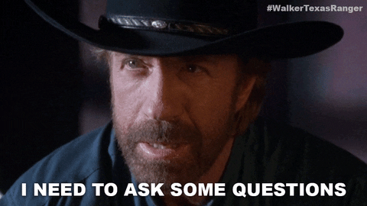

Slide 4
Give Thought
¹⁵ The simple believes everything,
but the prudent gives thought to his steps.
Proverbs 14:15 (ESV)

Slide 5
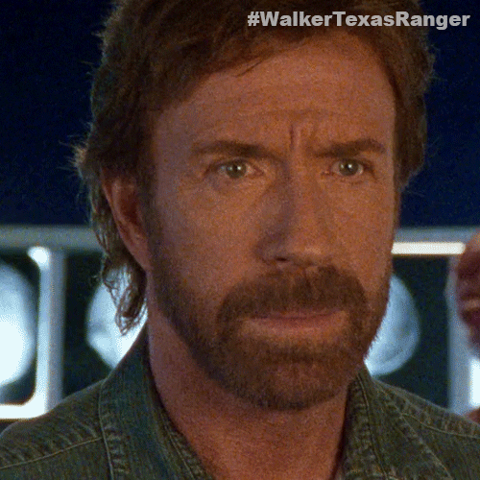
Do you believe Jesus rose from the dead?

Slide 6
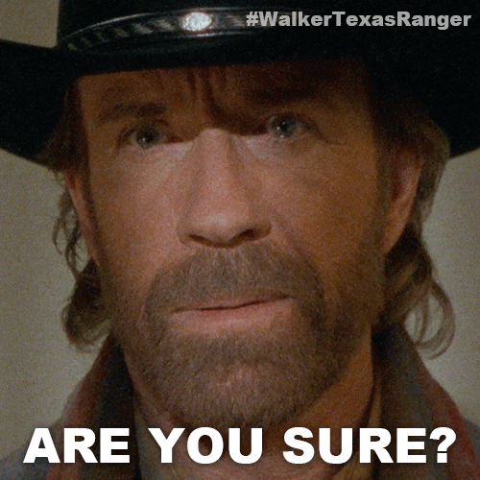
How do you know?

Slide 7
If Jesus did not rise from the dead,
would you still be a Christian?
Notes:
Jesus says to look into things?

Slide 8
How Important is Jesus’ Resurrection?
And if Christ has not been raised,
then our preaching is in vain and your faith is in vain…
your faith is futile and you are still in your sins.
1 Corinthians 15:14;17 (ESV)
Notes:
VERY

Slide 9
Arguments
Jesus did not die on the cross.
Jesus body was stolen, never put into the tomb, or they went to the wrong one.
The disciples lied about His resurrection.
The disciples hallucinated.

Slide 10
Argument: Jesus did not die on the cross
Death + Reanimation = Resurrection
Jesus had to die for there to be a resurrection.

Slide 11
Key Questions for Witnesses
Witness Present: Were they actually there?
Corroborated: Other evidence or witnesses?
Consistency/Accuracy: Does their story change over time?
Presence of Bias: Is there a motive for lying?

Slide 12
Using Scripture
¹⁶ All Scripture is breathed out by God and profitable for teaching, for reproof, for correction, and for training in righteousness, ¹⁷ that the man of God may be complete, equipped for every good work.
2 Timothy 3:16–17 (ESV)
Notes:
Certainly, there are several archaeological findings, ancient manuscripts, and historical accounts outside the Bible that provide context and, in some cases, support for various aspects of biblical narratives:
Archaeological Findings
Tel Dan Stele: This is an ancient stone inscription discovered in Israel that mentions the "House of David," providing evidence for the historical existence of King David.
Pilate Stone: Discovered at Caesarea Maritima, this stone bears the name of Pontius Pilate, the Roman prefect who ordered the crucifixion of Jesus according to the New Testament.
Dead Sea Scrolls: These ancient Jewish manuscripts, found near the Dead Sea, include some of the oldest known surviving copies of Hebrew Bible texts.
The Pool of Bethesda: Described in the Gospel of John as the location of Jesus' healing of a paralytic, its existence was confirmed through archaeological excavations in Jerusalem.
The House of Peter at Capernaum: Archaeologists have identified what they believe to be the house of Peter in Capernaum, mentioned in the Gospels as a place where Jesus stayed.
The Cyrus Cylinder: This ancient clay cylinder records the conquests of Cyrus the Great, including his policy of repatriation of the Jewish people, corroborating the biblical account of the end of Babylonian captivity.
Ancient Manuscripts
Septuagint: A Greek translation of the Hebrew Bible from the 3rd century BCE, significant for its influence on the Christian Old Testament and for understanding the Jewish diaspora.
Masoretic Text: The authoritative Hebrew text of the Jewish Bible, compiled and preserved by Jewish scribes known as the Masoretes between the 7th and 10th centuries CE.
Codex Sinaiticus and Codex Vaticanus: Among the oldest and most complete manuscripts of the Greek Bible (Old and New Testament), dating back to the 4th century CE.
Historical Accounts Outside the Bible
Flavius Josephus: A first-century Jewish historian whose works, especially "Antiquities of the Jews," mention several figures from the New Testament, including Jesus, John the Baptist, and James, the brother of Jesus.
Tacitus' Annals: Roman historian Tacitus refers to Christus (Christ), whom he notes was executed during the reign of Pontius Pilate, providing a non-Christian confirmation of Jesus’ execution.
Babylonian Talmud: Jewish rabbinic texts that, while primarily religious and legal in nature, also contain references to biblical figures and events.
Suetonius and Pliny the Younger: Roman writers who provide external accounts of early Christian communities and their practices, indirectly corroborating certain New Testament descriptions.
These findings and texts provide valuable context for understanding the historical and cultural background of the Bible. However, it's important to note that while these sources support certain historical aspects of the Bible, they do not necessarily confirm the theological or miraculous elements of the biblical narratives. The interpretation of these findings varies among scholars, historians, and religious groups.

Slide 13
Archaeological Findings
Tel Dan Stele: This is an ancient stone inscription discovered in Israel that mentions the "House of David," providing evidence for the historical existence of King David.
Pilate Stone: Discovered at Caesarea Maritima, this stone bears the name of Pontius Pilate, the Roman prefect who ordered the crucifixion of Jesus according to the New Testament.
Dead Sea Scrolls: These ancient Jewish manuscripts, found near the Dead Sea, include some of the oldest known surviving copies of Hebrew Bible texts.
The Pool of Bethesda: Described in the Gospel of John as the location of Jesus' healing of a paralytic, its existence was confirmed through archaeological excavations in Jerusalem.
The House of Peter at Capernaum: Archaeologists have identified what they believe to be the house of Peter in Capernaum, mentioned in the Gospels as a place where Jesus stayed.
The Cyrus Cylinder: This ancient clay cylinder records the conquests of Cyrus the Great, including his policy of repatriation of the Jewish people, corroborating the biblical account of the end of Babylonian captivity.
Ancient Manuscripts
Septuagint: A Greek translation of the Hebrew Bible from the 3rd century BCE, significant for its influence on the Christian Old Testament and for understanding the Jewish diaspora.
Masoretic Text: The authoritative Hebrew text of the Jewish Bible, compiled and preserved by Jewish scribes known as the Masoretes between the 7th and 10th centuries CE.
Codex Sinaiticus and Codex Vaticanus: Among the oldest and most complete manuscripts of the Greek Bible (Old and New Testament), dating back to the 4th century CE.
Historical Accounts Outside the Bible
Flavius Josephus: A first-century Jewish historian whose works, especially "Antiquities of the Jews," mention several figures from the New Testament, including Jesus, John the Baptist, and James, the brother of Jesus.
Tacitus' Annals: Roman historian Tacitus refers to Christus (Christ), whom he notes was executed during the reign of Pontius Pilate, providing a non-Christian confirmation of Jesus’ execution.
Babylonian Talmud: Jewish rabbinic texts that, while primarily religious and legal in nature, also contain references to biblical figures and events.
Suetonius and Pliny the Younger: Roman writers who provide external accounts of early Christian communities and their practices, indirectly corroborating certain New Testament descriptions.

Slide 14
Key Witnesses: Jesus’ Death
Roman Soldiers: Carried out the Crucifixion
Matthew 27:35, Mark 15:24, Luke 23:33, John 19:23; 33
The Centurion: Acknowledged Jesus’ Death
Mark 15:39; 44-45, Matthew 27:54, Luke 23:47
Mary, Salome, Mary Magdalene
Matthew 27:55-56; 61, Mark 15:40-41; 47, Luke 23:49; 55
Joseph of Arimathea & Nicodemus
Matthew 27:57-60, Mark 15:46, Luke 23:53-55, John 19:38-40
Notes:
Mary, Mother of James and Joseph
Solome, Mother of Zebedee’s Sons
Military Commanders: Let unites of 80 Roman Legionaries (Heavy Infantry Soldiers.
Experienced and well-respected soldiers.
Experienced with crucifixion; since 6th Century BC.
Experience with death.
Nicodemus: He was a Pharisee and a member of the Jewish ruling council (the Sanhedrin). Nicodemus first appears in the Gospel of John (John 3:1-21), where he visits Jesus at night to seek his teachings. He later defends Jesus when the Sanhedrin wants to arrest him (John 7:50-52) and assists in Jesus' burial by bringing a mixture of myrrh and aloes (John 19:39-40).
Joseph of Arimathea: He was a wealthy member of the Sanhedrin and a secret follower of Jesus. Joseph is noted for requesting Pontius Pilate for Jesus' body after the crucifixion. He provided his own new tomb for Jesus' burial (Matthew 27:57-60, Mark 15:43-46, Luke 23:50-53, John 19:38-42). His actions were significant as they fulfilled the prophecy of Isaiah 53:9 about Jesus being buried with the rich.

Slide 15
Thus, it remains unsettled whether Jesus died of cardiac rupture or of cardiorespiratory failure. However, the important feature may be not how he died but rather whether he died. Clearly, the weight of historical and medical evidence indicates that Jesus was dead before the wound to his side was inflicted and supports the traditional view that the spear, thrust between his right ribs, probably perforated not only the right lung but also the pericardium and heart and thereby ensured his death (Fig 7). Accordingly, interpretations based on the assumption that Jesus did not die on the cross appear to be at odds with modern medical knowledge
Journal of the American Medical Association
https://www.godonthe.net/evidence/on-the-physical-death-of-jesus-JAMA.pdf

Slide 16
Argument: Jesus did not die on the cross
Death + Reanimation = Resurrection
Jesus had to die for there to be a resurrection.

Slide 17
Arguments: Jesus body was stolen, never put into the tomb, or they went to the wrong tomb.
Joseph of Arimathea & Nicodemus
Matthew 27:59-60, Mark 15:46-47, Luke 23:53-55, John 19:38-40
Roman Guards:
Matthew 27:62-66:
⁶² The next day, that is, after the day of Preparation, the chief priests and the Pharisees gathered before Pilate ⁶³ and said, “Sir, we remember how that impostor said, while he was still alive, ‘After three days I will rise.’ ⁶⁴ Therefore order the tomb to be made secure until the third day, lest his disciples go and steal him away and tell the people, ‘He has risen from the dead,’ and the last fraud will be worse than the first.” ⁶⁵ Pilate said to them, “You have a guard of soldiers. Go, make it as secure as you can.” ⁶⁶ So they went and made the tomb secure by sealing the stone and setting a guard.

Slide 18
Argument: The disciples lied about His resurrection
Jesus Appears to Mary Magdalene
⁹ Now when he rose early on the first day of the week, he appeared first to Mary Magdalene, from whom he had cast out seven demons. ¹⁰ She went and told those who had been with him, as they mourned and wept. ¹¹ But when they heard that he was alive and had been seen by her, they would not believe it.
Jesus Appears to Two Disciples
¹² After these things he appeared in another form to two of them, as they were walking into the country. ¹³ And they went back and told the rest, but they did not believe them.
The Great Commission
¹⁴ Afterward he appeared to the eleven themselves as they were reclining at table, and he rebuked them for their unbelief and hardness of heart, because they had not believed those who saw him after he had risen.
Mark 16:1–18 (ESV)

Slide 19
Key Witnesses: Jesus’ Resurrection
Women:
Mary Magdalene: Mark 16:9, John 20:14-18
Mary, mother of James, and Salome: Matthew 28:9-10
All the Apostles:
Matthew 28:16-20, Mark 16:15-18, Luke 24:44-49, Acts 1:4-8
All the Apostles at the Ascension: Acts 1:6-11
More than 500 Brethren at Once: 1 Corinthians 15:6
Paul (then Saul): Acts 9:3-6, Acts 22:6-11, Acts 26:12-18, 1 Corinthians 15:8
The Disciples:
Excluding Thomas: Luke 24:36-43, John 20:19-24
Including Thomas: John 20:26-29, Mark 16:14
Seven Disciples by the Sea of Tiberias: John 21:1-23
James (brother of Jesus): 1 Corinthians 15:7
Peter (Cephas): Luke 24:34, 1 Corinthians 15:5
The Two Disciples (Cleopas & Simon) on the Road to Emmaus: Luke 24:13-35

Slide 20
Argument: The disciples hallucinated / were delusional
Consider the volume of eyewitness accounts.
Hallucinations Rarely Seen by Multiple People Over Time:
Hallucinations are typically individual experiences and are not shared between multiple people.
Hallucinations Rarely Experienced by Large Groups:
Hallucinations are generally experienced individually.
Hallucinations and Claims of Resurrection:
The research on hallucinations does not generally connect them with claims of resurrection.
Hallucinations Not Involving Enemies:
Content of hallucinations can be influenced by a person's experiences, memories, and emotional state.
Notes:
Hallucinations Rarely Seen by Multiple People Over Time:
Hallucinations are typically individual experiences and are not shared between multiple people. A rare exception is 'Folie à deux' or shared psychotic disorder, where delusional beliefs and sometimes hallucinations are transmitted from one individual to another, often in closely related or isolated pairs​​​​​​. However, these cases are not common and usually involve only two people or small groups in very specific circumstances.
Hallucinations Rarely Experienced by Large Groups:
Hallucinations are generally experienced individually. The concept of large groups experiencing the same hallucination simultaneously is not supported by typical cases of hallucinations. Mass hallucinations are more akin to mass hysteria or social phenomena rather than clinical hallucinations.
Hallucinations and Claims of Resurrection:
The research on hallucinations does not generally connect them with claims of resurrection. Hallucinations can include a variety of sensory experiences, such as auditory, visual, tactile, olfactory, and gustatory hallucinations, but they do not typically lead to beliefs or claims about resurrected individuals​​​​.
Hallucinations Not Involving Enemies:
There is no specific research that directly addresses whether hallucinations involve a person’s enemy or not. However, the content of hallucinations can be influenced by a person's experiences, memories, and emotional state. It's possible for hallucinations to include familiar figures or voices, which could potentially include those perceived as enemies, but this is not a widely documented characteristic of hallucinations​​​​.

Slide 21
He is Risen!!

Slide 22
Why did Jesus Die on the Cross?
For God so loved the world that he gave his one and only Son, that whoever believes in him shall not perish but have eternal life.
John 3:16

Slide 23
The End

Slide 24
I know in their own terms what they saw was the raised Jesus. That’s what they say, and then all the historic evidence we have afterwards attest to their conviction that that’s what they saw. I’m not saying that they really did see the raised Jesus. I wasn’t there. I don’t know what they saw. But I do know that as a historian that they must have seen something.
Paula Fredriksen
American Historian
https://youtu.be/iIG007Zxqy8?si=vaDcu5JkFWRY-9nG&t=451

Slide 25
But he was pierced for our transgressions, he was crushed for our iniquities; the punishment that brought us peace was on him, and by his wounds we are healed.
Isaiah 53:5

Slide 26
For God so loved the world that he gave his one and only Son, that whoever believes in him shall not perish but have eternal life.
John 3:16
But God demonstrates his own love for us in this: While we were still sinners, Christ died for us.
Romans 5:8

Slide 27
Where, O death, is your victory? Where, O death, is your sting? The sting of death is sin, and the power of sin is the law. But thanks be to God! He gives us the victory through our Lord Jesus Christ.
1 Corinthians 15:55-57

Slide 28
Atonement for Sin: Jesus' death was a sacrifice that atoned for the sins of humanity. Sin separates humans from God, and Jesus' sacrifice bridges that gap.
Romans 3:25: "God presented Christ as a sacrifice of atonement, through the shedding of his blood—to be received by faith."
Hebrews 9:26: "But now he has appeared once for all at the culmination of the ages to do away with sin by the sacrifice of himself."
Fulfillment of Prophecy: His death is the fulfillment of prophecies in the Old Testament about a Messiah who would come to save people from their sins.
Isaiah 53:5: "But he was pierced for our transgressions, he was crushed for our iniquities; the punishment that brought us peace was on him, and by his wounds we are healed."
Luke 24:44-46: "He said to them, 'This is what I told you while I was still with you: Everything must be fulfilled that is written about me in the Law of Moses, the Prophets and the Psalms.'"
Demonstration of God’s Love: Jesus' death is a demonstration of God's love for humanity, showing that He was willing to sacrifice His only Son for the salvation of mankind.
John 3:16: "For God so loved the world that he gave his one and only Son, that whoever believes in him shall not perish but have eternal life."
Romans 5:8: "But God demonstrates his own love for us in this: While we were still sinners, Christ died for us."
Victory Over Sin and Death: The crucifixion, followed by the resurrection, is Jesus’ victory over sin and death, offering eternal life to believers.
1 Corinthians 15:55-57: "Where, O death, is your victory? Where, O death, is your sting? The sting of death is sin, and the power of sin is the law. But thanks be to God! He gives us the victory through our Lord Jesus Christ."
Romans 6:9: "We know that Christ, being raised from the dead, will never die again; death no longer has dominion over him."

Slide 29
The Resurrection of Christ
15 Now I would remind you, brothers, of the gospel I preached to you, which you received, in which you stand, ² and by which you are being saved, if you hold fast to the word I preached to you—unless you believed in vain.
³ For I delivered to you as of first importance what I also received: that Christ died for our sins in accordance with the Scriptures, ⁴ that he was buried, that he was raised on the third day in accordance with the Scriptures, ⁵ and that he appeared to Cephas, then to the twelve. ⁶ Then he appeared to more than five hundred brothers at one time, most of whom are still alive, though some have fallen asleep. ⁷ Then he appeared to James, then to all the apostles. ⁸ Last of all, as to one untimely born, he appeared also to me. ⁹ For I am the least of the apostles, unworthy to be called an apostle, because I persecuted the church of God. ¹⁰ But by the grace of God I am what I am, and his grace toward me was not in vain. On the contrary, I worked harder than any of them, though it was not I, but the grace of God that is with me. ¹¹ Whether then it was I or they, so we preach and so you believed.
1 Corinthians 15:1–11 (ESV)

Slide 30
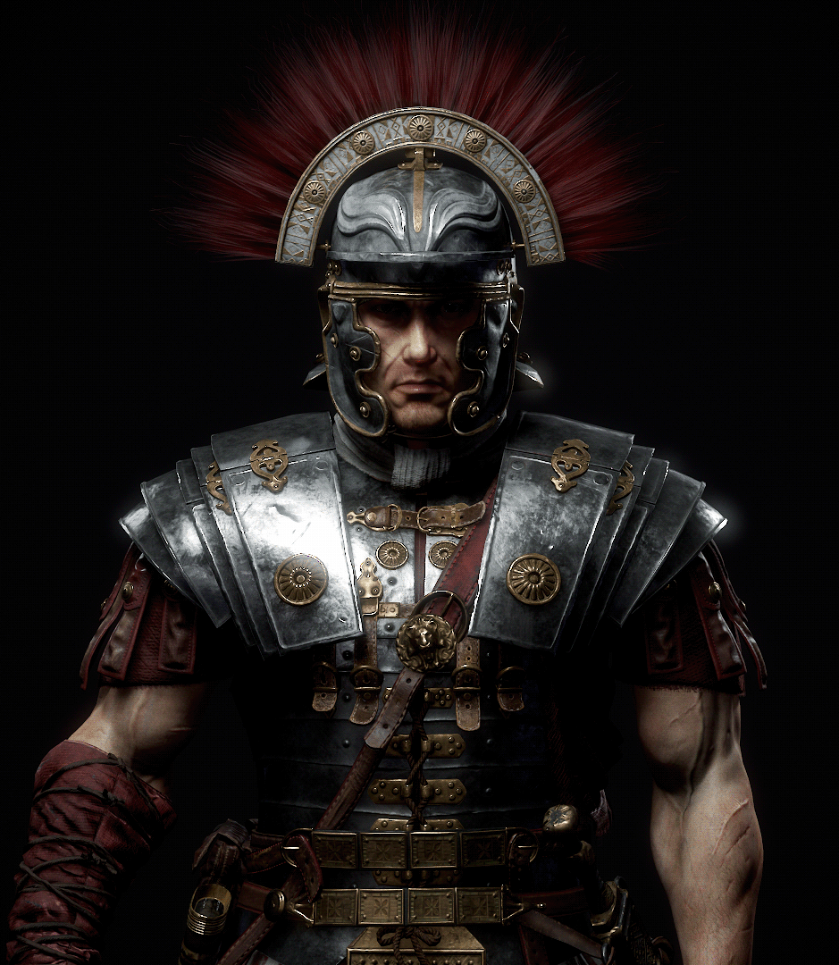
Centurions / Roman Soldiers
Military Commanders: Let unites of 80 Roman Legionaries (Heavy Infantry Soldiers.
Experienced and well-respected soldiers.
Experienced with crucifixion; since 6th Century BC.
Experience with death.

Slide 31
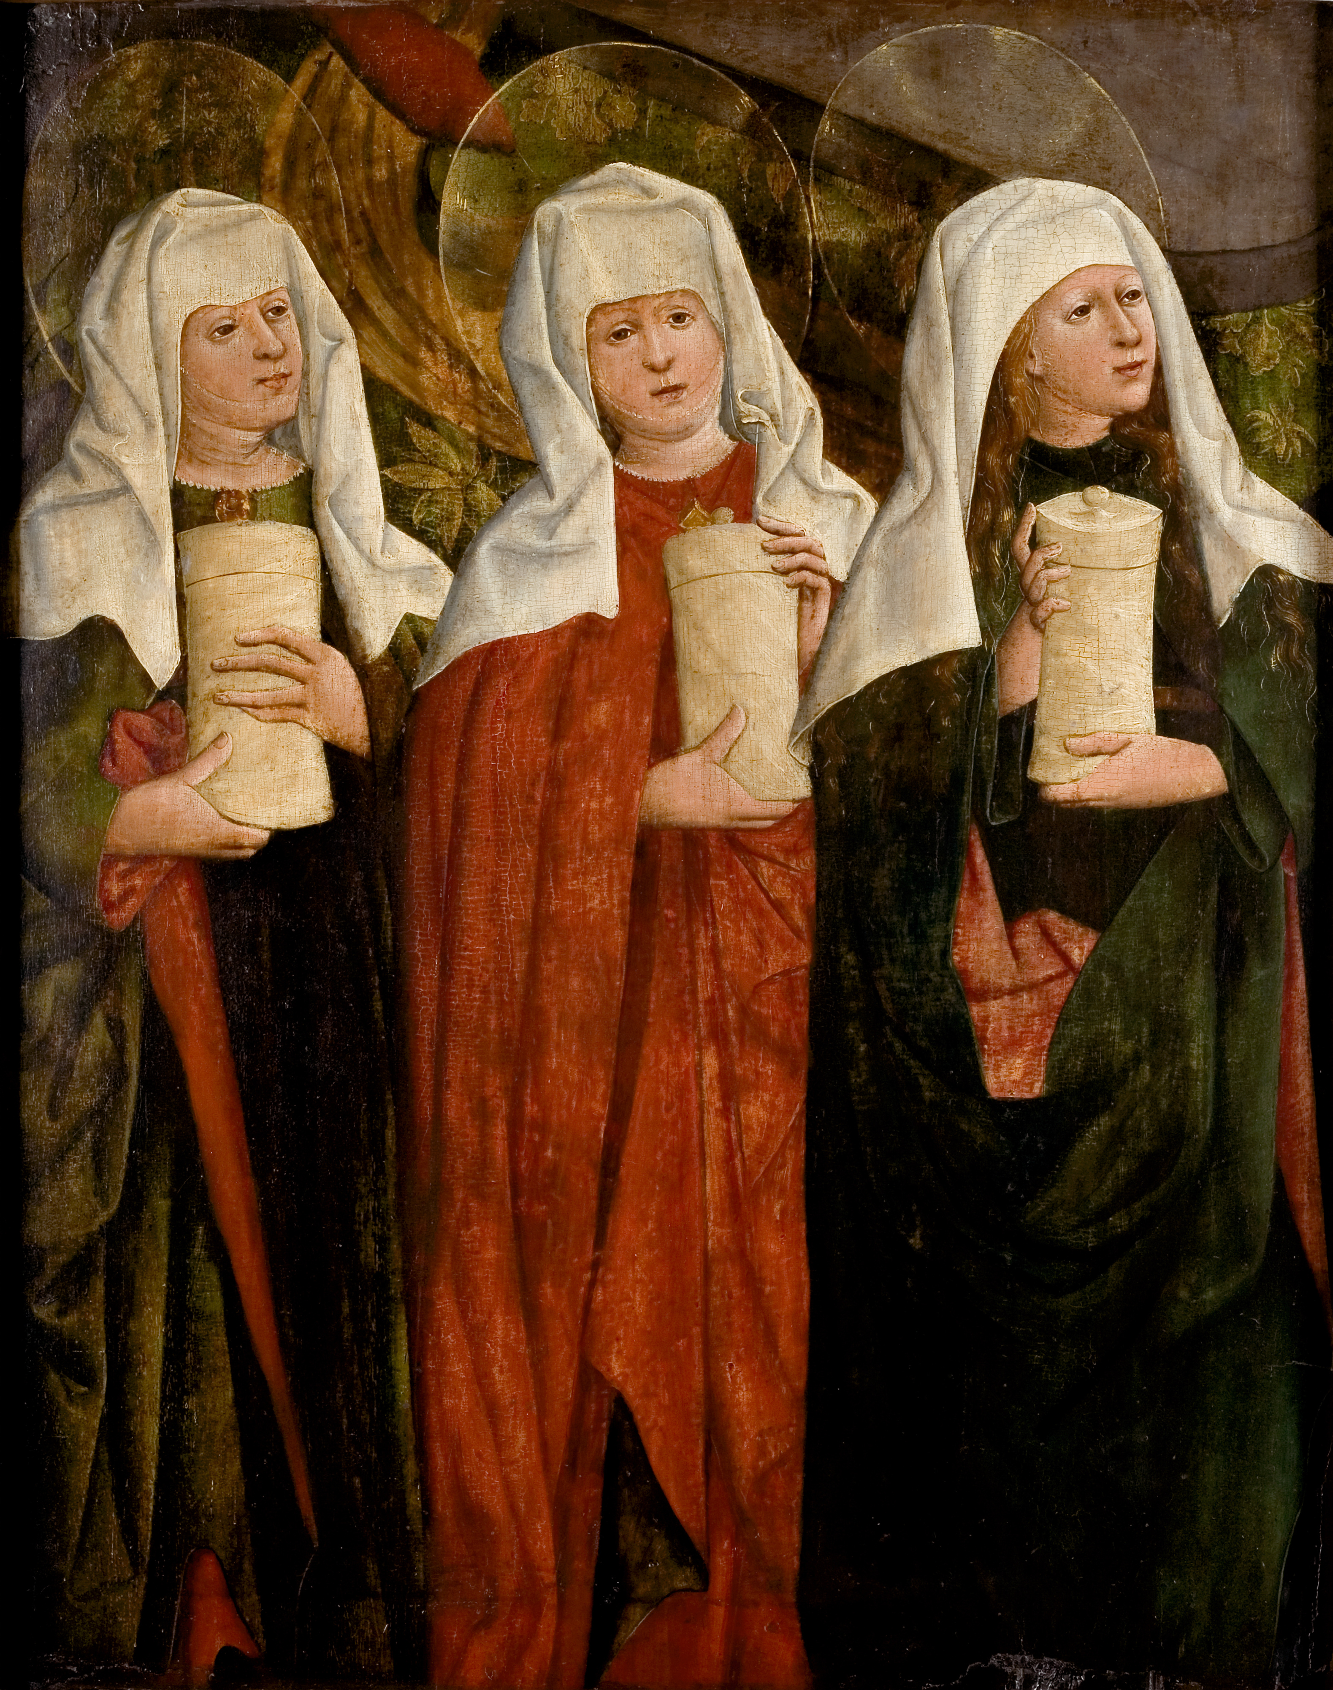
Mary (Mother of James and Joseph) Solome (Mother of Zebedee’s Sons) Mary Magdalene (Jesus cast out demons)
Watched from a distance
Watched Jesus put in his tomb

Slide 32
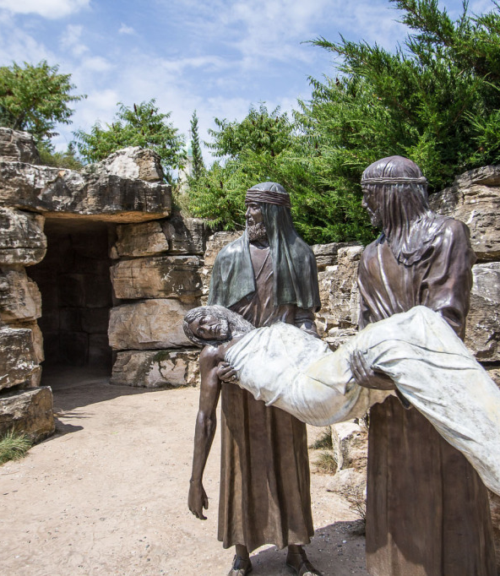
Nicodemus and Joseph

Slide 33
Fulfillment of Prophecies:
Died for our sins: Isaiah 53:5-12, Daniel 9:26, and Zechariah 13:7
Rose from the dead: Isaiah 53:10 and Psalm 16:10

Slide 34
Basic Evidence
Jesus died on the cross and was buried
Jesus’ tomb was empty, and no one ever produced His body
Jesus’ disciples believed that they saw Jesus resurrected from the the dead
Jesus’ disciples were transformed following their alleged resurrection observations

Slide 35
The Resurrection of the Dead
¹² Now if Christ is proclaimed as raised from the dead, how can some of you say that there is no resurrection of the dead? ¹³ But if there is no resurrection of the dead, then not even Christ has been raised. ¹⁴ And if Christ has not been raised, then our preaching is in vain and your faith is in vain. ¹⁵ We are even found to be misrepresenting God, because we testified about God that he raised Christ, whom he did not raise if it is true that the dead are not raised. ¹⁶ For if the dead are not raised, not even Christ has been raised. ¹⁷ And if Christ has not been raised, your faith is futile and you are still in your sins. ¹⁸ Then those also who have fallen asleep in Christ have perished. ¹⁹ If in Christ we have hope in this life only, we are of all people most to be pitied.
²⁰ But in fact Christ has been raised from the dead, the firstfruits of those who have fallen asleep. ²¹ For as by a man came death, by a man has come also the resurrection of the dead. ²² For as in Adam all die, so also in Christ shall all be made alive. ²³ But each in his own order: Christ the firstfruits, then at his coming those who belong to Christ. ²⁴ Then comes the end, when he delivers the kingdom to God the Father after destroying every rule and every authority and power. ²⁵ For he must reign until he has put all his enemies under his feet. ²⁶ The last enemy to be destroyed is death. ²⁷ For “God has put all things in subjection under his feet.” But when it says, “all things are put in subjection,” it is plain that he is excepted who put all things in subjection under him. ²⁸ When all things are subjected to him, then the Son himself will also be subjected to him who put all things in subjection under him, that God may be all in all.
1 Corinthians 15:12–28 (ESV)

Slide 36
The Resurrection
16 When the Sabbath was past, Mary Magdalene, Mary the mother of James, and Salome bought spices, so that they might go and anoint him. ² And very early on the first day of the week, when the sun had risen, they went to the tomb. ³ And they were saying to one another, “Who will roll away the stone for us from the entrance of the tomb?” ⁴ And looking up, they saw that the stone had been rolled back—it was very large. ⁵ And entering the tomb, they saw a young man sitting on the right side, dressed in a white robe, and they were alarmed. ⁶ And he said to them, “Do not be alarmed. You seek Jesus of Nazareth, who was crucified. He has risen; he is not here. See the place where they laid him. ⁷ But go, tell his disciples and Peter that he is going before you to Galilee. There you will see him, just as he told you.” ⁸ And they went out and fled from the tomb, for trembling and astonishment had seized them, and they said nothing to anyone, for they were afraid.
Jesus Appears to Mary Magdalene
⁹ [[Now when he rose early on the first day of the week, he appeared first to Mary Magdalene, from whom he had cast out seven demons. ¹⁰ She went and told those who had been with him, as they mourned and wept. ¹¹ But when they heard that he was alive and had been seen by her, they would not believe it.
Jesus Appears to Two Disciples
¹² After these things he appeared in another form to two of them, as they were walking into the country. ¹³ And they went back and told the rest, but they did not believe them.
The Great Commission
¹⁴ Afterward he appeared to the eleven themselves as they were reclining at table, and he rebuked them for their unbelief and hardness of heart, because they had not believed those who saw him after he had risen. ¹⁵ And he said to them, “Go into all the world and proclaim the gospel to the whole creation. ¹⁶ Whoever believes and is baptized will be saved, but whoever does not believe will be condemned. ¹⁷ And these signs will accompany those who believe: in my name they will cast out demons; they will speak in new tongues; ¹⁸ they will pick up serpents with their hands; and if they drink any deadly poison, it will not hurt them; they will lay their hands on the sick, and they will recover.”
¹⁹ So then the Lord Jesus, after he had spoken to them, was taken up into heaven and sat down at the right hand of God. ²⁰ And they went out and preached everywhere, while the Lord worked with them and confirmed the message by accompanying signs.]]
Mark 16:1–20 (ESV)

Slide 37
Peter -> His disconnection based on his betrayal
John 21:15–19
Baptism Requirements
Not guaranteed: Snakes, Healing, cast out demons, tongues, poison, pick up serpents.
Jesus’ Prophecies
Mark 8:31, 9:30-31, 10:33-34
Three Appearances:
Mary Mangelin (v9) <- They Sought the Lord Early (Psalm 63 – Early will I seek you)
Refused to believe
Two on the Road
Refused to believe
The 11 at the table
Had no choice but to believe; but still touched his hands
Jesus is Alive
If you came to a fork in the road; found two men, one dead and another alive. Which one do you ask directions from?
Jesus’ Credentials
Radically altered human history
Fulfilled prophecies
Resurrection

Slide 38
PETER STORY - 1
²⁹ Peter said to him, “Even though they all fall away, I will not.” ³⁰ And Jesus said to him, “Truly, I tell you, this very night, before the rooster crows twice, you will deny me three times.” ³¹ But he said emphatically, “If I must die with you, I will not deny you.” And they all said the same.
Mark 14:29–31 (ESV)

Slide 39
PETER STORY - 2
Peter Denies Jesus
⁶⁶ And as Peter was below in the courtyard, one of the servant girls of the high priest came, ⁶⁷ and seeing Peter warming himself, she looked at him and said, “You also were with the Nazarene, Jesus.” ⁶⁸ But he denied it, saying, “I neither know nor understand what you mean.” And he went out into the gateway and the rooster crowed. ⁶⁹ And the servant girl saw him and began again to say to the bystanders, “This man is one of them.” ⁷⁰ But again he denied it. And after a little while the bystanders again said to Peter, “Certainly you are one of them, for you are a Galilean.” ⁷¹ But he began to invoke a curse on himself and to swear, “I do not know this man of whom you speak.” ⁷² And immediately the rooster crowed a second time. And Peter remembered how Jesus had said to him, “Before the rooster crows twice, you will deny me three times.” And he broke down and wept.
Mark 14:66–72 (ESV)

Slide 40
PETER STORY - 3
Jesus and Peter
¹⁵ When they had finished breakfast, Jesus said to Simon Peter, “Simon, son of John, do you love me more than these?” He said to him, “Yes, Lord; you know that I love you.” He said to him, “Feed my lambs.” ¹⁶ He said to him a second time, “Simon, son of John, do you love me?” He said to him, “Yes, Lord; you know that I love you.” He said to him, “Tend my sheep.” ¹⁷ He said to him the third time, “Simon, son of John, do you love me?” Peter was grieved because he said to him the third time, “Do you love me?” and he said to him, “Lord, you know everything; you know that I love you.” Jesus said to him, “Feed my sheep. ¹⁸ Truly, truly, I say to you, when you were young, you used to dress yourself and walk wherever you wanted, but when you are old, you will stretch out your hands, and another will dress you and carry you where you do not want to go.” ¹⁹ (This he said to show by what kind of death he was to glorify God.) And after saying this he said to him, “Follow me.”
John 21:15–19 (ESV)

