Slide 1
Imminent Return
Mark 13:24-37

Slide 2
Who is Mark?
Son of a women named Mary – thought to be the owner of the upper room for Jesus’ last supper
Young man that fled naked on the night of Jesus’ arrest (Mark 14:51-52)
“John whose other name was Mark” ~ Acts 12:12
His Gospel is thought to be the earliest of the Gospels; written between 60-70 AD
Mark focuses what Jesus did rather what Jesus said
Mark is moving fast; “immediately” used 41 times
Stories are written as Mark remembers and hears them from Paul
Written as a Drama – To be spoken, not just read
Notes:
Something Unique in this passage; Mark is HEAVILY focused on what Jesus says
Longest section Jesus speaks consistently
Was not a disciple
Was there the night Jesus was arrested
Also known as John Mark
Son of a woman named Mary
His Gospel is thought to be the earliest
Max Mclean – Mark dramatized max
In Acts 12:12, ‘When this had dawned on him, he went to the house of Mary the mother of John, also called Mark, where many people had gathered and were praying’
Forgiveness is possible. So are second chances. Paul forgave Mark and gave him a chance to prove his worth. Peter was so taken with Mark he considered him like a son.
Paul made his first missionary journey to Cyprus, accompanied by Barnabas and John Mark. When they sailed to Perga in Pamphylia, Mark left them and returned to Jerusalem. No explanation is given for his departure, and Bible scholars have been speculating ever since.
According to Coptic tradition, John Mark is the founder of the Coptic Church in Egypt. Copts believe Mark was tied to a horse and dragged to his death by a mob of pagans on Easter, 68 A.D., in Alexandria.
A young man, wearing nothing but a linen garment, was following Jesus. When they seized him, he fled naked, leaving his garment behind. (Mark 14:51-52, NIV)
John Mark is mentioned in Acts 12:23-13:13, 15:36-39; Colossians 4:10; 2 Timothy 4:11; and 1 Peter 5:13.

Slide 3
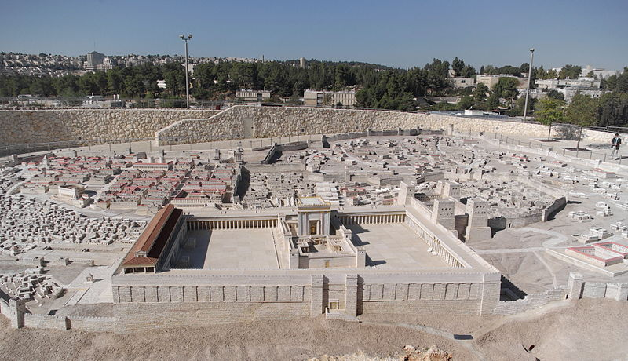
Notes:
36 Acres
Walls 9 stories high and 16 feet thick
Stones weighting 600+ ton
Jewish Eschatology
Significant turmoil in the world and land of Israel –> Roman Occupation led them to believe
Elijah-like forerunner will announce the Messiah –> John the Baptist
Messiah would establish his kingdom and defeat his enemies -> Jesus
Donkey ride, Zachariah 9
Scattered Jews will return Israel, and the temple would be restored
----
In 37 BC, King Herod enlarged the Temple Mount and rebuilt the temple with the consent of the public. During the Roman period, in AD 70, the Second Temple was destroyed, along with Jerusalem, by Titus’ army. It was also during this period that Jesus was in Jerusalem.
36 acres
1,600 feet (490 m) wide by 900 feet (270 m) broad by 9 stories high, with walls up to 16 feet (4.9 m) thick
To complete it, a trench was dug around the mountain, and huge stone blocks were laid. Some of these weighed well over 100 tons, the largest measuring 45 by 11 by 16.5 feet (13.6 m × 3.4 m × 5.0 m) and weighing approximately 567–628 tons.

Slide 4
² And Jesus said to him, “Do you see these great buildings? There will not be left here one stone upon another that will not be thrown down.”
Mark 13:2 (ESV)
Notes:
Jesus flips their Eschatology upside down…
He’s got their attention

Slide 5
The Second Temple
King Herod’s Temple
Construction from 20 B.C - 64 A.D.
Destroyed 70 A.D.
Notes:
In 37 BC, King Herod enlarged the Temple Mount and rebuilt the temple with the consent of the public. During the Roman period, in AD 70, the Second Temple was destroyed, along with Jerusalem, by Titus’ army. It was also during this period that Jesus was in Jerusalem.
36 acres
1,600 feet (490 m) wide by 900 feet (270 m) broad by 9 stories high, with walls up to 16 feet (4.9 m) thick
To complete it, a trench was dug around the mountain, and huge stone blocks were laid. Some of these weighed well over 100 tons, the largest measuring 45 by 11 by 16.5 feet (13.6 m × 3.4 m × 5.0 m) and weighing approximately 567–628 tons.

Slide 6
⁴ “Tell us, when will these things be, and what will be the sign when all these things are about to be accomplished?”
Mark 13:4

Slide 7
Jesus’ Prophecies (Mark 13)
Prophecy | Verses
Destruction of the Temple | Mark 13:2
False Prophets; Claiming to be Christ | Mark 13:5 / Mark 13:22
Wars and Rumors of Wars (Cold Wars) | Mark 13:7
Earthquakes and Famines | Mark 13:8
The Disciples will be Persecuted | Mark 13:9
Families will betray one another | Mark 13:12
Abomination of Desolation | Mark 13:14
Tribulation the world has never seen before | Mark 13:19
Sun and Moon Darkened and Stars Fall From the sky | Mark 13:24
Jesus to come from the clouds with great power and glory | Mark 13:26

Slide 8
²⁰ “But when you see Jerusalem surrounded by armies, then know that its desolation has come near.
Luke 21:20
Notes:
Elephant in the room – Israel / Hamas War

Slide 9
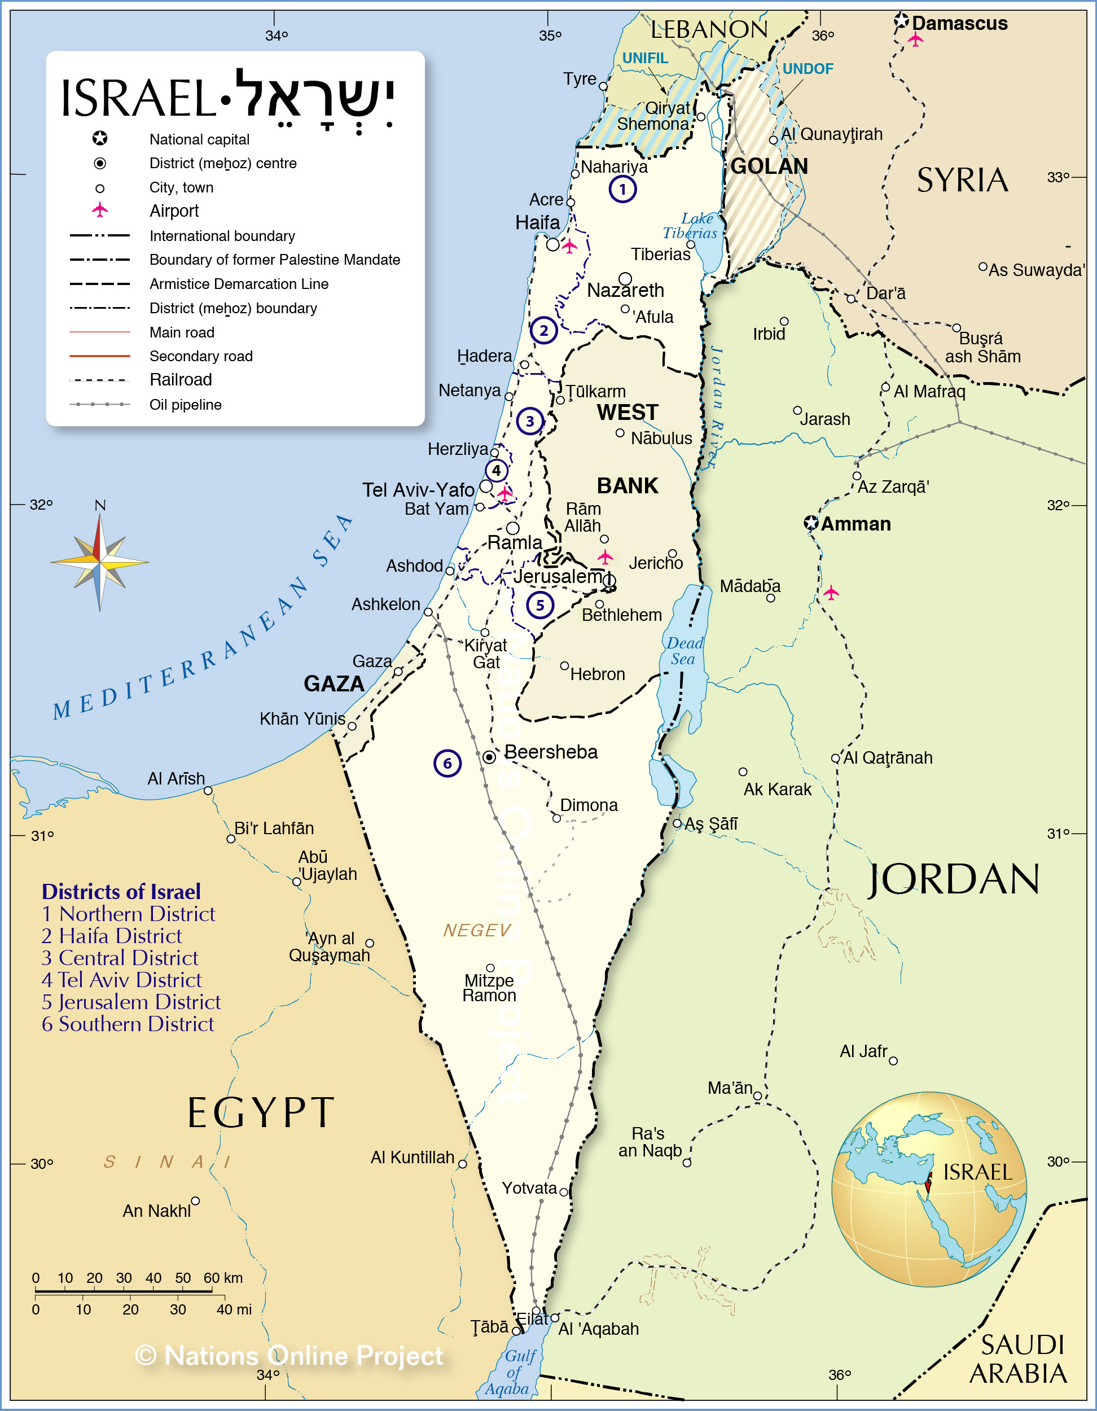
Israel
Hezbollah
Notes:
²⁰ “But when you see Jerusalem surrounded by armies, then know that its desolation has come near. Luke 21:20
Ezekiel 38:1–6 (ESV)
Israel is attacked from the North
Gog prince of Magog Region – Land of ancient Skidion’s North of Caspien and Black Seas -> Prophecy about Russia
Iran was called Persia
Why or why not prophecy
The battle is in the South
No one comes to Israel’s Defense
Iran gets involved and tells Hezbollah to get involved; Russia starts getting involved
UN Does not recognize Hamas as a terrorist organization
Everyone is telling Israel not to get too harsh; we could pull out
Taiwan gets attack by China
Ukraine
Terrorist cells within America

Slide 10
⁷ And when you hear of wars and rumors of wars, do not be alarmed. This must take place, but the end is not yet. ⁸ For nation will rise against nation, and kingdom against kingdom. There will be earthquakes in various places; there will be famines. These are but the beginning of the birth pains.
Mark 13:7–8 (ESV)

Slide 11
Jesus’ Prophecies (Mark 13)
Prophecy | Fulfillment
Destruction of the Temple | Temple Destroyed in 70 A.D.
False Prophets; Claiming to be Christ | Wikipedia: 46 Since the 17th Century
Wars and Rumors of Wars (Cold Wars) | Hamas/Israel War
Earthquakes and Famines | Over 10,000 ”strong” quakes since 1900 From 1860s to 2016 128 Million people died in famines
The Disciples will be Persecuted | Acts 4:5-12; 5:27-33; 12:1-5; 24: 1-9; 25:1-3, 7
Families will betray one another | Have we not seen this?
Abomination of Desolation | Antiochus Epiphanes Daniel 9:27; 11:31; 12:11
Tribulation the world has never seen before | Pandemics, Plagues, Holocaust, Roman Rule, etc.
Sun and Moon Darkened and Stars Fall From the sky | Not Seen
Jesus to come from the clouds with great power and glory | Not Seen
Notes:
Wikipedia only includes those with Wikipedia pages…It excludes David Koresh from Waco who claimed to be Christ
Between 1900 and 2015, there have been more than 10,000 “strong” quakes around the world.
https://ourworldindata.org/famines https://www.bloomberg.com/news/articles/2015-10-09/mapping-100-years-of-earthquakes-in-3-d
10’s of 1000’s of Jews died under Roman Rule and wars.
“Possible, but unlikely” ~ Bible Doctrine
The reality is… we don’t know.

Slide 12
Lesson of the Fig Tree
²⁸ “From the fig tree learn its lesson: as soon as its branch becomes tender and puts out its leaves, you know that summer is near. ²⁹ So also, when you see these things taking place, you know that he is near, at the very gates. ³⁰ Truly, I say to you, this generation will not pass away until all these things take place. ³¹ Heaven and earth will pass away, but my words will not pass away.
Mark 13:28-31 (ESV)

Slide 13
The Coming of the Son of Man
²⁶ And then they will see the Son of Man coming in clouds with great power and glory.
Mark 13:26 (ESV)
Notes:
EVERYONE WILL KNOW – You won’t need to worry about someone else telling you about it.

Slide 14
“But concerning that day or that hour, no one knows, not even the angels in heaven, nor the Son, but only the Father.”
Mark 13:32

Slide 15
No One Knows That Day or Hour
³³ Be on guard, keep awake. For you do not know when the time will come. ³⁴ It is like a man going on a journey, when he leaves home and puts his servants in charge, each with his work, and commands the doorkeeper to stay awake. ³⁵ Therefore stay awake—for you do not know when the master of the house will come, in the evening, or at midnight, or when the rooster crows, or in the morning— ³⁶ lest he come suddenly and find you asleep.
Mark 13:33-36 (ESV)

Slide 17
“And what I say to you I say to all: Stay awake.”
Mark 13:37 (ESV)

Slide 18
Be obedient to God’s Purpose and Plan for your Life
Notes:
We should be anticipating the Lords return
We should be excited about the Lords return
“Stephanie told me, except when there are people you know that might not be going to heaven!”
If you’re not saved, Me, Angie, or Mitch would LOVE to have that conversation with you.
If you are saved…

Slide 19
Go therefore and make disciples of all nations, baptizing them in the name of the Father and of the Son and of the Holy Spirit, teaching them to observe all that I have commanded you. And behold, I am with you always, to the end of the age.”
Matthew 28:19–20 (ESV)
Notes:
Don’t let the Lord return and find you slacking off.

Slide 20
The End

Slide 21
Jesus Foretells Destruction of the Temple
13 And as he came out of the temple, one of his disciples said to him, “Look, Teacher, what wonderful stones and what wonderful buildings!” ² And Jesus said to him, “Do you see these great buildings? There will not be left here one stone upon another that will not be thrown down.”
Signs of the End of the Age
³ And as he sat on the Mount of Olives opposite the temple, Peter and James and John and Andrew asked him privately, ⁴ “Tell us, when will these things be, and what will be the sign when all these things are about to be accomplished?” ⁵ And Jesus began to say to them, “See that no one leads you astray. ⁶ Many will come in my name, saying, ‘I am he!’ and they will lead many astray. ⁷ And when you hear of wars and rumors of wars, do not be alarmed. This must take place, but the end is not yet. ⁸ For nation will rise against nation, and kingdom against kingdom. There will be earthquakes in various places; there will be famines. These are but the beginning of the birth pains.
⁹ “But be on your guard. For they will deliver you over to councils, and you will be beaten in synagogues, and you will stand before governors and kings for my sake, to bear witness before them. ¹⁰ And the gospel must first be proclaimed to all nations. ¹¹ And when they bring you to trial and deliver you over, do not be anxious beforehand what you are to say, but say whatever is given you in that hour, for it is not you who speak, but the Holy Spirit. ¹² And brother will deliver brother over to death, and the father his child, and children will rise against parents and have them put to death. ¹³ And you will be hated by all for my name’s sake. But the one who endures to the end will be saved.
The Abomination of Desolation
¹⁴ “But when you see the abomination of desolation standing where he ought not to be (let the reader understand), then let those who are in Judea flee to the mountains. ¹⁵ Let the one who is on the housetop not go down, nor enter his house, to take anything out, ¹⁶ and let the one who is in the field not turn back to take his cloak. ¹⁷ And alas for women who are pregnant and for those who are nursing infants in those days! ¹⁸ Pray that it may not happen in winter. ¹⁹ For in those days there will be such tribulation as has not been from the beginning of the creation that God created until now, and never will be. ²⁰ And if the Lord had not cut short the days, no human being would be saved. But for the sake of the elect, whom he chose, he shortened the days. ²¹ And then if anyone says to you, ‘Look, here is the Christ!’ or ‘Look, there he is!’ do not believe it. ²² For false christs and false prophets will arise and perform signs and wonders, to lead astray, if possible, the elect. ²³ But be on guard; I have told you all things beforehand.
Mark 13:1–23 (ESV)

Slide 22
The Coming of the Son of Man
²⁴ “But in those days, after that tribulation, the sun will be darkened, and the moon will not give its light, ²⁵ and the stars will be falling from heaven, and the powers in the heavens will be shaken. ²⁶ And then they will see the Son of Man coming in clouds with great power and glory. ²⁷ And then he will send out the angels and gather his elect from the four winds, from the ends of the earth to the ends of heaven.
The Lesson of the Fig Tree
²⁸ “From the fig tree learn its lesson: as soon as its branch becomes tender and puts out its leaves, you know that summer is near. ²⁹ So also, when you see these things taking place, you know that he is near, at the very gates. ³⁰ Truly, I say to you, this generation will not pass away until all these things take place. ³¹ Heaven and earth will pass away, but my words will not pass away.
No One Knows That Day or Hour
³² “But concerning that day or that hour, no one knows, not even the angels in heaven, nor the Son, but only the Father. ³³ Be on guard, keep awake. For you do not know when the time will come. ³⁴ It is like a man going on a journey, when he leaves home and puts his servants in charge, each with his work, and commands the doorkeeper to stay awake. ³⁵ Therefore stay awake—for you do not know when the master of the house will come, in the evening, or at midnight, or when the rooster crows, or in the morning— ³⁶ lest he come suddenly and find you asleep. ³⁷ And what I say to you I say to all: Stay awake.”
Mark 13:24–37 (ESV)
Notes:
Generation == Jews

Slide 23
²⁰ “But when you see Jerusalem surrounded by armies, then know that its desolation has come near.
Luke 21:20
Notes:
Elephant in the room – Israel / Hamas War

Slide 24
Notes
Ezekiel -> End Times
It won’t be missed
Watch out for deception: People pretending to be Christ
Don’t be Alarmed: Wars and rumors of wars
Birth Pains
Nations will rise up against each other
Earthquakes
Famine
The Disciples will be persecuted; endure to the end
Fathers against children; children against parents

Slide 25
Notes
Abomination of Destruction -> Daniel 9:27
Judea to flee to the mountains
False prophets performing signs and leading others astray
Sun will be darkened and moon will not shed light
Stars will fall and the powers of heaven will be shaken
Son of man coming in clouds with great power and glory
Angels sent out to gather His elect
This generation will experience these things -> Jews
No one knows when: Only the father
Anyone who claims otherwise is wrong -> Jehovah’s witeness

Slide 26
Notes
Eschatology
Questions
Should we be so exhausted that we pray for the Lord to return?
We should be excited about the new world
Final reqard for beleivers
To be Ready - . Being obedient - > what is it God has put on our heard
Matthew 25:21
What happens when people know when the end is?
Withdraw from life
Quit jobs
Pull kids from school
Sell their house
Pull from long-term commitments

Slide 27
Cornerstone Chapel https://www.youtube.com/watch?v=dNs2tt7auQ4&list=PL01Zt3fZbKzjloyYyd3ENr1LS_AQJTVqU&index=9
The Bible is about Israel
God gave a savior who was born, died, and born again in Israel and will return to Israel
First time in 50 years; Israel’s 9/11
7.1 Million Jews, 30 times worse for Israel
Hamas and Islamic terrorism
Who is Hamas?
Why is Hamas so intent on destroying Israel?
Abraham slept with Hagar; Ishmael are Arab people
Isaac are the Jewish people
What is the history of Palestinian and land of Israel?
Why are youths supporting Palestine?
How does this fit the end times?

Slide 28
Cornerstone Chapel https://www.youtube.com/watch?v=dNs2tt7auQ4&list=PL01Zt3fZbKzjloyYyd3ENr1LS_AQJTVqU&index=9
Prophecy Against Gog
38 The word of the Lord came to me: ² “Son of man, set your face toward Gog, of the land of Magog, the chief prince of Meshech and Tubal, and prophesy against him ³ and say, Thus says the Lord God: Behold, I am against you, O Gog, chief prince of Meshech and Tubal. ⁴ And I will turn you about and put hooks into your jaws, and I will bring you out, and all your army, horses and horsemen, all of them clothed in full armor, a great host, all of them with buckler and shield, wielding swords. ⁵ Persia, Cush, and Put are with them, all of them with shield and helmet; ⁶ Gomer and all his hordes; Beth-togarmah from the uttermost parts of the north with all his hordes—many peoples are with you.
Ezekiel 38:1–6 (ESV)
Israel is attacked from the North
Gog prince of Magog Region – Land of ancient Skidion’s North of Caspien and Black Seas -> Prophecy about Russia
Iran was called Persia
Why or why not prophecy
The battle is in the South
No one comes to Israel’s Defense
Iran gets involved and tells Hezbollah to get involved; Russia starts getting involved
UN Does not recognize Hamas as a terrorist organization
Everyone is telling Israel not to get too harsh; we could pull out
Taiwan gets attack by China
Ukraine
Terrorist cells within America
Next, Rapture

Slide 29
Skip Heitzig https://www.youtube.com/watch?v=6WWGUJkYQ4Q&list=PL01Zt3fZbKzjloyYyd3ENr1LS_AQJTVqU&index=6
Transition from History to the Future
14-15 passion narrative; when Jesus goes to the cross
Longest section Jesus speaks consistently
Mostly focused on what Jesus did, but here its unique
Prophesy of the temple in Jerusalem will be destroyed
He weaves together near and far prophecy
He’s driven out the buyers and sellers in the temple
Moving toward the Mount of Olives; eastward
20 B.C - 64 A.D. to construct it; Destroyed 70 A.D.
Lazarus, Mary, and Martha is where He was staying
Eschatology – Study of end time events

Slide 30
Skip Heitzig https://www.youtube.com/watch?v=6WWGUJkYQ4Q&list=PL01Zt3fZbKzjloyYyd3ENr1LS_AQJTVqU&index=6
Jewish Eschatology
Significant turmoil in the world and land of Israel –> Roman Occupation led them to believe
Elijah-like forerunner will announce the Messiah –> John the Baptist
Messiah would establish his kingdom and defeat his enemies -> Jesus
Donkey ride, Zachariah 9
Scattered Jews will return Israel, and the temple would be restored
Now he’s saying the temple will be destroyed; that’s confusing to them

Slide 31
Skip Heitzig https://www.youtube.com/watch?v=6WWGUJkYQ4Q&list=PL01Zt3fZbKzjloyYyd3ENr1LS_AQJTVqU&index=6
Many will come in His name
Ultimately; Satan’s masterpiece – The Anti-Christ (Book of Daniel)
Revelation 12 the Drago will deceive the whole world
The wars – 3.64 Billion People have been killed by wars since 3600 B.C.
God’s Judgement referred to with Birth Pains historically
Frequency and intensity
Yes, you’re going to be persecuted and hassled
Abomination of desolation – Defined as taking away daily sacrifices and replaced with abomination
3 Prophecies Daniel
167 BC - Anticus Opifamy – incarnation of Zeus
He went to Jerusalem and stopped the sacrifice
Dedicated an altar to Zeus
Sacrificed a pig
Forbade circumcision and the Sabbath
80,000 Jews
40,000 Slaves

Slide 32
Skip Heitzig https://www.youtube.com/watch?v=6WWGUJkYQ4Q&list=PL01Zt3fZbKzjloyYyd3ENr1LS_AQJTVqU&index=6
There is a catastrophe that will be in the Middle East
Isaiah 17 – Damascus will be destroyed
One of the oldest standing city
Overnight strike and the next day it’s gone
3.5 years; great tribulations
Wrath of God on Earth
Hatred of Satan
Rebellion of Mankind

