Slide 1
Discovering God’s Plan
Mark 1:1-13
Notes:
Cell phone Bible conversation: other distractions; work, social media, news, and a ton of temptations that pull us away from the word
”best compliment you can give the author is to have a conversation with them in the book” Mark it up
Interact with Mark in the word
God preparing us for His purpose and through His plan?

Slide 2
The Gospels
Name | Occupation | Wrote To | Who is Jesus
Matthew | Tax Collector and Disciple of Jesus | Church of Jerusalem | A greater Moses: 5 blocks (5 books of Torah)
Mark | Unknown and Disciple of Peter | Non-Jewish Christians | A new start for humanity
Luke | Physician and Disciple of Paul | Theophilus; high official in the Roman government | God’s royal Servant from Isaiah bringing God’s life
John | Fisherman and Disciple of Jesus | Church of Ephesus | Yahweh as man; doing for us what we can’t do for ourselves
Notes:
Synoptic Gospels: Matthew Mark, and Luke
Good News
Mark: The Time is fulfilled; God’s kingdom has come near – God’s Kingdom is coming
God Created a World > Created a humanity to rule over it > we keep failing > God is committed > God won’t give up (prophets said) > He wants all creation to know > Kingdom of God > Jesus is bringing this Kingdom > Jesus is liberating people from death and disease > Jesus is inviting us to live in God’s good world
Not to just know of God’s Kingdom; they want them to become a part of it
Persuade us; to trust and follow Jesus; so we can participate in the new creation that He began.
----
Gospel is …
a Plan for eternity: As per the Bible
An Event: Christ Died
An Achievement: Sins were paid for; righteousness as achieved
An offer: Extended in an offer to the world that is free
The Application: By faith I am forgiven, by faith I am justified
God: 1 Peter 3:18; to bring us to God – God is the end

Slide 3
Who is Mark?
Young man that fled naked on the night of Jesus’ arrest (Mark 14:51-52)
“John whose other name was Mark” ~ Acts 12:12
Son of a women named Mary – thought to be the owner of the upper room for Jesus’ last supper
His Gospel is thought to be the earliest of the Gospels; written between 60-70 AD
Mark focuses what Jesus did rather what Jesus said
Mark is moving fast; “immediately” used 41 times
Stories are written as Mark remembers and hears them from Paul
Written as a Drama – To be spoken, not just read
Notes:
Was not a disciple
Was there the night Jesus was arrested
Also known as John Mark
Son of a woman named Mary
His Gospel is thought to be the earliest
Max Mclean – Mark dramatized max
In Acts 12:12, ‘When this had dawned on him, he went to the house of Mary the mother of John, also called Mark, where many people had gathered and were praying’
Forgiveness is possible. So are second chances. Paul forgave Mark and gave him a chance to prove his worth. Peter was so taken with Mark he considered him like a son.
Paul made his first missionary journey to Cyprus, accompanied by Barnabas and John Mark. When they sailed to Perga in Pamphylia, Mark left them and returned to Jerusalem. No explanation is given for his departure, and Bible scholars have been speculating ever since.
According to Coptic tradition, John Mark is the founder of the Coptic Church in Egypt. Copts believe Mark was tied to a horse and dragged to his death by a mob of pagans on Easter, 68 A.D., in Alexandria.
A young man, wearing nothing but a linen garment, was following Jesus. When they seized him, he fled naked, leaving his garment behind. (Mark 14:51-52, NIV)
John Mark is mentioned in Acts 12:23-13:13, 15:36-39; Colossians 4:10; 2 Timothy 4:11; and 1 Peter 5:13.

Slide 5
John the Baptist Prepares the Way
1 The beginning of the gospel of Jesus Christ, the Son of God.
² As it is written in Isaiah the prophet,
“Behold, I send my messenger before your face,
who will prepare your way,
³ the voice of one crying in the wilderness:
‘Prepare the way of the Lord,
make his paths straight,’ ”
⁴ John appeared, baptizing in the wilderness and proclaiming a baptism of repentance for the forgiveness of sins.
Mark 1:1-4 (ESV)
³ A voice cries:
“In the wilderness prepare the way of the Lord;
make straight in the desert a highway for our God.
⁴ Every valley shall be lifted up,
and every mountain and hill be made low;
the uneven ground shall become level,
and the rough places a plain.
⁵ And the glory of the Lord shall be revealed,
and all flesh shall see it together,
for the mouth of the Lord has spoken.”
Isaiah 40:3–5 (ESV)
Unfolding God’s
Plan
Notes:
John’s coming was foretold over 700 years previously by another prophet: (Isaiah 40:3–5)
John lived his life to introduce others to Jesus Christ; he was focused on the mission God had given him.

Slide 6
⁵ And all the country of Judea and all Jerusalem were going out to him and were being baptized by him in the river Jordan, confessing their sins. ⁶ Now John was clothed with camel’s hair and wore a leather belt around his waist and ate locusts and wild honey. ⁷ And he preached, saying, “After me comes he who is mightier than I, the strap of whose sandals I am not worthy to stoop down and untie. ⁸ I have baptized you with water, but he will baptize you with the Holy Spirit.”
Mark 1:5-8 (ESV)
5 “Behold, I will send you Elijah the prophet before the great and awesome day of the LORD comes.
Malachi 4:5 (ESV)
Unfolding God’s
Plan
Notes:
He ended nearly 400 years of prophetic silence and paved the way for the Messiah.
Stepping from OT to NT
In the spirit of Elijah, he preached a message of repentance and baptism.
John lived his life to introduce others to Jesus Christ; he was focused on the mission God had given him.

Slide 7
Genesis 22:2
The Baptism of Jesus
⁹ In those days Jesus came from Nazareth of Galilee and was baptized by John in the Jordan. ¹⁰ And when he came up out of the water, immediately he saw the heavens being torn open and the Spirit descending on him like a dove. ¹¹ And a voice came from heaven, “You are my beloved Son; with you I am well pleased.”
Mark 1:9-11 (ESV)
Seed of Abraham
² He said, “Take your son, your only son Isaac, whom you love, and go to the land of Moriah, and offer him there as a burnt offering on one of the mountains of which I shall tell you.”
Psalm 2:7
Son of David
⁷ I will tell of the decree:
The Lord said to me, “You are my Son;
today I have begotten you.
Isaiah 42:1
Servant that will Suffer
42 Behold my servant, whom I uphold,
my chosen, in whom my soul delights;
I have put my Spirit upon him;
he will bring forth justice to the nations.
Unfolding God’s
Plan
Notes:
God’s plan is being played out and God references scripture from Genesis to Psalms to Isaiah
God Created a World > Created a humanity to rule over it > we keep failing > God is committed > God won’t give up (prophets said) > He wants all creation to know of the Kingdom of God > Jesus is bringing this Kingdom > Jesus is liberating people from death and disease > Jesus is inviting us to live in God’s good world

Slide 8
The Temptation of Jesus
¹² The Spirit immediately drove him out into the wilderness. ¹³ And he was in the wilderness forty days, being tempted by Satan. And he was with the wild animals, and the angels were ministering to him.
Mark 1:12-13 (ESV)
³ Not only that, but we rejoice in our sufferings, knowing that suffering produces endurance, ⁴ and endurance produces character, and character produces hope, ⁵ and hope does not put us to shame, because God’s love has been poured into our hearts through the Holy Spirit who has been given to us.
Romans 5:3–5 (ESV)
Trials
Notes:
We will face trials; if Jesus did, so will we!

Slide 9
The Temptation of Jesus
¹² The Spirit immediately drove him out into the wilderness. ¹³ And he was in the wilderness forty days, being tempted by Satan. And he was with the wild animals, and the angels were ministering to him.
Mark 1:12-13 (ESV)
Trials
Notes:
We will face trials; if Jesus did, so will we!
I’m brought back to John the Baptist

Slide 10
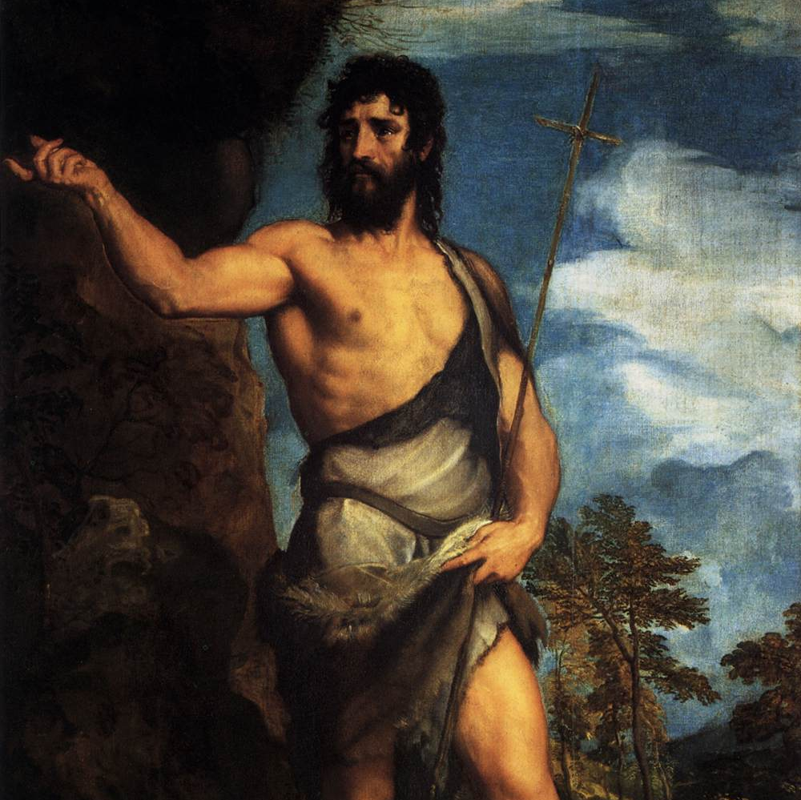
Who is John?
God’s plan for John: To be the Forerunner for the Messiah
His Story:
30 years of seclusion
1.5 years of public preaching,
1 year and 4 months in prison
Beheaded
Notes:
In his darkest hour he questioned if Jesus was the One who was to come, or whether there would be another.
We have our own version of what God’s plan looks like in our life.
He believed this with his whole heart and spent his days "preparing the way" for the Lord’s coming (Matthew 11:10).
But the road was not an easy one to prepare. Daily he faced doubters who did not share his enthusiasm for the coming Messiah. Under hard questioning from the Pharisees, John shared his belief: "I baptize with water, . . . but among you stands one you do not know. He is the one who comes after me, the thongs of whose sandals I am not worthy to untie" (John 1:26–27).
While it is hard to know for sure what John was feeling as he sat in prison, he did certainly seem to have doubts. But John sent a message out to Jesus in an effort to find the truth. As Christians we all will have our faith put to the test, and we will either falter in our faith or, like John, cling to Christ, seek truth, and stand firm in our faith to the end.
Malachi ends with these powerful words closing both the book and Old Testament with the hope of what was still to come, “See I will send you the prophet Elijah before that great and dreadful day of the Lord comes. He will turn the hearts of the fathers to their children, and the hearts of the children to their fathers…” (Malachi 4:5-6).

Slide 11
Jesus said…
¹¹ Truly, I say to you, among those born of women there has arisen no one greater than John the Baptist.
Matthew 11:11

Slide 12
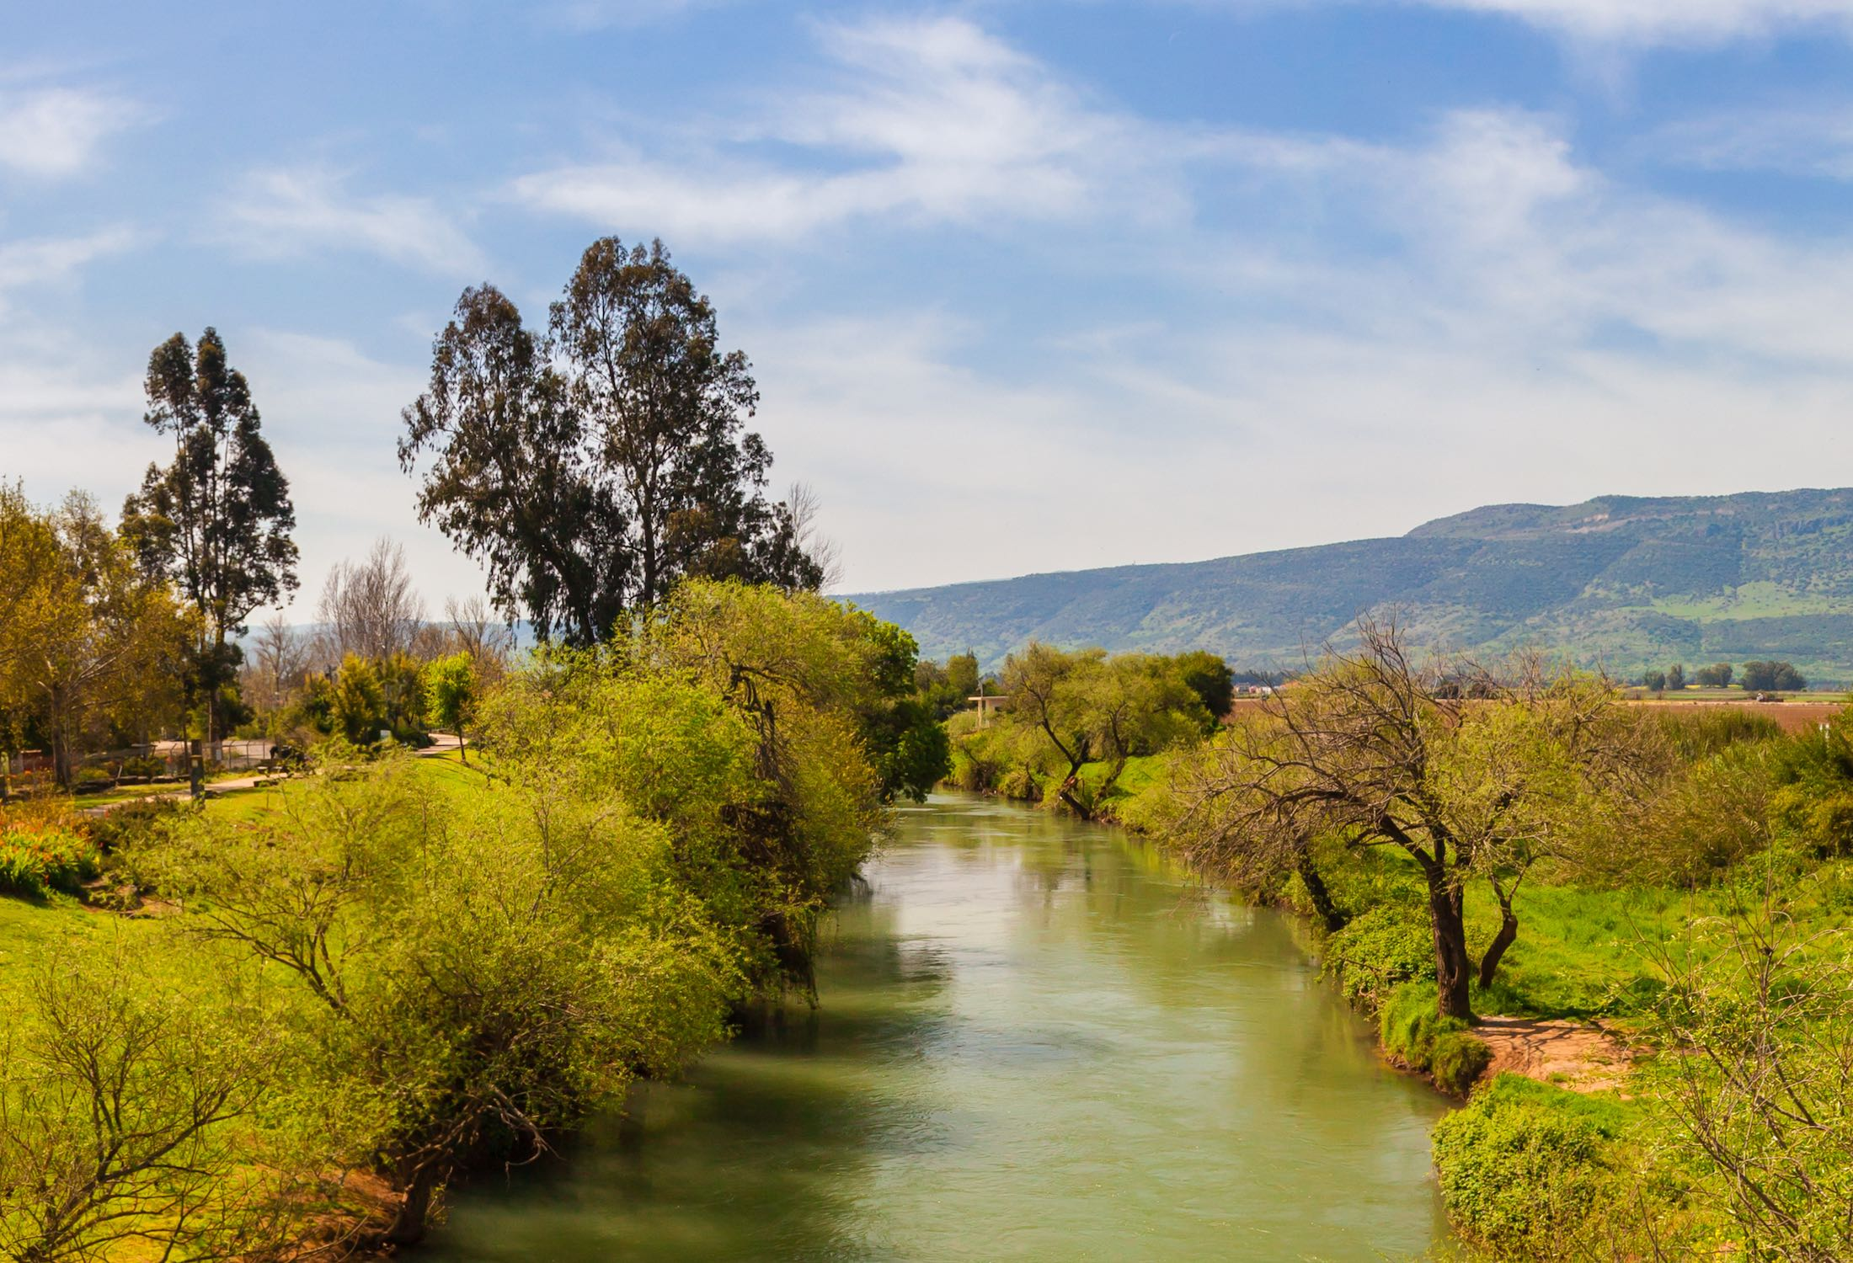
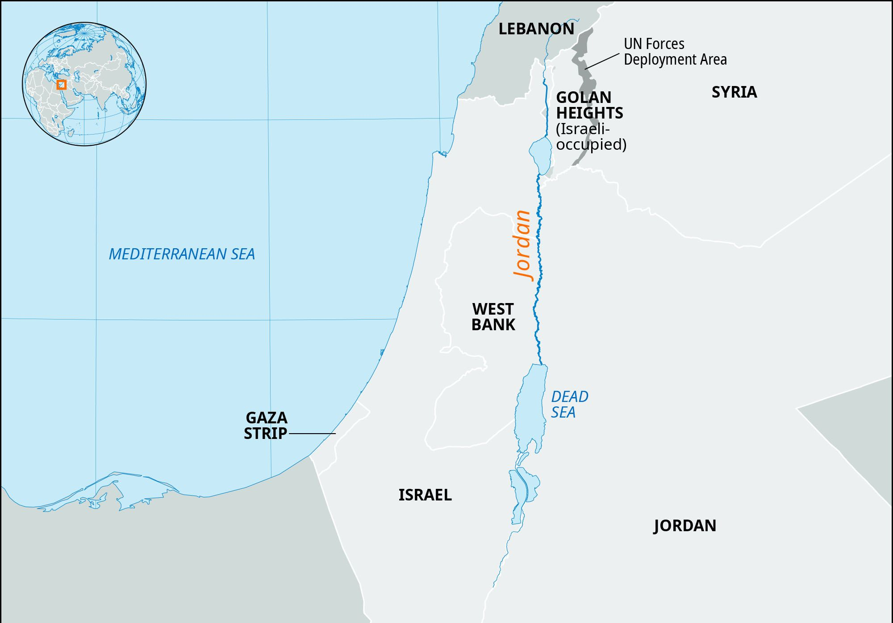
Jordan River
Notes:
He wore clothes made of camel’s hair with a leather belt around his waist, the typical garb of a prophet.
As an adult John lived a rugged life in the mountainous area of Judea, between the city of Jerusalem and the Dead Sea.

Slide 13
Outline
God has a Plan for Us
God is Preparing Us
We will face Trials
Notes:
Here’s the itinerary
PRAY PRAY PRAY PRAY PRAY

Slide 14
How can I know God’s plan for my life?
Notes:
⁹ The heart of man plans his way,
but the Lord establishes his steps.
Proverbs 16:9 (ESV)

Slide 16
Prepare
¹³ Therefore, preparing your minds for action, and being sober-minded, set your hope fully on the grace that will be brought to you at the revelation of Jesus Christ.
1 Peter 1:13 (ESV)
Notes:
Then, I came across this definition of wisdom.

Slide 17
Trust
⁵ Trust in the Lord with all your heart,
and do not lean on your own understanding.
⁶ In all your ways acknowledge him,
and he will make straight your paths.
Proverbs 3:5–6 (ESV)
Notes:
I began looking around for answers.
Digging in I found a few answers…
I need to trust in his plan
How can I know God’s plan for my life?

Slide 18
God’s Instruction
⁸ I will instruct you and teach you in the way you should go;
I will counsel you with my eye upon you.
Psalm 32:8 (ESV)
Notes:
Prepare
Trust in his word
He will instruct you… but how?
Then I came across this definition of Wisdom
How can I know God’s plan for my life?

Slide 19
What is Wisdom?
It’s seeing the world, and your circumstances, as God sees them, and then acting in accordance with that knowledge.
Notes:
Wisdom is God-given and God-centered discernment
How has God most fully and completely revealed his mind and character to us? Through His son, Jesus Chirst; the incarnate Word of God.”
----
“Seeing the world and your circumstances as God sees them and then acting in accordance with that knowledge.”
“Wisdom is actually the very mind of God, the pattern according to which he created and ordered the world. To have wisdom, therefore, is to see the world as God sees it, and then to act in accordance with that understanding.

Slide 20
Ask for Wisdom
⁵ If any of you lacks wisdom, let him ask God, who gives generously to all without reproach, and it will be given him.
James 1:5 (ESV)
Notes:
God gives it freely, just ask!

Slide 21
How can I learn to see the world as God sees it?
Notes:
How has God most fully and completely revealed his mind and character to us? Through His son, Jesus Chirst; the incarnate Word of God.”
Spend time learning about Jesus -> the Gospels

Slide 22
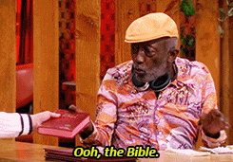
Where might learn more about Jesus?

Slide 23
God’s Promise
^{6.} For the Lord gives wisdom;
from his mouth come knowledge and understanding;
⁷ he stores up sound wisdom for the upright;
he is a shield to those who walk in integrity,
⁸ guarding the paths of justice
and watching over the way of his saints.
⁹ Then you will understand righteousness and justice
and equity, every good path;
¹⁰ for wisdom will come into your heart,
and knowledge will be pleasant to your soul;
¹¹ discretion will watch over you,
understanding will guard you,
¹² delivering you from the way of evil,
from men of perverted speech,
Proverbs 2:6–12 (ESV)
Notes:
When we put God’s wisdom to work, what does he promise us?

Slide 24
Outline
To know God’s Plan
To understand how God is preparing you
To manage through the Trials
You Must Seek Wisdom
You Must Seek Jesus
Notes:
It’s seeing the world, and your circumstances, as God sees them, and then acting in accordance with that knowledge.

Slide 25
The End

Slide 26
⁹ The heart of man plans his way,
but the Lord establishes his steps.
Proverbs 16:9 (ESV)

Slide 27
God’s Plan
Prepare -> Wisdom -> God’s Eye’s -> Jesus -> Bible

Slide 28
Wisdom from the Spirit
⁶ Yet among the mature we do impart wisdom, although it is not a wisdom of this age or of the rulers of this age, who are doomed to pass away. ⁷ But we impart a secret and hidden wisdom of God, which God decreed before the ages for our glory. ⁸ None of the rulers of this age understood this, for if they had, they would not have crucified the Lord of glory. ⁹ But, as it is written,
“What no eye has seen, nor ear heard,
nor the heart of man imagined,
what God has prepared for those who love him”—
¹⁰ these things God has revealed to us through the Spirit. For the Spirit searches everything, even the depths of God. ¹¹ For who knows a person’s thoughts except the spirit of that person, which is in him? So also no one comprehends the thoughts of God except the Spirit of God. ¹² Now we have received not the spirit of the world, but the Spirit who is from God, that we might understand the things freely given us by God. ¹³ And we impart this in words not taught by human wisdom but taught by the Spirit, interpreting spiritual truths to those who are spiritual.
1 Corinthians 2:6–13 (ESV)

Slide 29
Wisdom from Above
¹³ Who is wise and understanding among you? By his good conduct let him show his works in the meekness of wisdom. ¹⁴ But if you have bitter jealousy and selfish ambition in your hearts, do not boast and be false to the truth. ¹⁵ This is not the wisdom that comes down from above, but is earthly, unspiritual, demonic. ¹⁶ For where jealousy and selfish ambition exist, there will be disorder and every vile practice. ¹⁷ But the wisdom from above is first pure, then peaceable, gentle, open to reason, full of mercy and good fruits, impartial and sincere. ¹⁸ And a harvest of righteousness is sown in peace by those who make peace.
James 3:13–18 (ESV)

Slide 30
Proverbs 1:7 (ESV)
⁷ The fear of the Lord is the beginning of knowledge;
fools despise wisdom and instruction.

Slide 31
The Temptation of Jesus
¹² The Spirit immediately drove him out into the wilderness. ¹³ And he was in the wilderness forty days, being tempted by Satan. And he was with the wild animals, and the angels were ministering to him.
Mark 1:12-13 (ESV)
² Count it all joy, my brothers, when you meet trials of various kinds, ³ for you know that the testing of your faith produces steadfastness. ⁴ And let steadfastness have its full effect, that you may be perfect and complete, lacking in nothing.
James 1:2–4 (ESV)
We will face Trials

Slide 32
Outline
There will be Trials
James 1:2–4 <- Trials
Romans 5:3-5 <- Trials
Jesus was tried in the wilderness
God will use your trials to make you a more faithful follower of Jesus
God has a Plan
Jesus <- Isaiah 40:3–5
Us <- Ephesians 2:10
God is Preparing Us
Seek Wisdom <- James 1:5
Seek Wisdom from God <- Proverbs 2:6–12
What is Wisdom
Wisdom is God-given and God-centered discernment
“Seeing the world and your circumstances as God sees them and then acting in accord with that knowledge.”
“Wisdom is actually the very mind of God, the pattern according to which he created and ordered the world. To have wisdom, therefore, is to see the wold as God sees it, and then to act in accordance with that understanding. How has God most fully and completely revealed his mind and character to us? Through His son, Jesus Chirst; the incarnate Word of God.”
How do we get it?
Read the Bible

Slide 33
Mark 1:1-13 (ESV)
John the Baptist Prepares the Way
1 The beginning of the gospel of Jesus Christ, the Son of God.
² As it is written in Isaiah the prophet,
“Behold, I send my messenger before your face,
who will prepare your way,
³ the voice of one crying in the wilderness:
‘Prepare the way of the Lord,
make his paths straight,’ ”
⁴ John appeared, baptizing in the wilderness and proclaiming a baptism of repentance for the forgiveness of sins. ⁵ And all the country of Judea and all Jerusalem were going out to him and were being baptized by him in the river Jordan, confessing their sins. ⁶ Now John was clothed with camel’s hair and wore a leather belt around his waist and ate locusts and wild honey. ⁷ And he preached, saying, “After me comes he who is mightier than I, the strap of whose sandals I am not worthy to stoop down and untie. ⁸ I have baptized you with water, but he will baptize you with the Holy Spirit.”
The Baptism of Jesus
⁹ In those days Jesus came from Nazareth of Galilee and was baptized by John in the Jordan. ¹⁰ And when he came up out of the water, immediately he saw the heavens being torn open and the Spirit descending on him like a dove. ¹¹ And a voice came from heaven, “You are my beloved Son; with you I am well pleased.”
The Temptation of Jesus
¹² The Spirit immediately drove him out into the wilderness. ¹³ And he was in the wilderness forty days, being tempted by Satan. And he was with the wild animals, and the angels were ministering to him.
Notes:
Mark is moving at lightening speed but he’s opening up with a guy named John the Baptist

Slide 34
What is Wisdom?
² Do not be conformed to this world, but be transformed by the renewal of your mind, that by testing you may discern what is the will of God, what is good and acceptable and perfect.
Romans 12:2 (ESV)

Slide 35
Use the Wisdom
¹¹ Beloved, I urge you as sojourners and exiles to abstain from the passions of the flesh, which wage war against your soul. ¹² Keep your conduct among the Gentiles honorable, so that when they speak against you as evildoers, they may see your good deeds and glorify God on the day of visitation.
1 Peter 2:11–12 (ESV)

