Slide 1
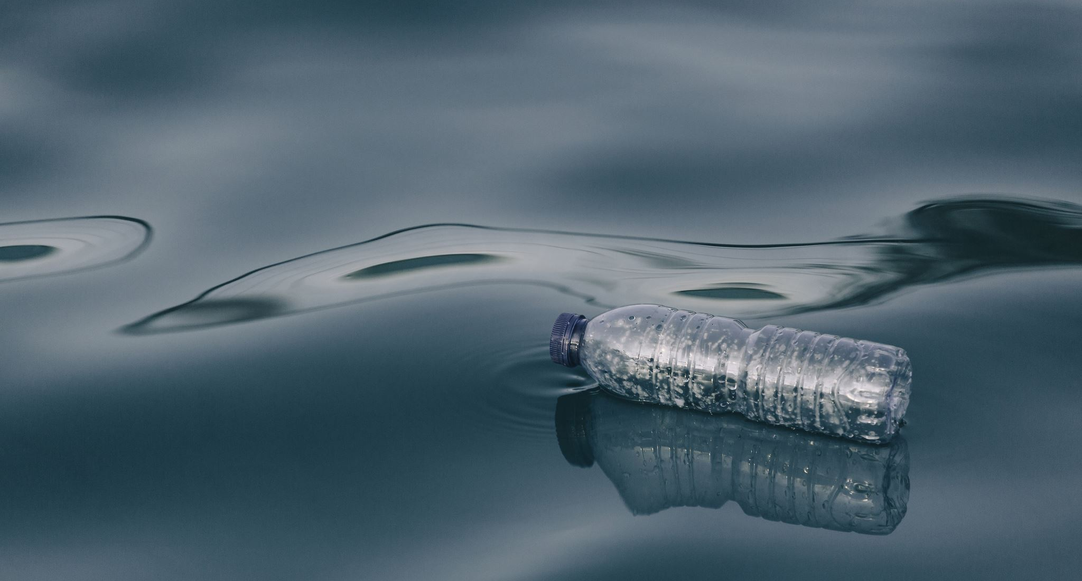
THIRST
John 4:1-26
Notes:
16:47 - NGL

Slide 2
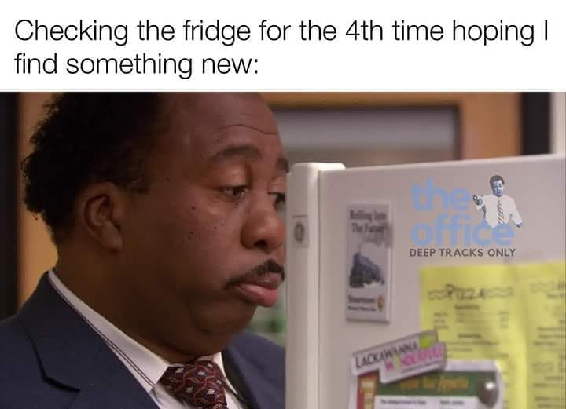
Notes:
37% of people mistake thirst for hunger.
Laptops around my island

Slide 3
4 Now when Jesus learned that the Pharisees had heard that Jesus was making and baptizing more disciples than John ²(although Jesus himself did not baptize, but only his disciples), ³ he left Judea and departed again for Galilee. ⁴ And he had to pass through Samaria. ⁵ So he came to a town of Samaria called Sychar, near the field that Jacob had given to his son Joseph. ⁶ Jacob’s well was there; so Jesus, wearied as he was from his journey, was sitting beside the well. It was about the sixth hour.
John 4:1–6 ESV

Slide 4
SAMARITANS
⁷ A woman from Samaria came to draw water. Jesus said to her, “Give me a drink.” ⁸ (For his disciples had gone away into the city to buy food.) ⁹ The Samaritan woman said to him, “How is it that you, a Jew, ask for a drink from me, a woman of Samaria?” (For Jews have no dealings with Samaritans.)
Notes:
Build a bridge of TRUST that can bear the weight of TRUTH
Are there social groups we’ve given up on; “there is no hope for them”

Slide 5
THIRST
¹⁰ Jesus answered her, “If you knew the gift of God, and who it is that is saying to you, ‘Give me a drink,’ you would have asked him, and he would have given you living water.” ¹¹ The woman said to him, “Sir, you have nothing to draw water with, and the well is deep. Where do you get that living water? ¹² Are you greater than our father Jacob? He gave us the well and drank from it himself, as did his sons and his livestock.” ¹³ Jesus said to her, “Everyone who drinks of this water will be thirsty again, ¹⁴ but whoever drinks of the water that I will give him will never be thirsty again. The water that I will give him will become in him a spring of water welling up to eternal life.” ¹⁵ The woman said to him, “Sir, give me this water, so that I will not be thirsty or have to come here to draw water.”
Notes:
We long to fill a hole
We long to feel whole
Jesus says, I have what you thirst for.
She’s missing the point and gets a bit sarcastic

Slide 6
DESIRES
¹⁶ Jesus said to her, “Go, call your husband, and come here.” ¹⁷ The woman answered him, “I have no husband.” Jesus said to her, “You are right in saying, ‘I have no husband’; ¹⁸ for you have had five husbands, and the one you now have is not your husband. What you have said is true.”
Notes:
What are you filling your void with?
Identity
We fill the gap with things, adrenaline rushes, activities, careers, phones, etc.
Hayes -

Slide 7
WORSHIP
¹⁹ The woman said to him, “Sir, I perceive that you are a prophet. ²⁰ Our fathers worshiped on this mountain, but you say that in Jerusalem is the place where people ought to worship.” ²¹ Jesus said to her, “Woman, believe me, the hour is coming when neither on this mountain nor in Jerusalem will you worship the Father. ²² You worship what you do not know; we worship what we know, for salvation is from the Jews. ²³ But the hour is coming, and is now here, when the true worshipers will worship the Father in spirit and truth, for the Father is seeking such people to worship him. ²⁴ God is spirit, and those who worship him must worship in spirit and truth.”
Notes:
She’s deflecting to a theological debate, but Jesus is still seeking her heart.
Things start to get deep and the person says, “free will vs predestination”

Slide 8
THE MESSIAH
²⁵ The woman said to him, “I know that Messiah is coming (he who is called Christ). When he comes, he will tell us all things.” ²⁶ Jesus said to her, “I who speak to you am he.”

Slide 9
“If I find in myself a desire which no experience in this world can satisfy, the most probable explanation is that I was made for another world.” C.S. Lewis

Slide 11
THE END

Slide 12
John 4:1-26
4 Now when Jesus learned that the Pharisees had heard that Jesus was making and baptizing more disciples than John ²(although Jesus himself did not baptize, but only his disciples), ³ he left Judea and departed again for Galilee. ⁴ And he had to pass through Samaria. ⁵ So he came to a town of Samaria called Sychar, near the field that Jacob had given to his son Joseph. ⁶ Jacob’s well was there; so Jesus, wearied as he was from his journey, was sitting beside the well. It was about the sixth hour.
⁷ A woman from Samaria came to draw water. Jesus said to her, “Give me a drink.” ⁸ (For his disciples had gone away into the city to buy food.) ⁹ The Samaritan woman said to him, “How is it that you, a Jew, ask for a drink from me, a woman of Samaria?” (For Jews have no dealings with Samaritans.) ¹⁰ Jesus answered her, “If you knew the gift of God, and who it is that is saying to you, ‘Give me a drink,’ you would have asked him, and he would have given you living water.” ¹¹ The woman said to him, “Sir, you have nothing to draw water with, and the well is deep. Where do you get that living water? ¹² Are you greater than our father Jacob? He gave us the well and drank from it himself, as did his sons and his livestock.” ¹³ Jesus said to her, “Everyone who drinks of this water will be thirsty again, ¹⁴ but whoever drinks of the water that I will give him will never be thirsty again. The water that I will give him will become in him a spring of water welling up to eternal life.” ¹⁵ The woman said to him, “Sir, give me this water, so that I will not be thirsty or have to come here to draw water.”
¹⁶ Jesus said to her, “Go, call your husband, and come here.” ¹⁷ The woman answered him, “I have no husband.” Jesus said to her, “You are right in saying, ‘I have no husband’; ¹⁸ for you have had five husbands, and the one you now have is not your husband. What you have said is true.” ¹⁹ The woman said to him, “Sir, I perceive that you are a prophet. ²⁰ Our fathers worshiped on this mountain, but you say that in Jerusalem is the place where people ought to worship.” ²¹ Jesus said to her, “Woman, believe me, the hour is coming when neither on this mountain nor in Jerusalem will you worship the Father. ²² You worship what you do not know; we worship what we know, for salvation is from the Jews. ²³ But the hour is coming, and is now here, when the true worshipers will worship the Father in spirit and truth, for the Father is seeking such people to worship him. ²⁴ God is spirit, and those who worship him must worship in spirit and truth.” ²⁵ The woman said to him, “I know that Messiah is coming (he who is called Christ). When he comes, he will tell us all things.” ²⁶ Jesus said to her, “I who speak to you am he.”
John 4:1–26 ESV

