Slide 1
How Should We Worship?
John 12:1-11
Notes:
Interpreting worship – song or daily routine?

Slide 2
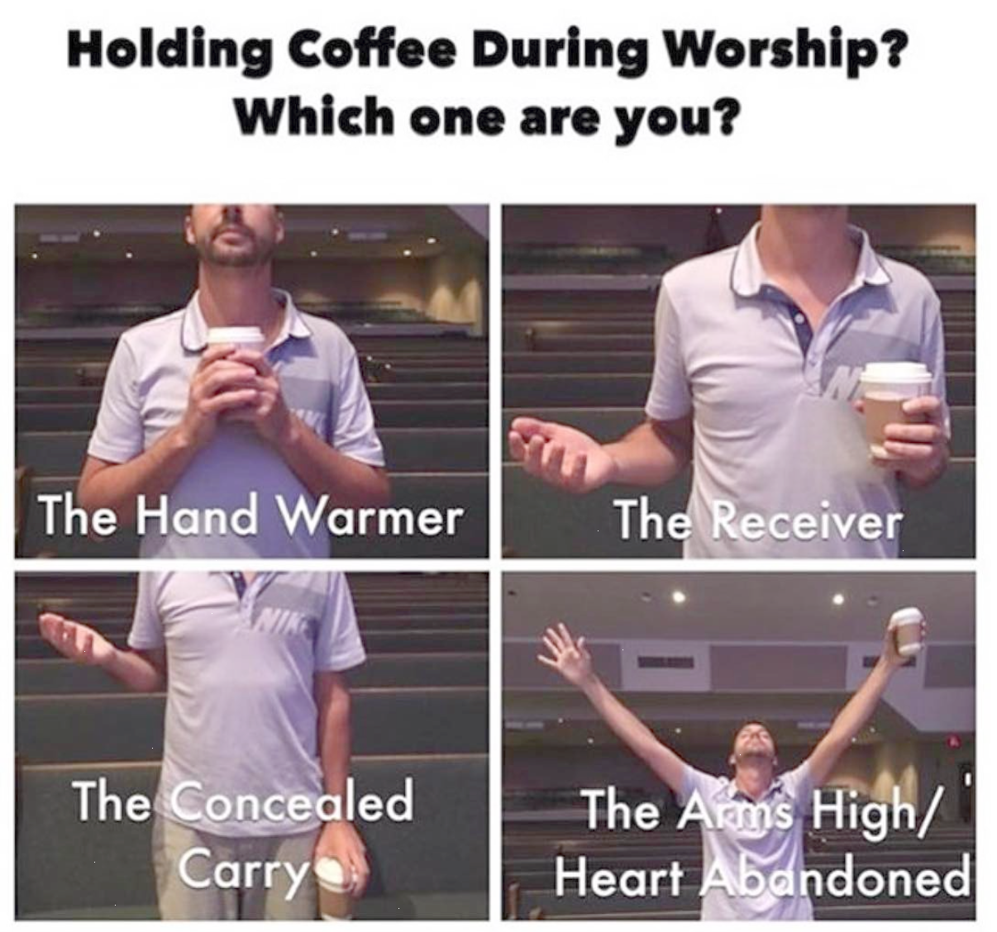

Slide 3
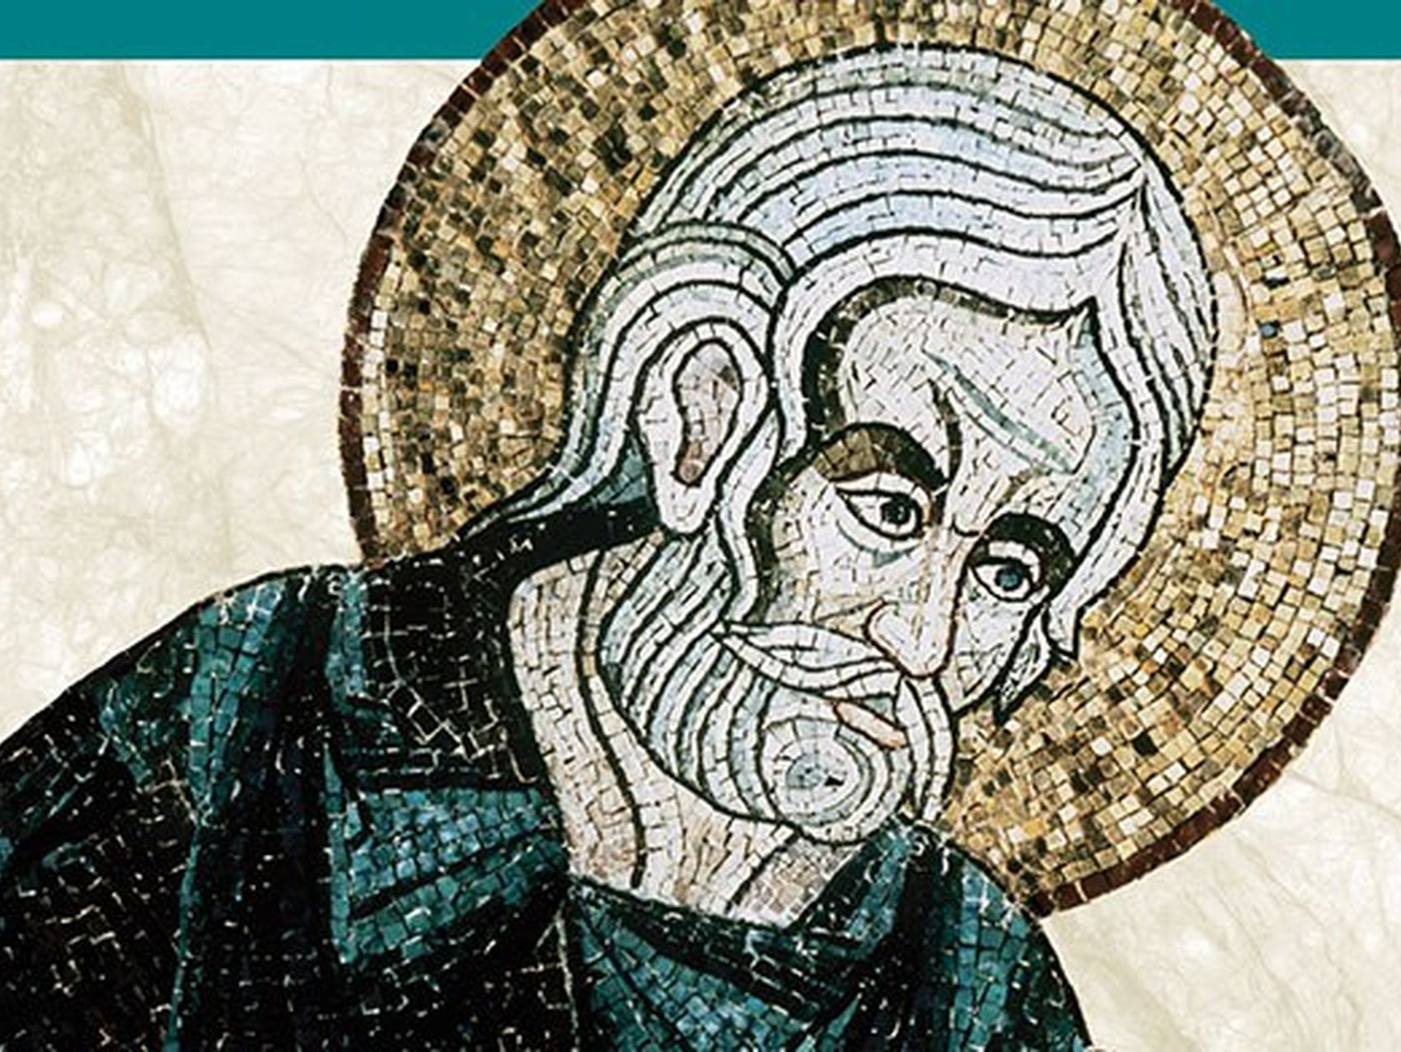
The Apostle John
Son of Zebedee (Matthew 10:2-4)
One of The Sons of Thunder (Mark 3:17)
One of the twelve Disciples
One of the 3 most intimate with Jesus (Peter and James)
Wrote the Gospel of John, 1-3 John, and Revelation
Gospel Written 80-90 A.D. (~50 years After the Ministry of Jesus)
Referred to himself as “Whom Jesus Loved”

Slide 4
Mary Anoints Jesus at Bethany
12 Six days before the Passover, Jesus therefore came to Bethany, where Lazarus was, whom Jesus had raised from the dead. ² So they gave a dinner for him there. Martha served, and Lazarus was one of those reclining with him at table. ³ Mary therefore took a pound of expensive ointment made from pure nard, and anointed the feet of Jesus and wiped his feet with her hair. The house was filled with the fragrance of the perfume. ⁴ But Judas Iscariot, one of his disciples (he who was about to betray him), said, ⁵ “Why was this ointment not sold for three hundred denarii and given to the poor?” ⁶ He said this, not because he cared about the poor, but because he was a thief, and having charge of the moneybag he used to help himself to what was put into it. ⁷ Jesus said, “Leave her alone, so that she may keep it for the day of my burial. ⁸ For the poor you always have with you, but you do not always have me.”
The Plot to Kill Lazarus
⁹ When the large crowd of the Jews learned that Jesus was there, they came, not only on account of him but also to see Lazarus, whom he had raised from the dead. ¹⁰ So the chief priests made plans to put Lazarus to death as well, ¹¹ because on account of him many of the Jews were going away and believing in Jesus.
John 12:1–11 (ESV)
Notes:
SET THE STAGE – WHERE ARE THEY?
They are praising Jesus for what he’s done – He’s brough a man back from the dead!
Likely to be about 16 people at this dinner
In Matthew and Mark we get an account of this story and it’s told the location is at the home of Simon the Leper – keep in mind, no one could socialize with lepers
They were worshipping the Lord
PRAY

Slide 5
Worship happens out of the overflow of a grateful heart for who God is and what He’s done.
Notes:
When does worship happen?
We get to see 3 ways in which we should worship from this dinner party

Slide 6
Serve the Lord
Mary Anoints Jesus at Bethany
12 Six days before the Passover, Jesus therefore came to Bethany, where Lazarus was, whom Jesus had raised from the dead. ² So they gave a dinner for him there. Martha served, and Lazarus was one of those reclining with him at table. ³ Mary therefore took a pound of expensive ointment made from pure nard, and anointed the feet of Jesus and wiped his feet with her hair. The house was filled with the fragrance of the perfume. ⁴ But Judas Iscariot, one of his disciples (he who was about to betray him), said, ⁵ “Why was this ointment not sold for three hundred denarii and given to the poor?” ⁶ He said this, not because he cared about the poor, but because he was a thief, and having charge of the moneybag he used to help himself to what was put into it. ⁷ Jesus said, “Leave her alone, so that she may keep it for the day of my burial. ⁸ For the poor you always have with you, but you do not always have me.”
The Plot to Kill Lazarus
⁹ When the large crowd of the Jews learned that Jesus was there, they came, not only on account of him but also to see Lazarus, whom he had raised from the dead. ¹⁰ So the chief priests made plans to put Lazarus to death as well, ¹¹ because on account of him many of the Jews were going away and believing in Jesus.
John 12:1–11 (ESV)
Notes:
This isn’t the first time Martha was serving – Luke 10 up next

Slide 7
Martha and Mary
³⁸ Now as they went on their way, Jesus entered a village. And a woman named Martha welcomed him into her house. ³⁹ And she had a sister called Mary, who sat at the Lord’s feet and listened to his teaching. ⁴⁰ But Martha was distracted with much serving. And she went up to him and said, “Lord, do you not care that my sister has left me to serve alone? Tell her then to help me.” ⁴¹ But the Lord answered her, “Martha, Martha, you are anxious and troubled about many things, ⁴² but one thing is necessary. Mary has chosen the good portion, which will not be taken away from her.”
Luke 10:38–42 (ESV)
Notes:
She was “distracted” with much serving
Jesus doesn’t say serving is unnecessary or unimportant
Mary is worried about all the things needing to be done
She’s serving in a way that’s impacting everyone around her.
Serving is a wonderful way and harnessed in a way that benefits others and doesn’t make you frantic
In John 12; Martha is no longer frantic, “Martha Served”
Now she was serving in the right disposition

Slide 8
Serve the Lord
²³ Whatever you do, work heartily, as for the Lord and not for men, ²⁴ knowing that from the Lord you will receive the inheritance as your reward. You are serving the Lord Christ.
Colossians 3:23–24 (ESV)
Notes:
Her heart was focused on serving for the Lord and no one else
Now she wants to serve out of the overflow of her love for Jesus
When we serve other’s we serving Christ; it’s honoring Jesus;
Where can we serve?
And we should do it as unto the Lord
What are some other ways?

Slide 9
Spend Time with the Lord
Mary Anoints Jesus at Bethany
12 Six days before the Passover, Jesus therefore came to Bethany, where Lazarus was, whom Jesus had raised from the dead. ² So they gave a dinner for him there. Martha served, and Lazarus was one of those reclining with him at table. ³ Mary therefore took a pound of expensive ointment made from pure nard, and anointed the feet of Jesus and wiped his feet with her hair. The house was filled with the fragrance of the perfume. ⁴ But Judas Iscariot, one of his disciples (he who was about to betray him), said, ⁵ “Why was this ointment not sold for three hundred denarii and given to the poor?” ⁶ He said this, not because he cared about the poor, but because he was a thief, and having charge of the moneybag he used to help himself to what was put into it. ⁷ Jesus said, “Leave her alone, so that she may keep it for the day of my burial. ⁸ For the poor you always have with you, but you do not always have me.”
The Plot to Kill Lazarus
⁹ When the large crowd of the Jews learned that Jesus was there, they came, not only on account of him but also to see Lazarus, whom he had raised from the dead. ¹⁰ So the chief priests made plans to put Lazarus to death as well, ¹¹ because on account of him many of the Jews were going away and believing in Jesus.
John 12:1–11 (ESV)
Notes:
Let’s take a look at Lazarus… He reclined
He’s been dead give him a break
He is enjoying the presence of the Lord
He wanted to…
fellowship with Jesus
talk with Jesus
hear Jesus
We should want to enjoy being present in the Lord

Slide 10
Spend Time with the Lord
¹¹ You make known to me the path of life;
in your presence there is fullness of joy;
at your right hand are pleasures forevermore.
Psalms 16:11 (ESV)
Notes:
RUSHED PRAYER
Be still and know he is God
Meditate on His word
Pray to Him
Shut out this world and Listen – Don’t be too busy
Early in the morning, late at night, lunch break – take time to be with Him
Show me the things about my own heart that I’m blind to – be still long enough so that we can hear Him
***There is no substitute for enjoying the presence of the Lord
GAVIN’S STORY

Slide 11
Sacrifice for the Lord
Mary Anoints Jesus at Bethany
12 Six days before the Passover, Jesus therefore came to Bethany, where Lazarus was, whom Jesus had raised from the dead. ² So they gave a dinner for him there. Martha served, and Lazarus was one of those reclining with him at table. ³ Mary therefore took a pound of expensive ointment made from pure nard, and anointed the feet of Jesus and wiped his feet with her hair. The house was filled with the fragrance of the perfume. ⁴ But Judas Iscariot, one of his disciples (he who was about to betray him), said, ⁵ “Why was this ointment not sold for three hundred denarii and given to the poor?” ⁶ He said this, not because he cared about the poor, but because he was a thief, and having charge of the moneybag he used to help himself to what was put into it. ⁷ Jesus said, “Leave her alone, so that she may keep it for the day of my burial. ⁸ For the poor you always have with you, but you do not always have me.”
The Plot to Kill Lazarus
⁹ When the large crowd of the Jews learned that Jesus was there, they came, not only on account of him but also to see Lazarus, whom he had raised from the dead. ¹⁰ So the chief priests made plans to put Lazarus to death as well, ¹¹ because on account of him many of the Jews were going away and believing in Jesus.
John 12:1–11 (ESV)
Notes:
Costly oil; 300 Denarii: 1 denar was a single days wage
Not the size of the gift, but the sacrifice
It was a prophetic gesture – she was anointing his body for burial
His burial was less than a week away – 6 days; Jesus was crucified on Passover
She was honoring Him and Thanking Him
Jesus is not dismissing the poor – the Church is to address the poor
Generous to God – Move to Fragrance

Slide 12
Sacrifice for the Lord
Mary Anoints Jesus at Bethany
12 Six days before the Passover, Jesus therefore came to Bethany, where Lazarus was, whom Jesus had raised from the dead. ² So they gave a dinner for him there. Martha served, and Lazarus was one of those reclining with him at table. ³ Mary therefore took a pound of expensive ointment made from pure nard, and anointed the feet of Jesus and wiped his feet with her hair. The house was filled with the fragrance of the perfume. ⁴ But Judas Iscariot, one of his disciples (he who was about to betray him), said, ⁵ “Why was this ointment not sold for three hundred denarii and given to the poor?” ⁶ He said this, not because he cared about the poor, but because he was a thief, and having charge of the moneybag he used to help himself to what was put into it. ⁷ Jesus said, “Leave her alone, so that she may keep it for the day of my burial. ⁸ For the poor you always have with you, but you do not always have me.”
The Plot to Kill Lazarus
⁹ When the large crowd of the Jews learned that Jesus was there, they came, not only on account of him but also to see Lazarus, whom he had raised from the dead. ¹⁰ So the chief priests made plans to put Lazarus to death as well, ¹¹ because on account of him many of the Jews were going away and believing in Jesus.
John 12:1–11 (ESV)
Notes:
The fragrance of Mary’s devotion to Jesus was noticed throughout the whole house
Everywhere we go we should spread the fragrance our love and devotion for Jesus; it should be smelled by everyone we come in contact with
Have you ever worked at McDonalds?
Then Jacket
2 Corinthians 2:14

Slide 13
Sacrifice for the Lord
¹⁴ But thanks be to God, who in Christ always leads us in triumphal procession, and through us spreads the fragrance of the knowledge of him everywhere.
2 Corinthians 2:14 (ESV)
Notes:
You’re going to smell anywhere you’ve hung out
You hang out with the world, you will smell like that; if you hang out with Jesus you will smell like Jesus
May we spread everywhere the fragrant aroma of Jesus Crhist

Slide 14
Juda’s Will Criticize
Mary Anoints Jesus at Bethany
12 Six days before the Passover, Jesus therefore came to Bethany, where Lazarus was, whom Jesus had raised from the dead. ² So they gave a dinner for him there. Martha served, and Lazarus was one of those reclining with him at table. ³ Mary therefore took a pound of expensive ointment made from pure nard, and anointed the feet of Jesus and wiped his feet with her hair. The house was filled with the fragrance of the perfume. ⁴ But Judas Iscariot, one of his disciples (he who was about to betray him), said, ⁵ “Why was this ointment not sold for three hundred denarii and given to the poor?” ⁶ He said this, not because he cared about the poor, but because he was a thief, and having charge of the moneybag he used to help himself to what was put into it. ⁷ Jesus said, “Leave her alone, so that she may keep it for the day of my burial. ⁸ For the poor you always have with you, but you do not always have me.”
The Plot to Kill Lazarus
⁹ When the large crowd of the Jews learned that Jesus was there, they came, not only on account of him but also to see Lazarus, whom he had raised from the dead. ¹⁰ So the chief priests made plans to put Lazarus to death as well, ¹¹ because on account of him many of the Jews were going away and believing in Jesus.
John 12:1–11 (ESV)
Notes:
Threatened and Betrayed
He Gets Us – Superbowl ad’s – $100 Million – People criticized the use of funds
Judas will tell you why this is a dumb investment
People that will be challenging you – attacking you even

Slide 15
How Should We Worship?
Serve the Lord
Spend Time with the Lord
Sacrifice for the Lord

Slide 16
The END

Slide 17
Dead guy at the dinner party
  Lazarus
Dinner in honor of Jesus
  “made him a supper”
Judas Hypocrite – He stole (cleptas)
  They used that money to fund the ministry
16 People potentially at the party
  12 Disciples, Jesus, Mary, Martha, and Lazarus
3 Adults, siblings, living and supporting each other
Worship happens out of the overflow of a grateful heart for who God is and what He’s done
  A thank you for raising Lazarus from the dead
  They want to praise him for who He is and what He’s done
All three of them model for us ways we can honor and thank Jesus

Slide 18
Martha Served
Served
Luke 10
  This isn’t the first time Martha was serving
  She was frazzled back in Luke 10
  Mary is sitting and Jesus’ feet listening while Martha is running frantic
  She was “distracted” with much serving
  Jesus doesn’t say serving is unnecessary or unimportant
  Mary is worried about all the things needing to be done; “Martha, come help me with everything is being done”
  She’s serving in a way that’s impacting everyone around her.
  The expectation is that everything needs to get done
  Serving is a wonderful way and harnessed in a way that benefits others and doesn’t make you frantic
John 12 – Martha is no longer frantic, she “served”
  Now serving in the right disposition
  Wants to serve out of the overflow of her love for Jesus
  Colossians 3:23-24
    Serving Christ; honoring Jesus; when we serve others
  Serving at Church
  Serving at Work – as unto the Lord
  Her servant heart is how she’s honoring Jesus

Slide 19
Lazarus Reclined
Reclined
He’s been dead
He is enjoying the presence of the Lord
He wanted to fellowship with Jesus
He wanted to talk with Jesus
He wanted to hear Jesus
We should want to enjoy being present in the Lord
Be still and know he is God
Meditate on His word
Don’t be hurried
Pray to Him
Be still and silence with Him
Shut out this world and Listen – Don’t be too busy
  Early in the morning, late at night, lunch break – take time to be with Him
Show me the things about my own heart that I’m blind to – be still long enough so that we can hear Him
There is no substitute for enjoying the presence of the Lord
Psalm 16:11
James 4:8

Slide 20
Mary Sacrificed
Sacrificed
Costly oil
  300 Denarii: 1 denar was a single days wage
  When was the last time any one of us gave a years worth of salary as a sacrifice for the Lord?
She’s giving it all to Jesus
Not the size of the gift, but the sacrifice
It was a prophetic gesture – she was anointing his body for burial
His burial was less than a week away – 6 days
  Jesus was crucified on Passover
She was honoring Him and Thanking Him
Jesus is not dismissing the poor – the Church is to address the poor
Don’t over-spiritualize everything
Generous to God
The house was filled with the fragrance of the oil
  The fragrance of Mary’s deovition to Jesus was noticed throughout the whole house
  Everywhere we go we should spread the fragrance our love and devotion for Jesus; it should be smelled by everyone we come in contact with
  What aroma are we spreading around
    Have you ever worked at McDonalds?
    You’re going to smell anywhere you’ve hung out
    You hang out with the world, you will smell like that; if you hang out with Jesus you will smell like Jesus
    May we spread everywhere the fragrant aroma of Jesus Crhist
    2 Corinthians 2:14

Slide 21
Judas & Chief Priests
Threatened and Betrayed
Denier
“Haters”
Judas will tell you why this is a dumb investment
People that will be challenging you – attacking you even

