Slide 1
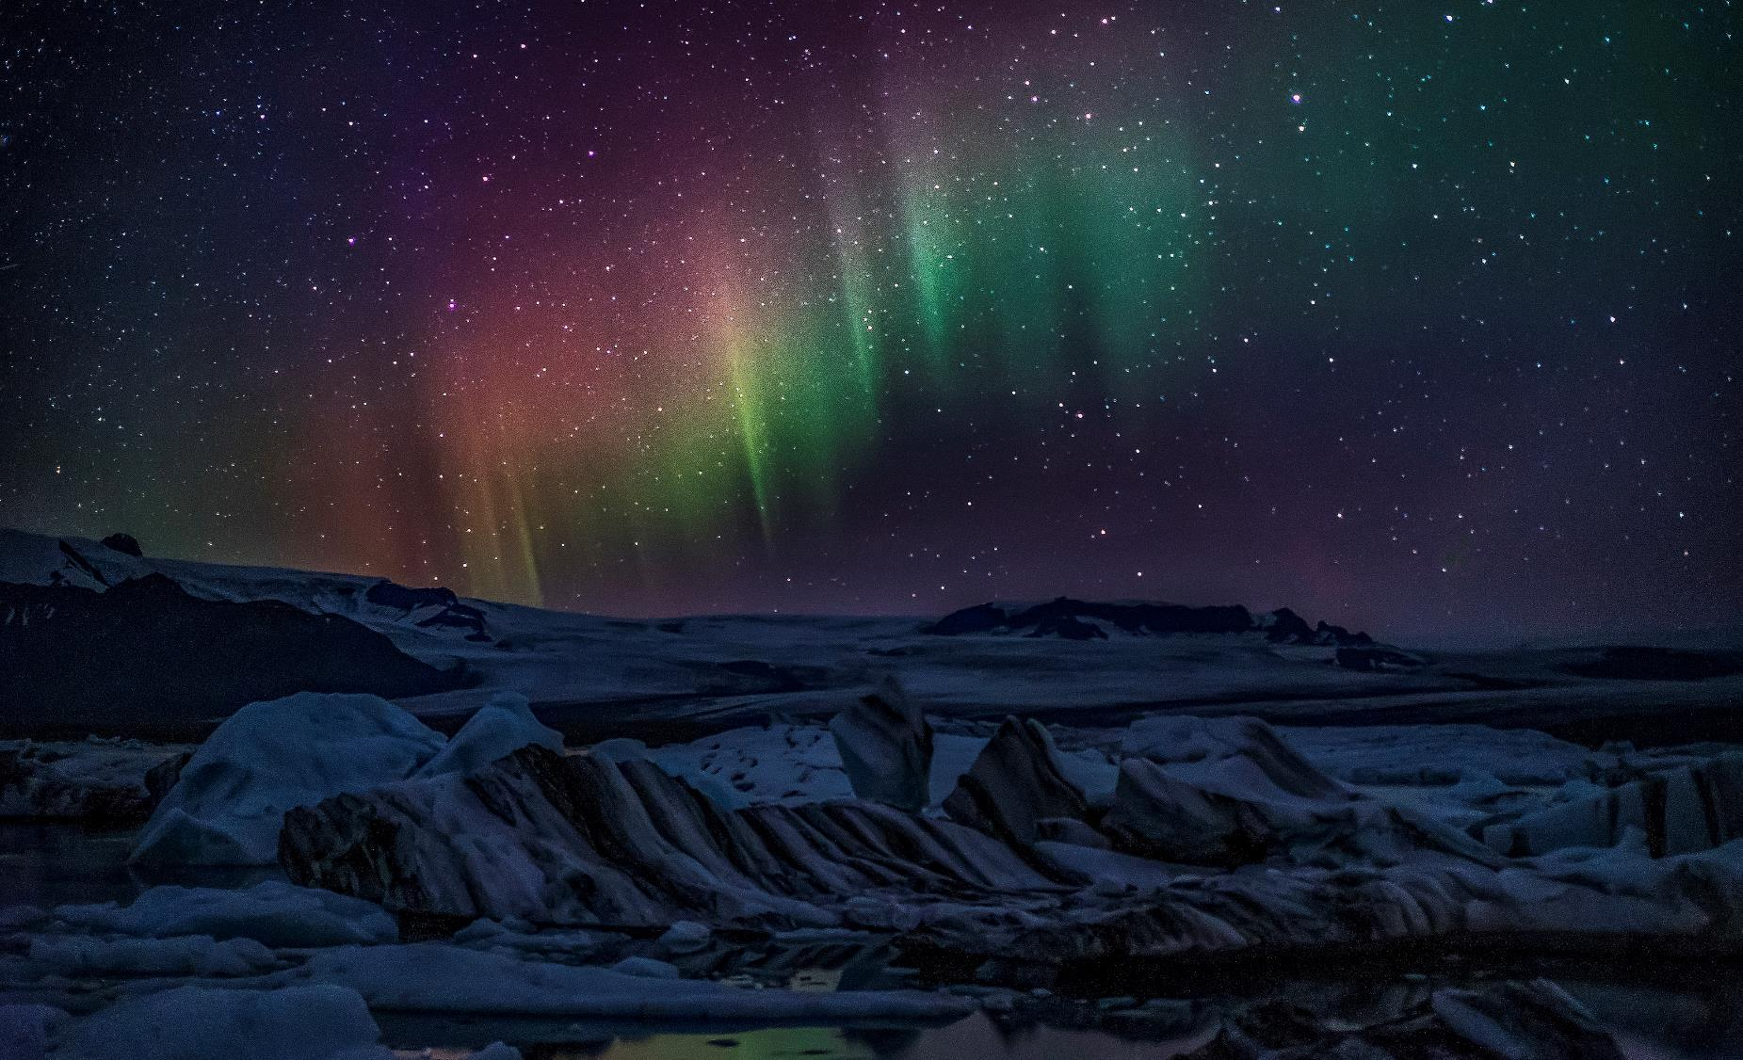
The Light
John 1:1-14

Slide 2
The Apostle John
Son of Zebedee (Matthew 10:2-4)
One of The Sons of Thunder (Mark 3:17)
One of the twelve Disciples
One of the 3 most intimate with Jesus (Peter and James)
Wrote the Gospel of John, 1-3 John, and Revelation
Gospel Written 80-90 A.D. (~50 years After the Ministry of Jesus)
Referred to himself as “Whom Jesus Loved”
Notes:
Brother James (older brother)
When did John write this book?
After Christ’s ascension, John became a “pillar” in the Jerusalem church. He ministered with Peter until he went to Ephesus, before the destruction of Jerusalem, where he wrote this gospel and from where the Romans exiled him to Patmos, where he wrote Revelation.
What’s unique about the gospel of John?
Miracles of Jesus which were not depicted in the other gospels
John supplies answers to some gaps in the other gospels
Most theological of the Gospels – which is what we’re going to talk about - along with the teach of the holy spirit
Why did John write this book?
Likely John was aware of the other Gospels (Matthew, Mark, and Luke)

Slide 3
³¹ but these are written so that you may believe that Jesus is the Christ, the Son of God, and that by believing you may have life in his name.
John 20:31
Notes:
If Jesus is not the Son of God, then the est He can do for us is make us feel guilty.
PRAY

Slide 4
1 In the beginning was the Word, and the Word was with God, and the Word was God. ² He was in the beginning with God. ³ All things were made through him, and without him was not any thing made that was made. ⁴ In him was life, and the life was the light of men. ⁵ The light shines in the darkness, and the darkness has not overcome it.
⁶ There was a man sent from God, whose name was John. ⁷He came as a witness, to bear witness about the light, that all might believe through him. ⁸ He was not the light, but came to bear witness about the light.
⁹ The true light, which gives light to everyone, was coming into the world. ¹⁰ He was in the world, and the world was made through him, yet the world did not know him. ¹¹ He came to his own, and his own people did not receive him. ¹² But to all who did receive him, who believed in his name, he gave the right to become children of God, ¹³ who were born, not of blood nor of the will of the flesh nor of the will of man, but of God.
¹⁴ And the Word became flesh and dwelt among us, and we have seen his glory, glory as of the only Son from the Father, full of grace and truth.
John 1:1–14 (ESV)
Notes:
NEXT: 3 Different Views of Jesus

Slide 5
Different Views of Jesus
Islam | Judaism | Jehovah’s Witness
Islam considers Jesus (Isa in Arabic) one of the most respected of the over 124,000 prophets sent by Allah. Jesus was sinless, born of a virgin, and a great miracle worker, but NOT the Son of God. His virgin birth is like Adam’s creation, but Jesus is not God and Muhammad will return rather than Jesus. | Judaism sees Jesus as either an extremist false messiah or a good but martyred Jewish rabbi. Many Jews do not even consider Jesus. | Jehovah’s Witnesses do not believe Jesus is God, but instead that he’s Michael, the archangel. They believe Jehovah made the universe through him. They do believe on earth he was a man who lived a perfect life and after dying on a stake (not a cross) he was resurrected as a spirit; his body was destroyed. Jesus is not coming again; he had already returned in spirit in 1914.

Slide 6
“The apologetic purpose is closely related to the evangelistic purpose. John wrote to convince his readers of Jesus’ true identity as the incarnate God-Man whose divine and human natures were perfectly united into one person who was the prophesied Christ, Messiah, and savior of the world.”
John MacArthur
Notes:
The four Gospels are the most important part of the Bible. The knowledge of Christ is critical. The books that precede the Gospel anticipate Jesus, and those that follow the gospel explain, the central figure of the four Gospels, Jesus.

Slide 7
¹In the beginning was the Word, and the Word was with God, and the Word was God. ² He was in the beginning with God. ³ All things were made through him, and without him was not any thing made that was made.
John 1:1-3 (ESV)
Notes:
Jesus’ Origin Story
The Word; Divine Reasoning, Mind, Wisdom
Greek philosophers used logos to indicate that rational principle by which everything exists.
John wasn’t just trying to speak to the Jew’s, but to the Greeks as well… to everyone

Slide 8
The Word…
¹In the beginning was the Word, and the Word was with God, and the Word was God. ² He was in the beginning with God. ³ All things were made through him, and without him was not any thing made that was made.
John 1:1-3 (ESV)
1. Existed from the beginning
2. Has a unique Relationship with God
3. Is God Himself
Notes:
John made 3 claims
The Word Existed from the beginning
Had a unique relationship with God
Was God
NEXT: CLARIFICATION

Slide 9
The Word: Logos
Divine Reason
Mind
Wisdom
Notes:
Greek philosophers used logos to indicate that rational principle by which everything exists.
John wasn’t just trying to speak to the Jew’s, but to the Greeks as well… to everyone

Slide 10
To Clarify…
Jesus == The Word
Jesus was in the Beginning
Jesus was with God
Jesus is God
Notes:
NEXT: WHY DID JOHN WRITE THIS AGAIN?

Slide 11
³¹ but these are written so that you may believe that Jesus is the Christ, the Son of God, and that by believing you may have life in his name.
John 20:31
Notes:
NEXT: CONTINUING TO VERSE 4

Slide 12
⁵ And now, Father, glorify me in your own presence with the glory that I had with you before the world existed.
John 17:5

Slide 13
⁶ By the word of the Lord the heavens were made,
and by the breath of his mouth all their host.
Psalms 33:6
⁵ Woe to you inhabitants of the seacoast,
you nation of the Cherethites!
The word of the Lord is against you,
O Canaan, land of the Philistines;
and I will destroy you until no inhabitant is left.
Zephaniah 2:5
²⁰ He sent out his word and healed them,
and delivered them from their destruction.
Psalms 107:20
Notes:
Dates into the Old Testament where God sent his world to heal, used his words to create,

Slide 14
⁴ In him was life, and the life was the light of men. ⁵ The light shines in the darkness, and the darkness has not overcome it.
John 1:4-5 (ESV)
Notes:
Incarnate Christ - 4-5
The source of Life, of Eternal Life
The Light OF Men
NEXT: EXTENDING TO VERSES 9-11

Slide 15
⁹ The true light, which gives light to everyone, was coming into the world. ¹⁰ He was in the world, and the world was made through him, yet the world did not know him. ¹¹ He came to his own, and his own people did not receive him.
John 1:9-11 (ESV)
Notes:
The Unrecognized Christ – 9-11
Jews did not know him.
NEXT: CONTINUE WITH LIGHT IN GENESIS

Slide 16
1 In the beginning, God created the heavens and the earth. ² The earth was without form and void, and darkness was over the face of the deep. And the Spirit of God was hovering over the face of the waters.
³ And God said, “Let there be light,” and there was light. ⁴ And God saw that the light was good. And God separated the light from the darkness.
Genesis 1:1–4 (ESV)
Notes:
Eternal Christ – 1-3
Formless, Dark and Void
Formless to Formed, Darkness to Light, Void to Full
NEXT: BLACK SCREEN

Slide 17
Notes:
Formless, Dark and Void
What our lives might feel like sometimes, wher ewe might have come from
NEXT: JESUS LIGHTS OUR PATH IN PSALMS

Slide 18
¹⁰⁵ Your word is a lamp to my feet and a light to my path.
^{Psalm 119:105}
Notes:
You see how this is all connected? From Genesis, to Psalms, to The Gospels
Jesus is the word, he is the lamp to light your path
NEXT: How do we get that light?

Slide 19
¹² But to all who did receive him, who believed in his name, he gave the right to become children of God, ¹³ who were born, not of blood nor of the will of the flesh nor of the will of man, but of God.
John 1:12-13 (ESV)
Notes:
The omnipotent Christ – 12-13 & 6
All are saved through Him.
GET EXCITED, we are ALL saved, who? ALL!
Gavin getting baptized – he is not born of blood nor of the will of the flesh nor of the will of man, but of God
NEXT: WHERE / HOW DO WE GET OUR SALVATION

Slide 20
SALVATION
By grace alone
Through faith alone
In Christ alone
Notes:
NEXT: IT’S NOT JUST FOR YOU!

Slide 21
¹⁵ Nor do people light a lamp and put it under a basket, but on a stand, and it gives light to all in the house. ¹⁶ In the same way, let your light shine before others, so that they may see your good works and give glory to your Father who is in heaven.
Matthew 5:15–16
Notes:
God says to be the light before others – what does that look like?
NEXT: Tell you what it doesn’t look like…

Slide 23
Bring Glory to God by Enjoying Him Forever
Notes:
NEXT: HERE’S THE DEAL…

Slide 24
¹² Again Jesus spoke to them, saying, “I am the light of the world. Whoever follows me will not walk in darkness, but will have the light of life.”
John 8:12

Slide 25
⁶ There was a man sent from God, whose name was John. ⁷He came as a witness, to bear witness about the light, that all might believe through him. ⁸ He was not the light, but came to bear witness about the light.
John 1:6-8 (ESV)
Notes:
The forerunner of Christ – 6-8
What are we called to do?

Slide 26
¹⁴ And the Word became flesh and dwelt among us, and we have seen his glory, glory as of the only Son from the Father, full of grace and truth.
John 1:14 (ESV)
Notes:
The Glorious Christ – 14-18

Slide 27
Is Eternal (1-3)
Is Incarnate (4-5)
Had a forerunner (6-8)
Was Unrecognized (9-11)
Is omnipotent (12-13 & 6)
Is Glorious (14-18)
6 Truths
CHRIST
Notes:
Incarnate – born in the flesh, became man
Omnipotent – all powerful

Slide 28
The ENd

Slide 29
God is Jesus; Jesus is God
Believe in Him and receive the light
You are the light of the world
Let your light shine

Slide 31
1 In the beginning was the Word, and the Word was with God, and the Word was God. ² He was in the beginning with God. ³ All things were made through him, and without him was not any thing made that was made. ⁴ In him was life, and the life was the light of men. ⁵ The light shines in the darkness, and the darkness has not overcome it.
⁶ There was a man sent from God, whose name was John. ⁷He came as a witness, to bear witness about the light, that all might believe through him. ⁸ He was not the light, but came to bear witness about the light.
⁹ The true light, which gives light to everyone, was coming into the world. ¹⁰ He was in the world, and the world was made through him, yet the world did not know him. ¹¹ He came to his own, and his own people did not receive him. ¹² But to all who did receive him, who believed in his name, he gave the right to become children of God, ¹³ who were born, not of blood nor of the will of the flesh nor of the will of man, but of God.
¹⁴ And the Word became flesh and dwelt among us, and we have seen his glory, glory as of the only Son from the Father, full of grace and truth.
John 1:1–14 (ESV)

