Slide 1
OBEDIENCE
Jeremiah 42

Slide 2
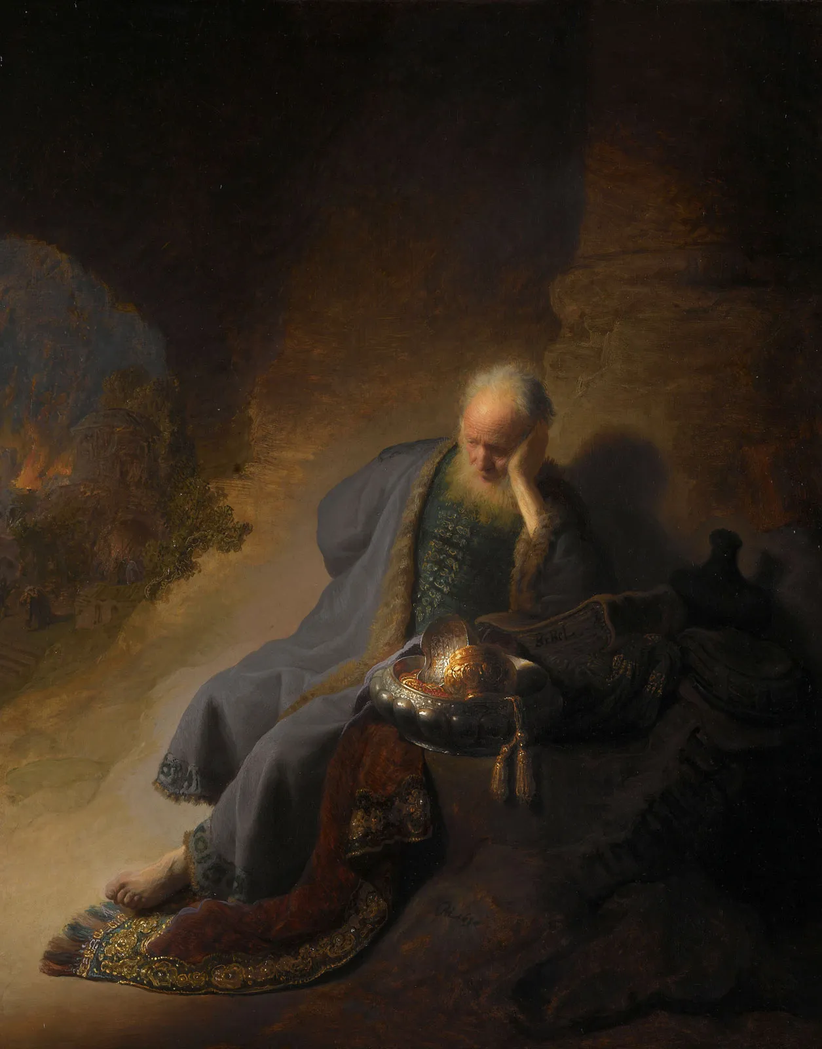
Jeremiah “The Lord exalts”
Prophet to Judah
Known as the Weeping Prophet (v9:1; v13:18; v14:7)
Son of Hilkiah; a priest (2 King 22:8)
Grew up North of Jerusalem in Anathoth (v1.1)
Called by God between the ages of 12-20 (v1.2)
Lived 80-90 years
Unmarried at the command of God (v16:1-4)
Prophet between 626 B.C. to 586 B.C. (v1:3)
Jehoiakim burned the original scroll (v36:20-26)
Scribed by Baruch (v36:4; v32; v45:1)
History: 2 Kings 22-25 and 2 Chronicles 34-36
Notes:
Jehoiakim
Ana*toth
Read 2 Kings 22-25 and then pickup at Jeremiah 40

Slide 3
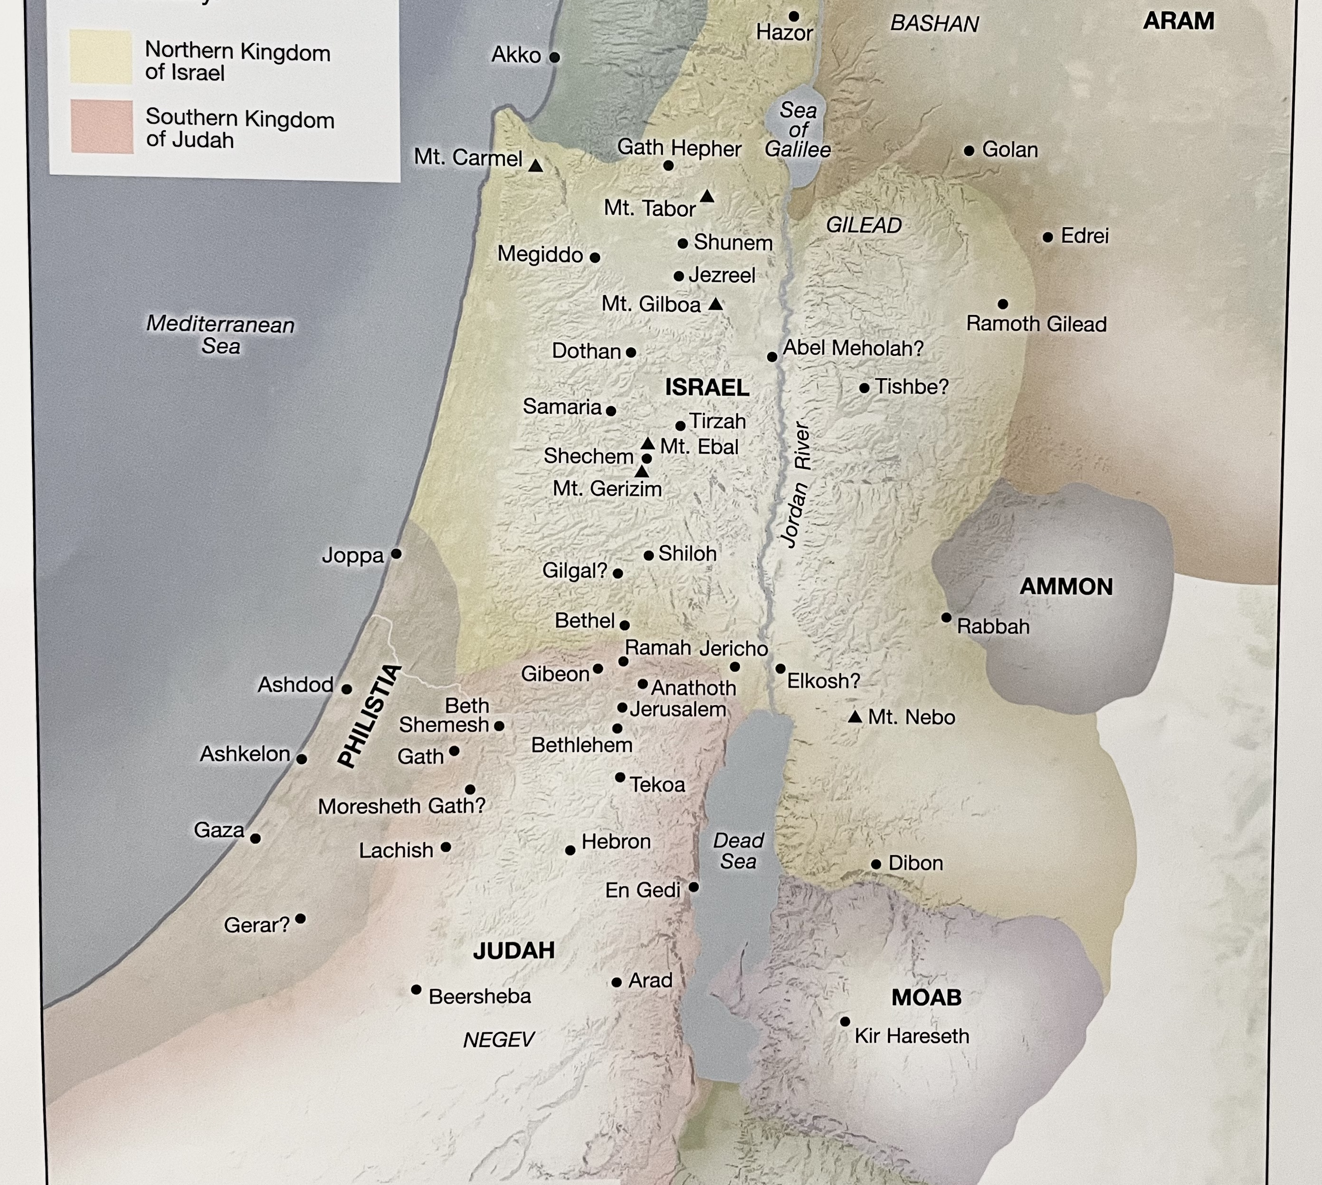
Separation of the Kingdom
After King Solomon there was civil war and the Kingdom of Israel split:
Israel to the North
-
Judah to the South
Notes:
At this point the kingdom of Israel is divided. We have Israel to the north and Judah to the South.
Shortened version of apocalypse
Ishmael murders Gedaliah; Johanan, leader of forces, avenges his death
PRAY
GOD PREPARING ME -> Work Problems; feeling me heart Separated/Divided
Turned to prayer
NEW Opportunity; Felt God Telling me to ”Go”

Slide 4
42 Now all the captains of the forces, Johanan the son of Kareah, Jezaniah the son of Hoshaiah, and all the people, from the least to the greatest, came near ² and said to Jeremiah the prophet, “Please, let our petition be acceptable to you, and pray for us to the Lord your God, for all this remnant (since we are left but a few of many, as you can see), ³ that the Lord your God may show us the way in which we should walk and the thing we should do.”
⁴ Then Jeremiah the prophet said to them, “I have heard. Indeed, I will pray to the Lord your God according to your words, and it shall be, that whatever the Lord answers you, I will declare it to you. I will keep nothing back from you.”
⁵ So they said to Jeremiah, “Let the Lord be a true and faithful witness between us, if we do not do according to everything which the Lord your God sends us by you. ⁶ Whether it is pleasing or displeasing, we will OBEY the voice of the Lord our God to whom we send you, that it may be well with us when we OBEY the voice of the Lord our God.” ⁷ And it happened after ten days that the word of the Lord came to Jeremiah.
Jeremiah 42:1-7 (NKJV)
Notes:
I sought the council of others
Then Delays Started Happening -> Days -. FEAR

Slide 5
FEAR
Notes:
What were my fears in the delay?
They didn’t want me on the team
I wasn’t doing what God wanted me to do
This wasn’t God but rather my pride
I turned to prayer again

Slide 6
Ask God…
What do you want me to do?
What do you want me to learn?
What do you want from me?
What do you want me to do right now?

Slide 8
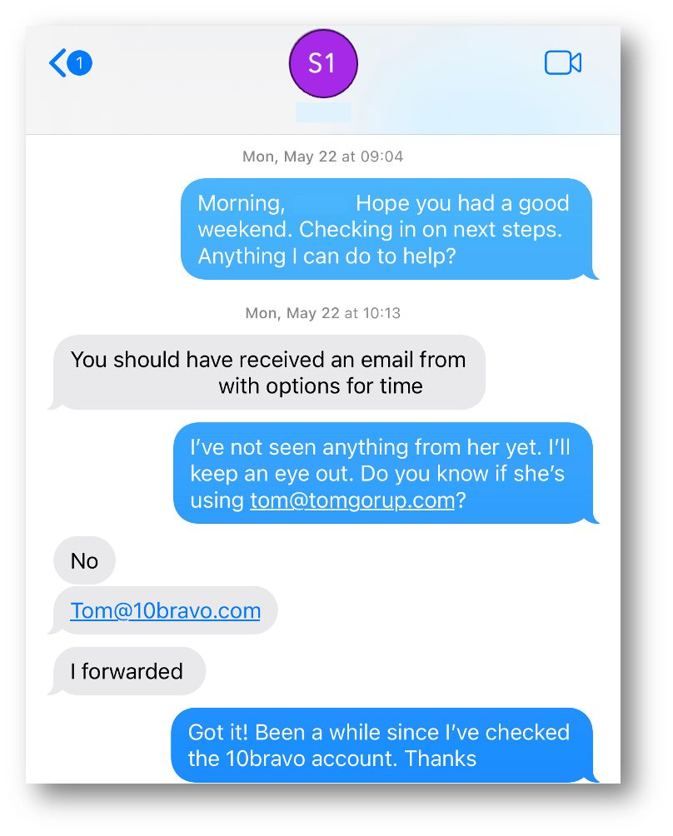
Notes:
Turned out they had the wrong email

Slide 9
⁷ And it happened after ten days that the word of the Lord came to Jeremiah. ⁸ Then he called Johanan the son of Kareah, all the captains of the forces which were with him, and all the people from the least even to the greatest, ⁹ and said to them, “Thus says the Lord, the God of Israel, to whom you sent me to present your petition before Him: ¹⁰ ‘If you will still remain in this land, then I will build you and not pull you down, and I will plant you and not pluck you up. For I relent concerning the disaster that I have brought upon you. ¹¹ Do not be afraid of the king of Babylon, of whom you are afraid; do not be afraid of him,’ says the Lord, ‘for I am with you, to save you and deliver you from his hand. ¹² And I will show you mercy, that he may have mercy on you and cause you to return to your own land.’
¹³ “But if you say, ‘We will not dwell in this land,’ DISOBEYING the voice of the Lord your God, ¹⁴ saying, ‘No, but we will go to the land of Egypt where we shall see no war, nor hear the sound of the trumpet, nor be hungry for bread, and there we will dwell’— ¹⁵ Then hear now the word of the Lord, O remnant of Judah! Thus says the Lord of hosts, the God of Israel: ‘If you wholly^{[c]} set your faces to enter Egypt, and go to dwell there, ¹⁶ then it shall be that the sword which you feared shall overtake you there in the land of Egypt; the famine of which you were afraid shall follow close after you there in Egypt; and there you shall die. ¹⁷ So shall it be with all the men who set their faces to go to Egypt to dwell there. They shall die by the sword, by famine, and by pestilence. And none of them shall remain or escape from the disaster that I will bring upon them.’
¹⁸ “For thus says the Lord of hosts, the God of Israel: ‘As My anger and My fury have been poured out on the inhabitants of Jerusalem, so will My fury be poured out on you when you enter Egypt. And you shall be an oath, an astonishment, a curse, and a reproach; and you shall see this place no more.’
Jeremiah 42:7-18 (NKJV)
Notes:
God puts a vision on our heart, he tells us what to do, but we run our own process

Slide 10
FEAR
Notes:
What were my fears for taking the job?
Failing in the public light
Not as familiar with the industry
Limited processes, documentation, etc.
Much smaller team that must be built up
Another job came up

Slide 11
¹⁹ “The Lord has said concerning you, O remnant of Judah, ‘Do not go to Egypt!’ Know certainly that I have admonished you this day. ²⁰ For you were hypocrites in your hearts when you sent me to the Lord your God, saying, ‘Pray for us to the Lord our God, and according to all that the Lord your God says, so declare to us and we will do it.’ ²¹ And I have this day declared it to you, but you have not OBEYED the voice of the Lord your God, or anything which He has sent you by me. ²² Now therefore, know certainly that you shall die by the sword, by famine, and by pestilence in the place where you desire to go to dwell.”
Jeremiah 42:19-22 (NKJV)
Notes:
Jeremiah had spoken for 40 years and he knew they would still not obey.

Slide 12
Notes:
Nor did I; I turned down the other job
Wrestled with God and myself
Then I was reminded of what he said earlier

Slide 13
God will put a vision on our heart, but we often want to take our own path in getting there.
Notes:
How does that work out for us?
God wanted me to go, he opened the door, then I started chasing a shiny object

Slide 15
FEAR
Notes:
What were my fears for reaching out again?
They won’t take me back
I’ll look foolish
They won’t trust me or think I’m indecisive
Well, I was obedient and text him
His response, “You just made my day.”

Slide 17
⁵ Trust in the Lord with all your heart, and do not lean on your own understanding. ⁶ In all your ways acknowledge him, and he will make straight your paths.
Proverbs 3:5–6 (ESV)

Slide 18
How do we make tough decisions?
Pray Asking God…
What do you want me to do?
What do you want me to learn?
What do you want from me?
What do you want me to do right now?
Seek the Council and Prayers of other Christians
Be Obedient

Slide 19
The End

Slide 20
Apocalyptic Story

Slide 21
Kings of Judah
Josiah
640-609 BC
Jehoiakim
(Eliakim)
609-598 BC
Zedekiah
(Mattaniah)
597-586 BC
700 BC
600BC
Jehoahaz
609 BC
Jehoiachin
Prophet to Israel
598-597 BC
Notes:
Josiah
Read the Book of the Covenant which had been found in the house of the Lord
Made a covenant before the Lord to follow the Lord and keep His commandments
All the people took a stand for the covenant
Removed and burned all the articles made for Baal, for Asherah,and all the host of heaven from the house of the Lord
Removed the idolatrous priests
Brought out the wooden images from the House of the Lord and burned them
Tore down the ritual booths
Defiled high places of Beersheba and Topheth
No man might make his son or his daughter pass through the firer of Molech
Removed horses dedicated to the sun
Burned chariots that were of the sun
Broke to pieces pillars and cut down wooden images
Removed shrines of high places
He executed all the priests of high places
Commanded to keep Passover to the Lord as it is written in the book
Put away those who consulted mediums and spirits
Josiah killed by Pharaoh Necho at Megiddo.
Jehoahaz
King for a whole 3 months before he was taken prisoner
Jehoaikim
Original name Eliakim
Appointed by the Pharoah Necho
During which time a tribute of 100 talents of silver and a talent of gold was due to the pharaoh– Jehoakim taxed the people to pay the tribute
Reigned 11 years
Nebuchadnezzar, King of Babylon came up and Jehoaikim became his vassal for 3 years
He eventually rebelled and the Lord sent bands of Syrians, Moabites and Ammon against Judah
The Pharoah didn’t come around anymore because of the rise of Babylon
Jehoiachin
Began reign with Babylon besieging Judah
He surrendered to Babylon -> The King took him prisoner
At this point, Nebuchadnezzar was desotrying and taking captive 1000’s of Jew’s (leaders and others alike; only leaving the poorest people of the land
Jehoiachin was taken to Babylon as captive
Zedekiah
Mattaniah Name was changed toZedekiah by the King of Babylon
He was appointed King of Judah
Zedekiah rebelled against the king of Babylon after 11 years of reign
Babylonian army encamped against Jerusalem
A famine had become so severe that the city had no food for the people
Walls were broken down and men of war fled at night along with the king
They ran down the king in the plains of Jericho
Took the king captive to Babylon at Riblah and killed his sons before his yes, put out the eyes of Zedekiah and bound him
Nebuzaradan completely destroyed Jerusalem
He took even more prisoners
Took away shovels, trimmers, spoons, and all the bronze utensils, firepans, and basins
He took the chief priests and doorrkeepers, army recruiters and other military captains to Babylon where they were killed
Gedaliah
Was made governor by Nebuchadnezzar
He encouraged the people to continue to dwell in the land and serve the king of Babylon
People small and great and captains went to Egypt because they were afraid of the Chaldeans
People began to come out of the wood works; all the Jews who were in Moab, Edom, and in all countries heard that the king of Babylon had left a remnant of Judah and they began to return
Johanan offered to kill Ishmael as he knew he was plotting to kill Gedaliah, but Gedaliah didn’t believe it and didn’t allow him to kill him
Ishmael (Baalis the king of the Ammonites sent him) with 10 men killed Gedaliah, the Jews, and the Chaldean who were with him at Mizpah
80 Men came from Shechem, Shiloh, and Samaria to mourn what’s happened to Judah; Ishmael went out pretending to weep and he killed them
He filled a sistern with the slain; the sistern that was made by Asa
Ishmael took captive everyone that was committed to Gedaliah by the King of Babylon
When Johanan heard of this, he went after him with all the men – they found him
Ishmael escaped with 8 men and went to the Ammonites
They all went to Chimham near Bethlehem and hid because they were afraid

Slide 22
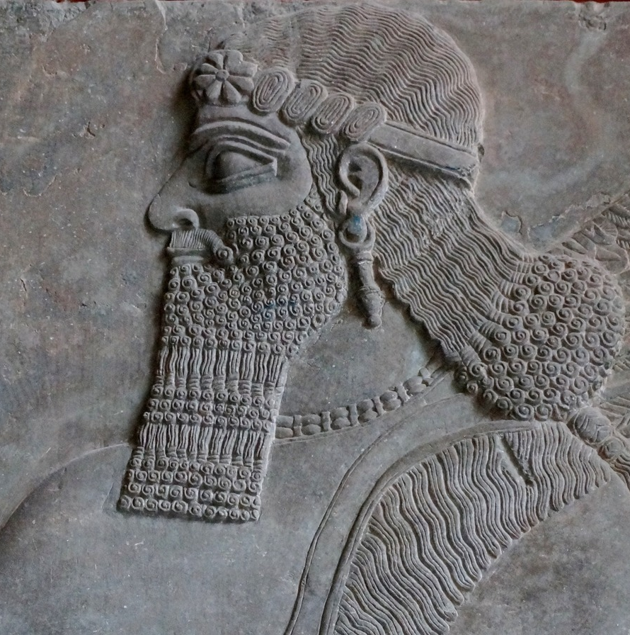
Nebuchadnezzar
King of Babylon
Nebuzaradan
Prince of the Guard
Ishmael
Reports to Baalis King of Ammonites
Jeremiah
Prophet of the Lord
Gedaliah
Governor of Judah
Johanan
Leader of Forces

Slide 23
My New Job
What were my fears for taking the job?
What were my fears in the delay?
What were my fears for reaching out again?
Work began to become difficult; I began to feel a separation from work as if I had lost some personal connection to it. Had been texted about roles in the past and kept at arms length. I believe God will open doors when He’s ready for you to move.
God has a purpose and plan for all of us. God puts a vision on our heart of what he wants for our life. The problem we run into is that sometimes we try to run our own plan rather than be patient through His.
Got a text from a friend about a project he’s working on that turned out to be pitching the job (April 20th)
It felt right, as if this is the right place to go
I prayed about it, and I felt God was saying to ”Go”
Things felt like they were going slow, I felt I was doing something wrong and I prayed to ask God: (May 22nd)
What do you want me to do?
What do you want me to learn?
What do you want from me?
What do you want me to do right now?
I began to pursue the role and another opportunity came in from another friend (June 1st)
As a result, I turned down the offer; I was chasing my own version of ”Go” (June 29th)
The version I was chasing turned me down (July 5th)
Reached back out after a long drive to pick up my Sister-in-law (July 8th)
Accepted the offer (July 20th)

Slide 24
¹ The word that came to Jeremiah from the Lord after Nebuzaradan the captain of the guard had let him go from Ramah, when he took him bound in chains along with all the captives of Jerusalem and Judah who were being exiled to Babylon. ² The captain of the guard took Jeremiah and said to him, “The Lord your God pronounced this disaster against this place. ³ The Lord has brought it about, and has done as he said. Because you sinned against the Lord and did not OBEY his voice, this thing has come upon you. ⁴ Now, behold, I release you today from the chains on your hands. If it seems good to you to come with me to Babylon, come, and I will look after you well, but if it seems wrong to you to come with me to Babylon, do not come. See, the whole land is before you; go wherever you think it good and right to go. ⁵ If you remain, then return to Gedaliah the son of Ahikam, son of Shaphan, whom the king of Babylon appointed governor of the cities of Judah, and dwell with him among the people. Or go wherever you think it right to go.” So the captain of the guard gave him an allowance of food and a present, and let him go. ⁶ Then Jeremiah went to Gedaliah the son of Ahikam, at Mizpah, and lived with him among the people who were left in the land. ⁷ When all the captains of the forces in the open country and their men heard that the king of Babylon had appointed Gedaliah the son of Ahikam governor in the land and had committed to him men, women, and children, those of the poorest of the land who had not been taken into exile to Babylon, ⁸ they went to Gedaliah at Mizpah—Ishmael the son of Nethaniah, Johanan the son of Kareah, Seraiah the son of Tanhumeth, the sons of Ephai the Netophathite, Jezaniah the son of the Maacathite, they and their men. ⁹ Gedaliah the son of Ahikam, son of Shaphan, swore to them and their men, saying, “Do not be afraid to serve the Chaldeans. Dwell in the land and serve the king of Babylon, and it shall be well with you. ¹⁰ As for me, I will dwell at Mizpah, to represent you before the Chaldeans who will come to us. But as for you, gather wine and summer fruits and oil, and store them in your vessels, and dwell in your cities that you have taken.” ¹¹ Likewise, when all the Judeans who were in Moab and among the Ammonites and in Edom and in other lands heard that the king of Babylon had left a remnant in Judah and had appointed Gedaliah the son of Ahikam, son of Shaphan, as governor over them, ¹² then all the Judeans returned from all the places to which they had been driven and came to the land of Judah, to Gedaliah at Mizpah. And they gathered wine and summer fruits in great abundance. ¹³ Now Johanan the son of Kareah and all the leaders of the forces in the open country came to Gedaliah at Mizpah ¹⁴ and said to him, “Do you know that Baalis the king of the Ammonites has sent Ishmael the son of Nethaniah to take your life?” But Gedaliah the son of Ahikam would not believe them. ¹⁵ Then Johanan the son of Kareah spoke secretly to Gedaliah at Mizpah, “Please let me go and strike down Ishmael the son of Nethaniah, and no one will know it. Why should he take your life, so that all the Judeans who are gathered about you would be scattered, and the remnant of Judah would perish?” ¹⁶ But Gedaliah the son of Ahikam said to Johanan the son of Kareah, “You shall not do this thing, for you are speaking falsely of Ishmael.”
Jeremiah 40:1–16 (ESV)

Slide 25
¹ In the seventh month, Ishmael the son of Nethaniah, son of Elishama, of the royal family, one of the chief officers of the king, came with ten men to Gedaliah the son of Ahikam, at Mizpah. As they ate bread together there at Mizpah, ² Ishmael the son of Nethaniah and the ten men with him rose up and struck down Gedaliah the son of Ahikam, son of Shaphan, with the sword, and killed him, whom the king of Babylon had appointed governor in the land. ³ Ishmael also struck down all the Judeans who were with Gedaliah at Mizpah, and the Chaldean soldiers who happened to be there. ⁴ On the day after the murder of Gedaliah, before anyone knew of it, ⁵ eighty men arrived from Shechem and Shiloh and Samaria, with their beards shaved and their clothes torn, and their bodies gashed, bringing grain offerings and incense to present at the temple of the Lord. ⁶ And Ishmael the son of Nethaniah came out from Mizpah to meet them, weeping as he came. As he met them, he said to them, “Come in to Gedaliah the son of Ahikam.” ⁷ When they came into the city, Ishmael the son of Nethaniah and the men with him slaughtered them and cast them into a cistern. ⁸ But there were ten men among them who said to Ishmael, “Do not put us to death, for we have stores of wheat, barley, oil, and honey hidden in the fields.” So he refrained and did not put them to death with their companions. ⁹ Now the cistern into which Ishmael had thrown all the bodies of the men whom he had struck down along with Gedaliah was the large cistern that King Asa had made for defense against Baasha king of Israel; Ishmael the son of Nethaniah filled it with the slain. ¹⁰ Then Ishmael took captive all the rest of the people who were in Mizpah, the king’s daughters and all the people who were left at Mizpah, whom Nebuzaradan, the captain of the guard, had committed to Gedaliah the son of Ahikam. Ishmael the son of Nethaniah took them captive and set out to cross over to the Ammonites. ¹¹ But when Johanan the son of Kareah and all the leaders of the forces with him heard of all the evil that Ishmael the son of Nethaniah had done, ¹² they took all their men and went to fight against Ishmael the son of Nethaniah. They came upon him at the great pool that is in Gibeon. ¹³ And when all the people who were with Ishmael saw Johanan the son of Kareah and all the leaders of the forces with him, they rejoiced. ¹⁴ So all the people whom Ishmael had carried away captive from Mizpah turned around and came back, and went to Johanan the son of Kareah. ¹⁵ But Ishmael the son of Nethaniah escaped from Johanan with eight men, and went to the Ammonites. ¹⁶ Then Johanan the son of Kareah and all the leaders of the forces with him took from Mizpah all the rest of the people whom he had recovered from Ishmael the son of Nethaniah, after he had struck down Gedaliah the son of Ahikam—soldiers, women, children, and eunuchs, whom Johanan brought back from Gibeon. ¹⁷ And they went and stayed at Geruth Chimham near Bethlehem, intending to go to Egypt ¹⁸ because of the Chaldeans. For they were afraid of them, because Ishmael the son of Nethaniah had struck down Gedaliah the son of Ahikam, whom the king of Babylon had made governor over the land.
Jeremiah 41:1–18 (ESV)

Slide 26
¹ Then all the commanders of the forces, and Johanan the son of Kareah and Jezaniah the son of Hoshaiah, and all the people from the least to the greatest, came near ² and said to Jeremiah the prophet, “Let our plea for mercy come before you, and pray to the Lord your God for us, for all this remnant—because we are left with but a few, as your eyes see us— ³ that the Lord your God may show us the way we should go, and the thing that we should do.” ⁴ Jeremiah the prophet said to them, “I have heard you. Behold, I will pray to the Lord your God according to your request, and whatever the Lord answers you I will tell you. I will keep nothing back from you.” ⁵ Then they said to Jeremiah, “May the Lord be a true and faithful witness against us if we do not act according to all the word with which the Lord your God sends you to us. ⁶ Whether it is good or bad, we will OBEY the voice of the Lord our God to whom we are sending you, that it may be well with us when we OBEY the voice of the Lord our God.” ⁷ At the end of ten days the word of the Lord came to Jeremiah. ⁸ Then he summoned Johanan the son of Kareah and all the commanders of the forces who were with him, and all the people from the least to the greatest, ⁹ and said to them, “Thus says the Lord, the God of Israel, to whom you sent me to present your plea for mercy before him: ¹⁰ If you will remain in this land, then I will build you up and not pull you down; I will plant you, and not pluck you up; for I relent of the disaster that I did to you. ¹¹ Do not fear the king of Babylon, of whom you are afraid. Do not fear him, declares the Lord, for I am with you, to save you and to deliver you from his hand. ¹² I will grant you mercy, that he may have mercy on you and let you remain in your own land. ¹³ But if you say, ‘We will not remain in this land,’ DISOBEYING the voice of the Lord your God ¹⁴ and saying, ‘No, we will go to the land of Egypt, where we shall not see war or hear the sound of the trumpet or be hungry for bread, and we will dwell there,’ ¹⁵ then hear the word of the Lord, O remnant of Judah. Thus says the Lord of hosts, the God of Israel: If you set your faces to enter Egypt and go to live there, ¹⁶ then the sword that you fear shall overtake you there in the land of Egypt, and the famine of which you are afraid shall follow close after you to Egypt, and there you shall die. ¹⁷ All the men who set their faces to go to Egypt to live there shall die by the sword, by famine, and by pestilence. They shall have no remnant or survivor from the disaster that I will bring upon them. ¹⁸ “For thus says the Lord of hosts, the God of Israel: As my anger and my wrath were poured out on the inhabitants of Jerusalem, so my wrath will be poured out on you when you go to Egypt. You shall become an execration, a horror, a curse, and a taunt. You shall see this place no more. ¹⁹ The Lord has said to you, O remnant of Judah, ‘Do not go to Egypt.’ Know for a certainty that I have warned you this day ²⁰ that you have gone astray at the cost of your lives. For you sent me to the Lord your God, saying, ‘Pray for us to the Lord our God, and whatever the Lord our God says, declare to us and we will do it.’ ²¹ And I have this day declared it to you, but you have not OBEYED the voice of the Lord your God in anything that he sent me to tell you. ²² Now therefore know for a certainty that you shall die by the sword, by famine, and by pestilence in the place where you desire to go to live.”
Jeremiah 42:1–22 (ESV)

Slide 27
43 Now it happened, when Jeremiah had stopped speaking to all the people all the words of the Lord their God, for which the Lord their God had sent him to them, all these words, ² that Azariah the son of Hoshaiah, Johanan the son of Kareah, and all the proud men spoke, saying to Jeremiah, “You speak falsely! The Lord our God has not sent you to say, ‘Do not go to Egypt to dwell there.’ ³ But Baruch the son of Neriah has set you against us, to deliver us into the hand of the Chaldeans, that they may put us to death or carry us away captive to Babylon.” ⁴ So Johanan the son of Kareah, all the captains of the forces, and all the people would not OBEY the voice of the Lord, to remain in the land of Judah. ⁵ But Johanan the son of Kareah and all the captains of the forces took all the remnant of Judah who had returned to dwell in the land of Judah, from all nations where they had been driven— ⁶ men, women, children, the king’s daughters, and every person whom Nebuzaradan the captain of the guard had left with Gedaliah the son of Ahikam, the son of Shaphan, and Jeremiah the prophet and Baruch the son of Neriah. ⁷ So they went to the land of Egypt, for they did not OBEY the voice of the Lord.
Jeremiah 43:1-7a (NKJV)
Notes:
Abraham’s return to Egypt, defeated and hopeless nearly 900 years after they had been liberated”

Slide 28
¹ When Jeremiah finished speaking to all the people all these words of the Lord their God, with which the Lord their God had sent him to them, ² Azariah the son of Hoshaiah and Johanan the son of Kareah and all the insolent men said to Jeremiah, “You are telling a lie. The Lord our God did not send you to say, ‘Do not go to Egypt to live there,’ ³ but Baruch the son of Neriah has set you against us, to deliver us into the hand of the Chaldeans, that they may kill us or take us into exile in Babylon.” ⁴ So Johanan the son of Kareah and all the commanders of the forces and all the people did not OBEY the voice of the Lord, to remain in the land of Judah. ⁵ But Johanan the son of Kareah and all the commanders of the forces took all the remnant of Judah who had returned to live in the land of Judah from all the nations to which they had been driven— ⁶ the men, the women, the children, the princesses, and every person whom Nebuzaradan the captain of the guard had left with Gedaliah the son of Ahikam, son of Shaphan; also Jeremiah the prophet and Baruch the son of Neriah. ⁷ And they came into the land of Egypt, for they did not OBEY the voice of the Lord. And they arrived at Tahpanhes. ⁸ Then the word of the Lord came to Jeremiah in Tahpanhes: ⁹ “Take in your hands large stones and hide them in the mortar in the pavement that is at the entrance to Pharaoh’s palace in Tahpanhes, in the sight of the men of Judah, ¹⁰ and say to them, ‘Thus says the Lord of hosts, the God of Israel: Behold, I will send and take Nebuchadnezzar the king of Babylon, my servant, and I will set his throne above these stones that I have hidden, and he will spread his royal canopy over them. ¹¹ He shall come and strike the land of Egypt, giving over to the pestilence those who are doomed to the pestilence, to captivity those who are doomed to captivity, and to the sword those who are doomed to the sword. ¹² I shall kindle a fire in the temples of the gods of Egypt, and he shall burn them and carry them away captive. And he shall clean the land of Egypt as a shepherd cleans his cloak of vermin, and he shall go away from there in peace. ¹³ He shall break the obelisks of Heliopolis, which is in the land of Egypt, and the temples of the gods of Egypt he shall burn with fire.’ ”
Jeremiah 43:1–13 (ESV)

Slide 29
Apocalyptic Movies
The Road
The Day After Tomorrow
2012
Greenland
28 Weeks Later
Doomsday
Oblivion
The Day the Earth Stood Still
Book of Eli
Interstellar
Finch
I Am Legend
Battle: Los Angeles
Don’t Look Up
Reign Of Fire
Mad Max
12 Monkeys
Children of Men
Hunger Games
Elysium
The Postman
Dredd
Bird Box
Divergent
World War Z
White Noise
Waterworld

Slide 30
Possible Clips
Mad Max
https://www.youtube.com/watch?v=b6l1KoNkqrw
Probably too much
Don’t Look Up
https://www.youtube.com/watch?v=4-zv5Cvg6pM
Sad, but not sure relevant
Waterworld
https://www.youtube.com/watch?v=Fv9_YOL38MM
Probably not
Postman
https://www.youtube.com/watch?v=BYpnyxLqaTc
Probably not
Hunger Games
https://www.youtube.com/watch?v=NQpNAhajqWc
OK Option
The Road
https://www.youtube.com/watch?v=WEP25kPtQCQ
Good Option
Son of Man
https://www.youtube.com/watch?v=pSdL1zeOfdk
Good Option until the end...
https://www.youtube.com/watch?v=YBzWTIexszQ
Better Option
The Divide
https://www.youtube.com/watch?v=RiHNeGf7P7o
Not Horrible
https://www.youtube.com/watch?v=iaLpieSNIfk
Maybe too much
The Hunger Games
https://www.youtube.com/watch?v=v98Rh9qzmPs
Not relevant

