Slide 1
God’s calling
Jeremiah 1:4-19
Notes:
The example Jeremiah sets for us through his obedience in spite the challenges and his inperfections which we’ll learn about in coming weeks.

Slide 2
Jeremiah “The Lord exalts”
Known as the Weeping Prophet (v9:1; v13:18; v14:7)
Son of Hilkiah; a priest (2 King 22:8)
Grew up North of Jerusalem in Anathoth (v1.1)
Called by God between the ages of 12-20 (v1.2)
Lived 80-90 years
Unmarried at the command of God (v16:1-4)
Prophet between 626 B.C. to 586 B.C. (v1:3)
Scribed by Baruch (v36:4; v32; v45:1)
History: 2 King 22-25 and 2 Chronicles 34-36
Notes:
40 Years – began under King Josiah
Jeremiah was threatened, tried for his life, put in stocks, forced to flee from Jehoiakim, humiliated by false prophet and thrown into a pit
We are called to live like Christ; whom Jeremiah personified
We are called to love our neighbor and to love our enemies
We are called to love the Lord above all things
Jeremiah put this on full display by speaking God’s word no matter how much it hurt.
What we're going to find is that God uses humble people to accomplish great eternal things

Slide 3
Rise of Assyria
Assyria begins to expand its territory.
912BC
Norther Kingdom of Israel is forced to pay tribute to Assyria.
841BC
Southern Kingdom of Judah falls to Babylon. 586BC
Israel falls to Assyria. 722BC
Samuel
Prophet to Israel
1060-1020BC
Elijah
Prophet to Israel
870-845BC
Amos
Prophet to Israel
760-753BC
Isaiah
Prophet to Judah
740-661BC
Zephaniah
Prophet to Judah
641-628BC
Habakkuk
Prophet to Judah
609-598BC
1100BC
500BC
Kings
Josiah: 640-609 BC
Jehoahaz 609 BC
Jehoiakim: 609-598 BC
Jehoiachin: 598-597 BC
Zedekiah 597-586 BC
Nathan
Prophet to King David
990-971BC
Hosea
Prophet to Israel
752-722BC
Micah
Prophet to Judah
738-698BC
Jeremiah
Prophet to Judah
626-586BC

Slide 4
Notes:
At this point the kingdom is divided. We have Israel to the north and Judah to the South.

Slide 5
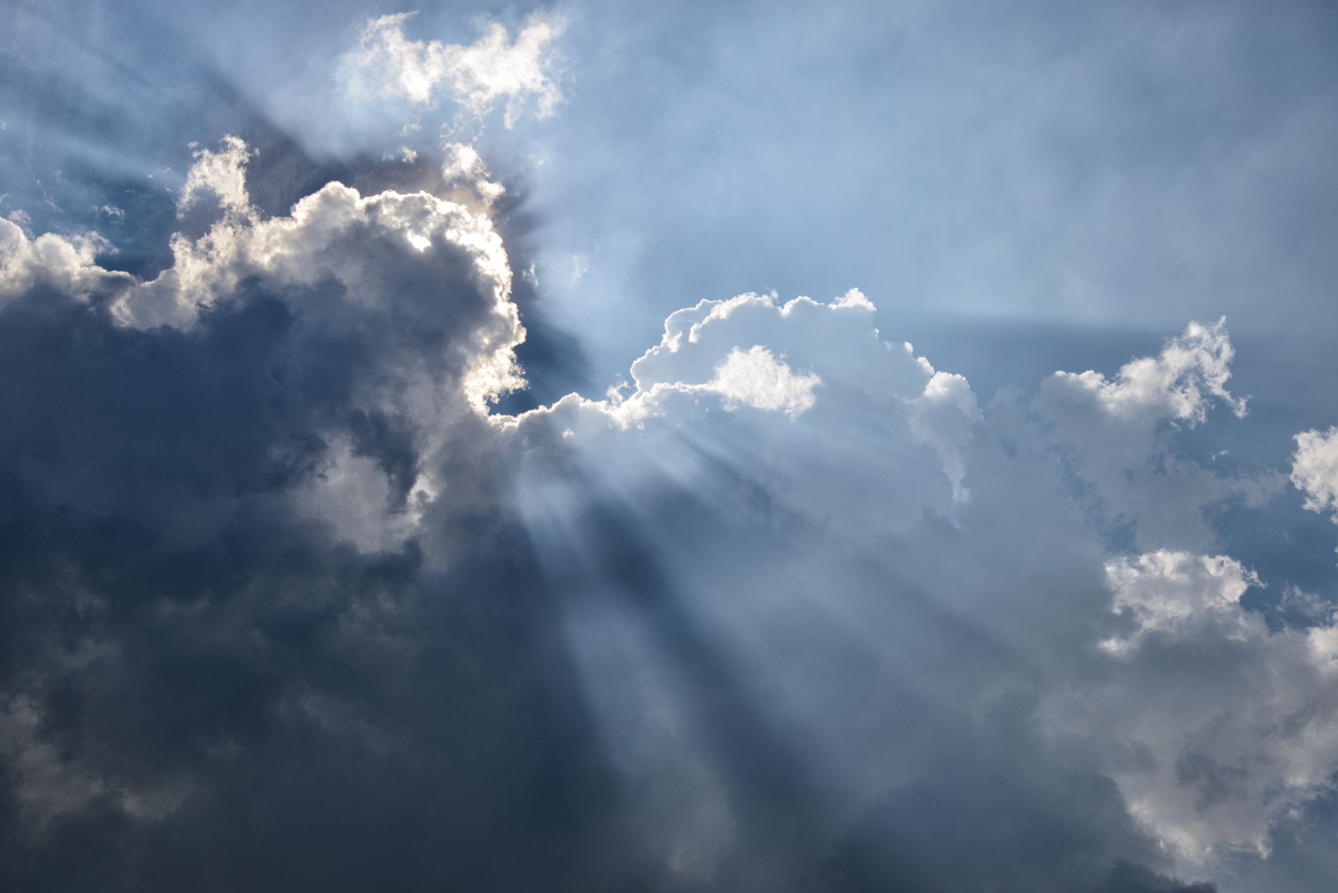
THEMES
GOD CHOSE YOU
GOD HAS A PLAN FOR YOU
GOD IS PREPARING YOU
GOD SEEKS OBEDIENCE
Notes:
I PRAYED AND GOD SAID CHURCH
STEPHANIE THOUGHT I WAS GOING TO QUIT MY JOB

Slide 6
⁴ Now the word of the Lord came to me, saying,
⁵ “Before I formed you in the womb I knew you,
and before you were born I consecrated you;
I appointed you a prophet to the nations.”
Jeremiah 1:4-5 (ESV)
God chose US
Notes:
GOD CHOSE US
Pro-Abortion: Life begins at birth
Pro-Life: Life begives at conception
We should be Pre-Pro-Life
Conception
Conceived
GOD CHOSE US
GOD IS PREPARING US
GOD HAS A PLAN
READY YOURSELF

Slide 7
13 For you formed my inward parts;
you knitted me together in my mother’s womb.
14 I praise you, for I am fearfully and wonderfully made.
Wonderful are your works;
my soul knows it very well.
15 My frame was not hidden from you,
when I was being made in secret,
intricately woven in the depths of the earth.
16 Your eyes saw my unformed substance;
in your book were written, every one of them,
the days that were formed for me,
when as yet there was none of them.
Psalm 139:13–16 (ESV)
God chose US
Notes:
David said
He created us on purpose for a purpose
Even the smallest details of our lives matter to God
Conception
Conceived
Politically Charged Conversation
Pro-Abortion: Life begins at birth
Pro-Life: Life begives at conception
We should be Pre-Pro-Life
GOD CHOSE US
GOD IS PREPARING US
GOD HAS A PLAN
READY YOURSELF

Slide 8
10 For we are his workmanship, created in Christ Jesus for good works, which God prepared beforehand, that we should walk in them.
Ephesians 2:10 (ESV)
God chose US
Notes:
THIS PLAN DOESN’T NEED TO BE A HUGE PLAN

Slide 9
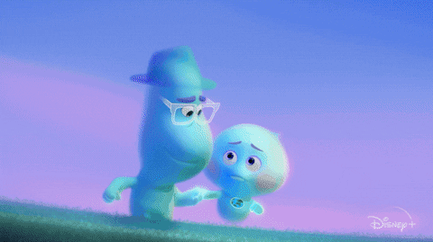
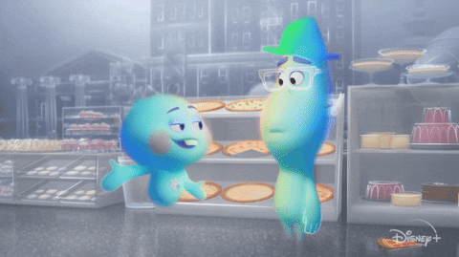

Slide 10
⁴ Now the word of the Lord came to me, saying,
⁵ “Before I formed you in the womb I knew you,
and before you were born I consecrated you;
I appointed you a prophet to the nations.”
⁶ Then I said, “Ah, Lord God! Behold, I do not know how to speak, for I am only a youth.”
Jeremiah 1:6 (ESV)
WE HAVE excuses
Notes:
Moses Said This
Timothy Said this
WE all have our excuses
EMMA
GOD CHOSE US
GOD IS PREPARING US
GOD HAS A PLAN
READY YOURSELF

Slide 11
11 But Moses said to God, “Who am I that I should go to Pharaoh and bring the children of Israel out of Egypt?”
Exodus 3:11 (ESV)
4 Then Moses answered, “But behold, they will not believe me or listen to my voice, for they will say, ‘The LORD did not appear to you.’ ”
Exodus 4:1 (ESV)
10 But Moses said to the LORD, “Oh, my Lord, I am not eloquent, either in the past or since you have spoken to your servant, but I am slow of speech and of tongue.”
Exodus 4:10 (ESV)
13 But he said, “Oh, my Lord, please send someone else.”
Exodus 4:13 (ESV)
WE HAVE excuses
Notes:
GOD CHOSE MOSES
GOD CHOSE US
GOD IS PREPARING US
GOD HAS A PLAN
READY YOURSELF

Slide 12
“I don’t have a theology degree.”
“I don’t know the scriptures well enough.”
“This could be a huge mistake.”
”Maybe I just made that up.”
“I’ll likely fail.”
”I’m too old.”
“I’m not good enough.”
WE HAVE excuses
Notes:
GOD CHOSE YOU
My Stories of Second Guessing God
Christi
GOD CHOSE US
GOD IS PREPARING US
GOD HAS A PLAN
READY YOURSELF

Slide 13
⁴ Now the word of the Lord came to me, saying,
⁵ “Before I formed you in the womb I knew you,
and before you were born I consecrated you;
I appointed you a prophet to the nations.”
⁶ Then I said, “Ah, Lord God! Behold, I do not know how to speak, for I am only a youth.” ⁷ But the Lord said to me,
“Do not say, ‘I am only a youth’;
for to all to whom I send you, you shall go,
and whatever I command you, you shall speak.
⁸ Do not be afraid of them,
for I am with you to deliver you,
declares the Lord.”
Jeremiah 1:7-8 (ESV)
HE SEEKS OBEDIENCE
Notes:
GOD CHOSE YOU
I don't need your excuses; I need your obedience
BE OBEDIENT
GOD CHOSE US
GOD IS PREPARING US
GOD HAS A PLAN
READY YOURSELF

Slide 14
⁹ Then the Lord put out his hand and touched my mouth. And the Lord said to me,
“Behold, I have put my words in your mouth.
¹⁰ See, I have set you this day over nations and over kingdoms,
to pluck up and to break down,
to destroy and to overthrow,
to build and to plant.”
Jeremiah 1:9-10 (ESV)
God is preparing us
Notes:
PREPARES US
How does he put his words in our mouth?
GOD CHOSE US
GOD IS PREPARING US
GOD HAS A PLAN
READY YOURSELF

Slide 15
4 But he answered, “It is written,
“ ‘Man shall not live by bread alone,
but by every word that comes from the mouth of God.’ ”
Matthew 4:4 (ESV)
7 If you abide in me, and my words abide in you, ask whatever you wish, and it will be done for you.
John 15:7 (ESV)
God is preparing us
Notes:
READ THE BIBLE
SPEND TIME IN THE WORD
Men’s Bible Study
GOD CHOSE US
GOD IS PREPARING US
GOD HAS A PLAN
READY YOURSELF

Slide 16
¹¹ And the word of the Lord came to me, saying, “Jeremiah, what do you see?” And I said, “I see an almond branch.” ¹² Then the Lord said to me, “You have seen well, for I am watching over my word to perform it.”
¹³ The word of the Lord came to me a second time, saying, “What do you see?” And I said, “I see a boiling pot, facing away from the north.” ¹⁴ Then the Lord said to me, “Out of the north disaster shall be let loose upon all the inhabitants of the land. ¹⁵ For behold, I am calling all the tribes of the kingdoms of the north, declares the Lord, and they shall come, and every one shall set his throne at the entrance of the gates of Jerusalem, against all its walls all around and against all the cities of Judah.
Jeremiah 1:14-15
GOD HAS A PLAN
Notes:
GOD HAS A PLAN
WHAT DOES A PLAN MEAN FOR US?
DOESN’T REQUIRE A SPECIAL GIFT <- LOOK AT JEREMIAH AND MOSES
GOD CHOSE US
GOD IS PREPARING US
GOD HAS A PLAN
READY YOURSELF

Slide 17
Notes:
Let’s talk about what happened to Israel and Judah’s experience with ignoring warning signs.

Slide 18
¹⁶ And I will declare my judgments against them, for all their evil in forsaking me. They have made offerings to other gods and worshiped the works of their own hands.
Jeremiah 1:16 (ESV)
GOD HAS A PLAN
Notes:
Gavin said he is talented
Not paying attention to God
Offering our time to other things

Slide 19
¹⁷ But you, dress yourself for work; arise, and say to them everything that I command you. Do not be dismayed by them, lest I dismay you before them. ¹⁸ And I, behold, I make you this day a fortified city, an iron pillar, and bronze walls, against the whole land, against the kings of Judah, its officials, its priests, and the people of the land. ¹⁹ They will fight against you, but they shall not prevail against you, for I am with you, declares the Lord, to deliver you.”
Jeremiah 1:17-19 (ESV)
GIRD UP THY LOINS
Notes:
PREPARE YOURSELF
gird up thy loins
DO NOT BE AFRAID TO SPEAK GOD’S TRUTH
WHY SHOULD YOU NOT BE AFRAID?
GOD CHOSE US
GOD IS PREPARING US
GOD HAS A PLAN
READY YOURSELF

Slide 20
The Call of Jeremiah
⁴ Now the word of the Lord came to me, saying,
⁵ “Before I formed you in the womb I knew you,
and before you were born I consecrated you;
I appointed you a prophet to the nations.”
⁶ Then I said, “Ah, Lord God! Behold, I do not know how to speak, for I am only a youth.” ⁷ But the Lord said to me,
“Do not say, ‘I am only a youth’;
for to all to whom I send you, you shall go,
and whatever I command you, you shall speak.
⁸ Do not be afraid of them,
for I am with you to deliver you,
declares the Lord.”
⁹ Then the Lord put out his hand and touched my mouth. And the Lord said to me,
“Behold, I have put my words in your mouth.
¹⁰ See, I have set you this day over nations and over kingdoms,
to pluck up and to break down,
to destroy and to overthrow,
to build and to plant.”
¹¹ And the word of the Lord came to me, saying, “Jeremiah, what do you see?” And I said, “I see an almond branch.” ¹² Then the Lord said to me, “You have seen well, for I am watching over my word to perform it.”
¹³ The word of the Lord came to me a second time, saying, “What do you see?” And I said, “I see a boiling pot, facing away from the north.” ¹⁴ Then the Lord said to me, “Out of the north disaster shall be let loose upon all the inhabitants of the land. ¹⁵ For behold, I am calling all the tribes of the kingdoms of the north, declares the Lord, and they shall come, and every one shall set his throne at the entrance of the gates of Jerusalem, against all its walls all around and against all the cities of Judah. ¹⁶ And I will declare my judgments against them, for all their evil in forsaking me. They have made offerings to other gods and worshiped the works of their own hands. ¹⁷ But you, dress yourself for work; arise, and say to them everything that I command you. Do not be dismayed by them, lest I dismay you before them. ¹⁸ And I, behold, I make you this day a fortified city, an iron pillar, and bronze walls, against the whole land, against the kings of Judah, its officials, its priests, and the people of the land. ¹⁹ They will fight against you, but they shall not prevail against you, for I am with you, declares the Lord, to deliver you.”
Jeremiah 1 (ESV)
Notes:
GOD PLAYS AN ACTIVE ROLE

Slide 21
ACTIONS
GET HIS WORD ON OUR LIPS
PRAY FOR HIS WILL
TRUST IN HIS PLAN
GIRD UP THY LOINS
Notes:
DON’T LET YOUR EXCUSES GET IN THE WAY
WHAT DOES GOD WANT FROM? HAVE YOU ASKED HIM THAT?

Slide 22
THE END

Slide 23
The Call of Jeremiah
⁴ Now the word of the Lord came to me, saying,
⁵ “Before I formed you in the womb I knew you,
and before you were born I consecrated you;
I appointed you a prophet to the nations.”
⁶ Then I said, “Ah, Lord God! Behold, I do not know how to speak, for I am only a youth.” ⁷ But the Lord said to me,
“Do not say, ‘I am only a youth’;
for to all to whom I send you, you shall go,
and whatever I command you, you shall speak.
⁸ Do not be afraid of them,
for I am with you to deliver you,
declares the Lord.”
⁹ Then the Lord put out his hand and touched my mouth. And the Lord said to me,
“Behold, I have put my words in your mouth.
¹⁰ See, I have set you this day over nations and over kingdoms,
to pluck up and to break down,
to destroy and to overthrow,
to build and to plant.”
¹¹ And the word of the Lord came to me, saying, “Jeremiah, what do you see?” And I said, “I see an almond branch.” ¹² Then the Lord said to me, “You have seen well, for I am watching over my word to perform it.”
¹³ The word of the Lord came to me a second time, saying, “What do you see?” And I said, “I see a boiling pot, facing away from the north.” ¹⁴ Then the Lord said to me, “Out of the north disaster shall be let loose upon all the inhabitants of the land. ¹⁵ For behold, I am calling all the tribes of the kingdoms of the north, declares the Lord, and they shall come, and every one shall set his throne at the entrance of the gates of Jerusalem, against all its walls all around and against all the cities of Judah. ¹⁶ And I will declare my judgments against them, for all their evil in forsaking me. They have made offerings to other gods and worshiped the works of their own hands. ¹⁷ But you, dress yourself for work; arise, and say to them everything that I command you. Do not be dismayed by them, lest I dismay you before them. ¹⁸ And I, behold, I make you this day a fortified city, an iron pillar, and bronze walls, against the whole land, against the kings of Judah, its officials, its priests, and the people of the land. ¹⁹ They will fight against you, but they shall not prevail against you, for I am with you, declares the Lord, to deliver you.”
Jeremiah 1 (ESV)

Slide 24
We are called to live like Christ; whom Jeremiah personified
We are called to love our neighbor and to love our enemies
We are called to love the Lord above all things
Jeremiah put this on full display by speaking God’s word no matter how much it hurt.
Jeremiah was threatened, tried for his life, put in stocks, forced to flee from Jehoiakim, humiliated by false prophet and thrown into a pit

Slide 25
Know that God has a calling for you
Hear what God’s calling is
Be obedient to His calling

Slide 26
The Call of Jeremiah
⁴ Now the word of the Lord came to me, saying,
⁵ “Before I formed you in the womb I knew you,
and before you were born I consecrated you;
I appointed you a prophet to the nations.”
⁶ Then I said, “Ah, Lord God! Behold, I do not know how to speak, for I am only a youth.” ⁷ But the Lord said to me,
“Do not say, ‘I am only a youth’;
for to all to whom I send you, you shall go,
and whatever I command you, you shall speak.
⁸ Do not be afraid of them,
for I am with you to deliver you,
declares the Lord.”
⁹ Then the Lord put out his hand and touched my mouth. And the Lord said to me,
“Behold, I have put my words in your mouth.
¹⁰ See, I have set you this day over nations and over kingdoms,
to pluck up and to break down,
to destroy and to overthrow,
to build and to plant.”
¹¹ And the word of the Lord came to me, saying, “Jeremiah, what do you see?” And I said, “I see an almond branch.” ¹² Then the Lord said to me, “You have seen well, for I am watching over my word to perform it.”
¹³ The word of the Lord came to me a second time, saying, “What do you see?” And I said, “I see a boiling pot, facing away from the north.” ¹⁴ Then the Lord said to me, “Out of the north disaster shall be let loose upon all the inhabitants of the land. ¹⁵ For behold, I am calling all the tribes of the kingdoms of the north, declares the Lord, and they shall come, and every one shall set his throne at the entrance of the gates of Jerusalem, against all its walls all around and against all the cities of Judah. ¹⁶ And I will declare my judgments against them, for all their evil in forsaking me. They have made offerings to other gods and worshiped the works of their own hands. ¹⁷ But you, dress yourself for work; arise, and say to them everything that I command you. Do not be dismayed by them, lest I dismay you before them. ¹⁸ And I, behold, I make you this day a fortified city, an iron pillar, and bronze walls, against the whole land, against the kings of Judah, its officials, its priests, and the people of the land. ¹⁹ They will fight against you, but they shall not prevail against you, for I am with you, declares the Lord, to deliver you.”
Jeremiah 1 (ESV)

