Slide 1
Love Story
Hosea 1-3
Notes:
Good morning. Today, we’re talking about a love story. It’s a love story filled with devotion, sacrifice, and redemption. But it doesn’t start off like your typical romcom storyline. What makes this love story unique is this couple’s marriage was destined for pain, heartache, betrayal.

Slide 2
Israel
(Northern Kingdom)
Economic prosperity, peace at their borders, and military power
⁹And the people of Israel did secretly against the LORD their God things that were not right. They built for themselves high places in all their towns, from watchtower to fortified city. 2 Kings 17:9 ESV
Notes:
But before we jump into this love story let’s get some background. First, let’s talk about the lay of the land. The tribes have broken up into two kingdoms, the southern kingdom, Judah, and the northern kingdom, Israel. Today, we’ll be focused on the northern kingdom of Israel. The kingdom of Israel thought they were doing pretty well. They had economic prosperity, peace at their borders and military power. The people of Israel were feeling pretty good about themselves; however, God knew the truth. In 2 Kings 17 it says:

Slide 3
Rise of Assyria: Israel & Judah’s Warnings
Assyria begins to expand its territory.
912BC
Norther Kingdom of Israel is forced to pay tribute to Assyria.
841BC
Southern Kingdom of Judah falls to Babylon. 586BC
Israel falls to Assyria. 722BC
Samuel
Prophet to Israel
1060-1020BC
Elijah
Prophet to Israel
870-845BC
Amos
Prophet to Israel
760-753BC
Isaiah
Prophet to Judah
740-661BC
Zephaniah
Prophet to Judah
641-628BC
Habakkuk
Prophet to Judah
609-598BC
1100BC
500BC
Nathan
Prophet to King David
990-971BC
Elisha
Prophet to Israel
845-800BC
Hosea
Prophet to Israel
752-722BC
Micah
Prophet to Judah
738-698BC
Jeremiah
Prophet to Judah
626-582BC
Prophesied to
Israel
Judah
Notes:
Their metrics were off. They were measuring their progress based on material things like economic growth, fine linen, luxurious palaces, and ultimately worshipping different gods. God knew this was bad for Israel so He sent them prophets, many prophets. Samuel, Elijah, Elisha, Amos, and now Hosea.

Slide 4
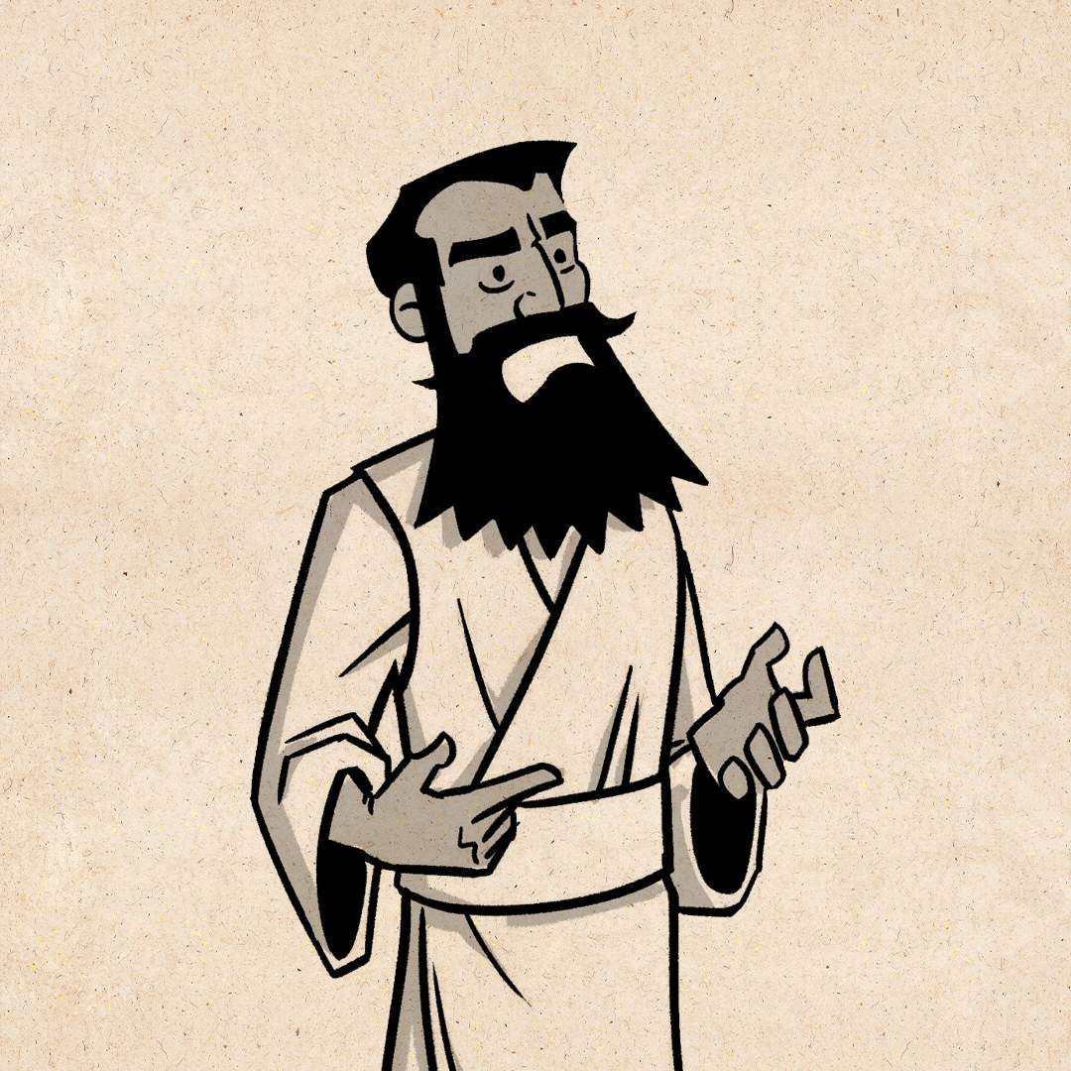
Who is Hosea?
His name means “Salvation”
From the Northern Kingdom; Israel
Minor Prophet
Called by God to Prophesy to the Israel
Aka: “death-bed prophet of Israel”
Ministry: 755-722 B.C. (2 Kings 15-17)
Called by God to marry…
Notes:
So, if you would like to follow along, we’re in the book of Hosea. If you’re not familiar with Hosea his name means “Salvation”, he was from the northern kingdom, Israel, and is considered a minor prophet. As a reminder, minor prophet doesn’t determine his significance, but rather signifies how much writing he has done. Major prophets have big books, minor have smaller books.
God called Hosea to prophecy to Israel. God had a message he had been trying to deliver for 100’s of years through the other prophets and Hosea was the last chance. Which is why some call him the “death-bed prophet of Israel”. Because Israel is on their death-bed and Hosea must once again tell them to turn away from their evil ways. His ministry lasted between 755-710 B.C.
One significant attribute of Hosea was his call to marry.

Slide 6
Called by God to Marry…
² When the Lord began to speak through Hosea, the Lord said to him, “Go, marry a promiscuous woman and have children with her, [...] ³ So he married Gomer daughter of Diblaim, and she conceived and bore him a son.
Hosea 1:2a, 3 NIV
Notes:
One significant attribute of Hosea was his call to marry. Hosea was called by God to marry a promiscuous woman.
And this is where our love story begins.

Slide 7
The Love Story
Notes:
Hosea was called to marry a promiscuous woman. First, you could imagine Hosea’s surprise when God said, “Go marry a promiscuous woman.” I’m confident that was not on Hosea’s list of attributes for his dream women. But, in Hosea’s obedience to God he went out and found a woman. Her name was Gomer. Hosea loved Gomer deeply, they married, and she bore him a son. But during their marriage Gomer began turning to other men. Using her fine linen, jewelry and perfumes purchased through the Hosea’s labor, she would lure men into bed with her. Over time, she had two more children, one a girl and the other a boy. Gomer’s promiscuity went so far, they aren’t even sure these children were Hosea’s or another man’s. Maybe it was Gomer’s shame, maybe it was her extreme lust and desire for other men, but she eventually turned her back completely to Hosea. She found herself in the arms of another man.

Slide 8
Called by God to Marry…
² When the Lord began to speak through Hosea, the Lord said to him, “Go, marry a promiscuous woman and have children with her, for like an adulterous wife this land is guilty of unfaithfulness to the Lord.” ³ So he married Gomer daughter of Diblaim, and she conceived and bore him a son.
Hosea 1:3 NIV
Notes:
But God knew this story all too well. God was actually trying to personify His relationship with Israel through Hosea’s relationship with his wife Gomer.

Slide 9
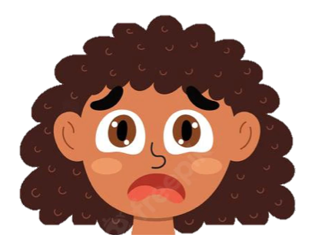
Children of Hosea & Gomer
Notes:
God used the names of Gomer and Hosea’s children to drive home a point.

Slide 10
⁴ And the Lord said to him, “Call his name Jezreel, for in just a little while I will punish the house of Jehu for the blood of Jezreel, and I will put an end to the kingdom of the house of Israel. ⁵ And on that day I will break the bow of Israel in the Valley of Jezreel.”
Hosea 1:4-5
Jezreel
Aka “Scattered”
Notes:
Their first child, God told Hosea to name him Jezreel means “Scattered”. God had two things to say here. First, God will scatter the people of Israel because of their sin; because of this promiscuity. Second,

Slide 11
Massacre of Jezreel
⁶ Then he wrote to them a second letter, saying, “If you are on my side, and if you are ready to obey me, take the heads of your master’s sons and come to me at Jezreel tomorrow at this time.” Now the king’s sons, seventy persons, were with the great men of the city, who were bringing them up. ⁷ And as soon as the letter came to them, they took the king’s sons and slaughtered them, seventy persons, and put their heads in baskets and sent them to him at Jezreel.
¹¹ So Jehu struck down all who remained of the house of Ahab in Jezreel, all his great men and his close friends and his priests, until he left him none remaining.
2 Kings 10:6–7; 10–11 ESV
Notes:
To punish the house of Jehu for the blood of Jezreel. That might sound a bit odd, but God was sending a reminder here for some activities that occurred in 2 Kings 10. There was a Massacre that was associate with the valley of Jezreel. Jehu was not happy with what king Ahab, King of Israel at the time, was doing. He had married Jezebel, brought Baal to the kingdom and a whole host of other terrible things. Jehu took it upon himself to kill the entire lineage and all associates of Ahab.
God was not entirely pleased with this action and by naming Hosea’s first born Jezreel his message was clear. “I will avenge the massacre of the house of Ahab” and “I will scatter the people of Israel.”

Slide 12
⁶ She conceived again and bore a daughter. And the Lord said to him, “Call her name No Mercy, for I will no more have mercy on the house of Israel, to forgive them at all. ⁷ But I will have mercy on the house of Judah, and I will save them by the Lord their God. I will not save them by bow or by sword or by war or by horses or by horsemen.”
Hosea 1:6-7
Lo-Ruhamah
Aka “No Mercy”
Notes:
The second child of Gomer was called by God to be named Lo-Ruhammah, which means “No Mercy”.
God was letting the people of Israel know that He will not be having mercy on them. He had given them 100’s of years, many generations to turn away from their wicked ways. He had been patient sending them warning after warning, but they were still doing their own thing.

Slide 13
God’s Mercy on Judah; 701 B.C.
³² “Therefore thus says the Lord concerning the king of Assyria: He shall not come into this city or shoot an arrow there, or come before it with a shield or cast up a siege mound against it. ³³ By the way that he came, by the same he shall return, and he shall not come into this city, declares the Lord. ³⁴ For I will defend this city to save it, for my own sake and for the sake of my servant David.”
³⁵ And that night the angel of the Lord went out and struck down 185,000 in the camp of the Assyrians. And when people arose early in the morning, behold, these were all dead bodies.
2 Kings 19:32–35 ESV
Notes:
Now, a bit of an aside in this passage, God says he will have mercy on the house of Judah. Now this is a pretty cool story we’re not going to go too deep with, but I thought worth calling out. God says here he will save the people of Israel, but not by bow or sword or war or horses or horsemen…
God sent an angel…

Slide 14
⁸ When she had weaned No Mercy, she conceived and bore a son. ⁹ And the Lord said, “Call his name Not My People, for you are not my people, and I am not your God.”
Hosea 1:8-9
Lo-Ammi
Aka “Not My People”
Notes:
Finally, Gomer had her third child and this one was to be called Lo-Ammi, “Not my people”. This was a sort of divorce statement. The people of Israel had turned their back to God.

Slide 15
⁸ And she did not know that it was I who gave her the grain, the wine, and the oil, and who lavished on her silver and gold, which they used for Baal.
Hosea 2:8 ESV
Notes:
See, the people of Israel had turned their back to God completely. They were using their gifts from God in sacrifice to another god.
Just as Gomer was not only adulterous but also using her gifts from her husband, Hosea, so were the people of Israel. The people of Israel were committing spiritual adultery. They had turned their backs from God and found themselves in the arms of another god using the gifts given to them by the one and only God.

Slide 16
¹¹ And I will put an end to all her mirth, her feasts, her new moons, her Sabbaths, and all her appointed feasts. ¹² And I will lay waste her vines and her fig trees, of which she said, ‘These are my wages, which my lovers have given me.’ I will make them a forest, and the beasts of the field shall devour them. ¹³ And I will punish her for the feast days of the Baals when she burned offerings to them and adorned herself with her ring and jewelry, and went after her lovers and forgot me, declares the Lord.
Hosea 2:11-13 ESV
Notes:
Eventually God could stand it no more. He said he will punish Israel for their sin. I will take away everything that He has given them to help them realize from where it came.

Slide 17
¹⁴ “Therefore, behold, I will allure her, and bring her into the wilderness, and speak tenderly to her.
Hosea 2:14
Notes:
But God was not finished with the people of Israel. The end of the story isn’t God’s punishment, it’s His redemption.
Sometimes, God must bring us to our knee’s before we’ll listen. Sometimes, we need to be sent to the wilderness where we are silenced by the removal of all our things, the removal of all our other idols before we can listen. But God says here He will be speaking tenderly to her in the wilderness.

Slide 18
¹⁰ Yet the number of the children of Israel shall be like the sand of the sea, which cannot be measured or numbered. And in the place where it was said to them, “You are not my people,” it shall be said to them, “Children of the living God.” ¹¹ And the children of Judah and the children of Israel shall be gathered together, and they shall appoint for themselves one head. And they shall go up from the land, for great shall be the day of Jezreel.
2 Say to your brothers, “You are my people,” and to your sisters, “You have received mercy.”
Hosea 1:10-2:1 ESV
Notes:
We have redemption.

Slide 19
²³ and I will sow her for myself in the land. And I will have mercy on No Mercy, and I will say to Not My People, ‘You are my people’; and he shall say, ‘You are my God.’ ”
Hosea 2:23
Notes:
God goes on to say…
Remember, Jezreel’s name meant to scatter. God says he will sow the scatter seeds of Israel. He tells Hosea to do the same thing.

Slide 20
3 And the Lord said to me, “Go again, love a woman who is loved by another man and is an adulteress, even as the Lord loves the children of Israel, though they turn to other gods and love cakes of raisins.” ² So I bought her for fifteen shekels of silver and a homer and a lethech of barley. ³ And I said to her, “You must dwell as mine for many days. You shall not play the whore, or belong to another man; so will I also be to you.” ⁴ For the children of Israel shall dwell many days without king or prince, without sacrifice or pillar, without ephod or household gods. ⁵ Afterward the children of Israel shall return and seek the Lord their God, and David their king, and they shall come in fear to the Lord and to his goodness in the latter days.
Hosea 3:1–5 ESV
Notes:
Now this is a Love story. It doesn’t start off how we might imagine. It’s not today’s romcom, it’s God’s love story. This is God’s love story for us. God is constantly pursuing us to turn to Him. He doesn’t give up on us and even when we’re unfaithful, when we’re turning to other gods, other things of worship, when we’re not using our spiritual gifts to forward God’s kingdom. He loves us. He loves us so much he sent His only son, Jesus, as a sacrifice to our constant sin. God teaches us so much in this story. God teaches us His limitless love, endless devotion, and massive sacrifice for us.

Slide 21
Love is not
Just a matter of the heart.
It’s also the matter of the will.
God chooses to love us even when we are unfaithful.
Notes:
But He also teaches us that “Love is not just a matter of the heart, it’s also the matter of the will.” God CHOOSES to love us even when we are unfaithful.

Slide 22
¹⁶ “For God so loved the world, that he gave his only Son, that whoever believes in him should not perish but have eternal life. ¹⁷ For God did not send his Son into the world to condemn the world, but in order that the world might be saved through him.
John 3:16–17

Slide 23
THE END

Slide 24
God Teaches us by Example
Story of Redemption, Sacrifice, and Humility
He Teaches us through His display of…
Mercy
Grace
Patience
Devotion
Notes:
“Those that think the God of the old testament is a God of Judgement and the God of the New Testament is a God of Love should spend some time here in Hosea” Amplified Study Bible
Hosea is a Love Story; God’s endless/relentless pursuit for us
God never stops loving us; He takes an active role in pursuing us
We are all guilty of unfaithfulness to God; not just in live, today
God does not condone our sins; He just love us

Slide 25
⁴ Love is patient and kind; love does not envy or boast; it is not arrogant ⁵ or rude. It does not insist on its own way; it is not irritable or resentful; ⁶ it does not rejoice at wrongdoing, but rejoices with the truth. ⁷ Love bears all things, believes all things, hopes all things, endures all things.
1 Corinthians 13:4–7

Slide 26
Verses
Hosea’s Wife and Children
² When the Lord first spoke through Hosea, the Lord said to Hosea, “Go, take to yourself a wife of whoredom and have children of whoredom, for the land commits great whoredom by forsaking the Lord.” ³ So he went and took Gomer, the daughter of Diblaim, and she conceived and bore him a son.
⁴ And the Lord said to him, “Call his name Jezreel, for in just a little while I will punish the house of Jehu for the blood of Jezreel, and I will put an end to the kingdom of the house of Israel. ⁵ And on that day I will break the bow of Israel in the Valley of Jezreel.”
⁶ She conceived again and bore a daughter. And the Lord said to him, “Call her name No Mercy, for I will no more have mercy on the house of Israel, to forgive them at all. ⁷ But I will have mercy on the house of Judah, and I will save them by the Lord their God. I will not save them by bow or by sword or by war or by horses or by horsemen.”
⁸ When she had weaned No Mercy, she conceived and bore a son. ⁹ And the Lord said, “Call his name Not My People, for you are not my people, and I am not your God.”
¹⁰ Yet the number of the children of Israel shall be like the sand of the sea, which cannot be measured or numbered. And in the place where it was said to them, “You are not my people,” it shall be said to them, “Children of the living God.” ¹¹ And the children of Judah and the children of Israel shall be gathered together, and they shall appoint for themselves one head. And they shall go up from the land, for great shall be the day of Jezreel.
2 Say to your brothers, “You are my people,” and to your sisters, “You have received mercy.”
The Holy Bible: English Standard Version (Wheaton, IL: Crossway Bibles, 2016), Ho 1:2–2:1.

Slide 27
¹ Say to your brothers, “You are my people,” and to your sisters, “You have received mercy.” ² “Plead with your mother, plead— for she is not my wife, and I am not her husband— that she put away her whoring from her face, and her adultery from between her breasts; ³ lest I strip her naked and make her as in the day she was born, and make her like a wilderness, and make her like a parched land, and kill her with thirst. ⁴ Upon her children also I will have no mercy, because they are children of whoredom. ⁵ For their mother has played the whore; she who conceived them has acted shamefully. For she said, ‘I will go after my lovers, who give me my bread and my water, my wool and my flax, my oil and my drink.’ ⁶ Therefore I will hedge up her way with thorns, and I will build a wall against her, so that she cannot find her paths. ⁷ She shall pursue her lovers but not overtake them, and she shall seek them but shall not find them. Then she shall say, ‘I will go and return to my first husband, for it was better for me then than now.’ ⁸ And she did not know that it was I who gave her the grain, the wine, and the oil, and who lavished on her silver and gold, which they used for Baal. ⁹ Therefore I will take back my grain in its time, and my wine in its season, and I will take away my wool and my flax, which were to cover her nakedness. ¹⁰ Now I will uncover her lewdness in the sight of her lovers, and no one shall rescue her out of my hand. ¹¹ And I will put an end to all her mirth, her feasts, her new moons, her Sabbaths, and all her appointed feasts. ¹² And I will lay waste her vines and her fig trees, of which she said, ‘These are my wages, which my lovers have given me.’ I will make them a forest, and the beasts of the field shall devour them. ¹³ And I will punish her for the feast days of the Baals when she burned offerings to them and adorned herself with her ring and jewelry, and went after her lovers and forgot me, declares the Lord. ¹⁴ “Therefore, behold, I will allure her, and bring her into the wilderness, and speak tenderly to her. ¹⁵ And there I will give her her vineyards and make the Valley of Achor a door of hope. And there she shall answer as in the days of her youth, as at the time when she came out of the land of Egypt. ¹⁶ “And in that day, declares the Lord, you will call me ‘My Husband,’ and no longer will you call me ‘My Baal.’ ¹⁷ For I will remove the names of the Baals from her mouth, and they shall be remembered by name no more. ¹⁸ And I will make for them a covenant on that day with the beasts of the field, the birds of the heavens, and the creeping things of the ground. And I will abolish the bow, the sword, and war from the land, and I will make you lie down in safety. ¹⁹ And I will betroth you to me forever. I will betroth you to me in righteousness and in justice, in steadfast love and in mercy. ²⁰ I will betroth you to me in faithfulness. And you shall know the Lord. ²¹ “And in that day I will answer, declares the Lord, I will answer the heavens, and they shall answer the earth, ²² and the earth shall answer the grain, the wine, and the oil, and they shall answer Jezreel, ²³ and I will sow her for myself in the land. And I will have mercy on No Mercy, and I will say to Not My People, ‘You are my people’; and he shall say, ‘You are my God.’ ”
Hosea 2:1–23 (ESV)

Slide 28
Verses
Hosea Redeems His Wife
3 And the Lord said to me, “Go again, love a woman who is loved by another man and is an adulteress, even as the Lord loves the children of Israel, though they turn to other gods and love cakes of raisins.” ² So I bought her for fifteen shekels of silver and a homer and a lethech of barley. ³ And I said to her, “You must dwell as mine for many days. You shall not play the whore, or belong to another man; so will I also be to you.” ⁴ For the children of Israel shall dwell many days without king or prince, without sacrifice or pillar, without ephod or household gods. ⁵ Afterward the children of Israel shall return and seek the Lord their God, and David their king, and they shall come in fear to the Lord and to his goodness in the latter days.
The Holy Bible: English Standard Version (Wheaton, IL: Crossway Bibles, 2016), Ho 3:1–5.

