Slide 1
Ezekiel's Warning Pride
Ezekiel 28:11-19, 25-26
Notes:
As I was studying the scripture for today I could feel it was directed at me, at us.
Pride is such a tough topic because it spans beyond just the boastful, the chest being pumped out. It also includes those that think less of themselves.
A lot of big, high stake meetings the last few weeks.
I’m come off them feeling like a home run.
So much as the CEO has gone out of their way to tell me “great job” and I give them a modest thanks but in my head I’m think “you nailed it”
In preparation I prayed, the morning of I prayed, just before the meeting I prayed, and leading up to my turn I was praying. I speak, it goes well, and I feel pride… but why?

Slide 2
⁶ I have applied all these things to myself and Apollos for your benefit, brothers, that you may learn by us not to go beyond what is written, that none of you may be puffed up in favor of one against another. ⁷ For who sees anything different in you? What do you have that you did not receive? If then you received it, why do you boast as if you did not receive it?
1 Corinthians 4:6–7
Notes:
Paul says to the Corinth the same thing…
There are other times I’ve felt not good enough, smart enough, athletic enough… Like I’m not worthy and try to turn away gifts.
These are gifts from God…who am I to say these things?

Slide 3
Everyone who is arrogant in heart is an abomination to the Lord; be assured, he will not go unpunished.
Proverbs 16:5
Notes:
And while listening to pastors speak on this topic I came across this scripture which hit home.
[read it]
An Abomination to the Lord. In my pride God is ehhh. He doesn’t want that for me, he doesn’t want that for you, he doesn’t want that for us.

Slide 4
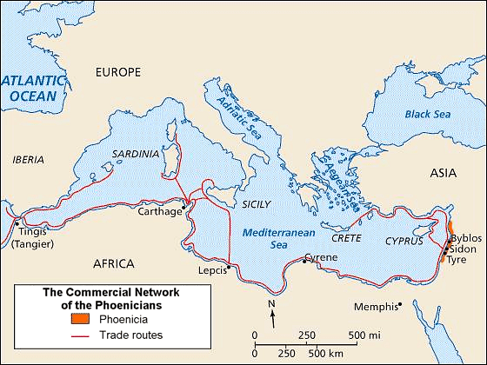
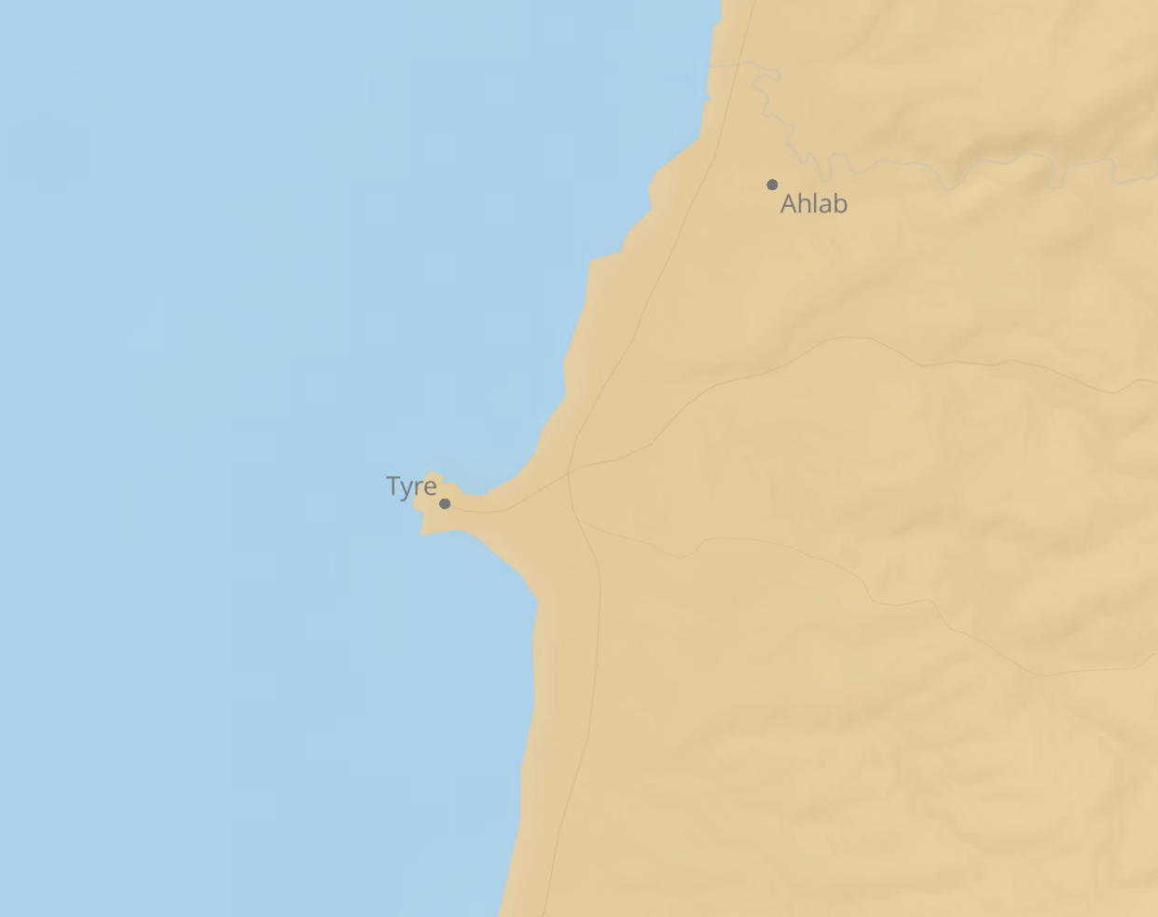
Tyre
Trade Center of the Mediterranean
Prosperous & Growing
Innovative & Educated
Defensible and Strategically Located
Notes:
Sydon
Anything going into Syria, Babylon, or even Persia would likely come through Tire.
Tyre, the largest and most important city-state of Phoenicia,
located both on the Mediterranean coast as well as a nearby island with two natural harbours on the landward side.
The island lay about a kilometre from the coast in Alexander’s days, its high walls reaching 45.8 m (150 ft) above the sea on the eastern, landward facing, side of the island.
“Alexander built a causeway. After months of frustration he took the city by costly storming. Tyre was broken, and the causeway still remains, now as a place, as Exekiel foretold, on which fiserhman dry their nets (Ezekiel 26:5, 14, 47:10)
https://en.wikipedia.org/wiki/Siege_of_Tyre_(332_BC)

Slide 5
How did the City of Tyre shore up (pun intended)?
Education
Competitiveness
Innovation and Technology
Economic Output
Share of World Trade
Military Strength
Financial Center Strength
Reserve Currency Status
Ezekiel 28:12b – Wisdom
Epicenter for trade in the area
Boats, Alphabet, Numeric System, Tyrian Purple
Most important city of Phoenicia
Copper of Cyprus, Silver of Spain, Tin of Cornwall, and Cedar for Solomons temple
Easily defended terrain
Ezekiel 28:13 - Wealth
Principles for Dealing with The Changing World Order Why Nations Succeed and Fail ~ Ray Dalio
Notes:
8 Determinants for the Rise and Decline of a Nation layed out in Ray Daiio’s book, The Changing World Order.
One could search and replace Determinants with Gifts.
Mediterranean Sea became known as the Tyrian Sea at one point
“The strain of Tyre’s resistance to Babylon and the damage to her commerce brought the city to poverty. She briefly fell under the power of Egypt and then became a dependency of Babylon, a status held until Babylon fell to Persia”

Slide 6
A Lament over the King of Tyre
¹¹ Moreover, the word of the Lord came to me: ^{12a} “Son of man, raise a lamentation over the king of Tyre, and say to him, Thus says the Lord God:
Ezekiel 28:11–12a (ESV)
Notes:
Ezekiel made it clear this was all from God. This was not his message and I imagine it wouldn’t be all that much fun to have to deliver it. He opens up here with …
Who is the King of Tyre?
Some scholars believe God is referring to Satan; however, others believe He is referring to (ETH Baal) Ithobaal III, who was the King of Tyre during the time of this passage. We’re going to stick with the ladder interpretations because the depth we would need to go into just to tease out the literal vs figurative context would take 3-4 weeks alone.

Slide 7
God’s Gifts
“You were the signet of perfection, full of wisdom and perfect in beauty. ¹³ You were in Eden, the garden of God; every precious stone was your covering, sardius, topaz, and diamond, beryl, onyx, and jasper, sapphire, emerald, and carbuncle; and crafted in gold were your settings and your engravings. On the day that you were created they were prepared. ¹⁴ You were an anointed guardian cherub. I placed you; you were on the holy mountain of God; in the midst of the stones of fire you walked. ¹⁵ You were blameless in your ways from the day you were created, till unrighteousness was found in you.
Ezekiel 28:12b–15
Notes:
God prepared all of these things when he was created. – on/from the day you were created

Slide 8
Pride
¹⁶ In the abundance of your trade you were filled with violence in your midst, and you sinned; so I cast you as a profane thing from the mountain of God, and I destroyed you, O guardian cherub, from the midst of the stones of fire. ¹⁷ Your heart was proud because of your beauty; you corrupted your wisdom for the sake of your splendor.
Ezekiel 28:16–17a
Notes:
Pride is hard…
I grew up, probably like most of you, with the saying "You can do anything you set your mind to”.
Where this isn’t a necessarily bad mindset it’s acknowledging that it’s from God these things are provided.

Slide 9
Your heart was PROUD because of your beauty
Notes:
[ME]
Our culture tells us to be proud.
We see it as not that bad; we actually encourage it.
We call it:
”Believing in yourself”
“Building yourself up”

Slide 10
The Great Sin
According to Christian teachers, the essential vice, the utmost evil, is pride. Unchastity, anger, greed, drunkenness, and all that are mere fleabites in comparison. It was through pride that the Devil became the Devil: Pride leads to every other vice. It is the complete anti-God state of mind.
C.S. Lewis
Notes:
But we have to be careful.
Pride sits beneath all sin, at every end of the spectrum. Pride is the source of our anxiety, Pride is the source of our Anger, Pride is the source of our Lust.
It’s pride that puts us in these bad situations, but for a lot of us it’s hard to admit your prideful. For others, not so much.

Slide 12
How to Identify Pride
Are you anxious?
Are you critical of others?
Are you defensive when someone points out sin in your life? Do you justify?
Do you quickly identify pride in others?
Do you seek out others approval? Are you insecure?
Do you take advantage of God’s grace?
Do you feel shame?
Do you feel your sin or broken is greater than God’s grace?
Notes:
Open to the possibility that you’re proud
[Purple heart story]
You might be saying, I’m not prideful. “I’m ugly, I’m awful, I’m pitiful”. That is pride my friend. What you're saying is you know better than God. That He didn't do a good job.
“This is God’s universe and God does things His way. Now you may have a better way, but you don’t have a universe.”
See, Pride is drawing attention to ourselves.
The source of anxiety is Pride. The solution is humility.
Why are you anxious?
Are you not Absolutely loved, provided for, and absolutely protected

Slide 13
The Fall
^{17b} I cast you to the ground; I exposed you before kings, to feast their eyes on you. ¹⁸ By the multitude of your iniquities, in the unrighteousness of your trade you profaned your sanctuaries; so I brought fire out from your midst; it consumed you, and I turned you to ashes on the earth in the sight of all who saw you. ¹⁹ All who know you among the peoples are appalled at you; you have come to a dreadful end and shall be no more forever.”
Ezekiel 28:17b–19
Notes:
So, what happened to Tire in their pride?
But there is hope here. It’s neither too late nor are we without options.
US Parallels: Riots,

Slide 14
pride is overcome with Humility

Slide 15
Do not imagine that if you meet a really humble man he will be what most people call ‘humble’ nowadays: he will not be a sort of greasy, smarmy person, who is always telling you that, of course, he is nobody. Probably all you will think about him is that he seemed a cheerful, intelligent chap who took a real interest in what you said to him. If you do dislike him it will be because you feel a little envious of anyone who seems to enjoy life so easily. He will not be thinking about humility: he will not be thinking about himself at all.
If anyone would like to acquire humility, I can, I think, tell him the first step. The first step is to realize that one is proud. And a biggish step, too. At least, nothing whatever can be done before it. If you think you are not conceited, it means you are very conceited indeed.
C.S. Lewis, Mere Christianity, Book 3, Chapter 8, “The Great Sin,”

Slide 16
Everyone who is arrogant in heart is an abomination to the Lord; be assured, he will not go unpunished.
Proverbs 16:5
Notes:
I’d like to bring this one back as a reminder. And abomination…

Slide 17
Humility, How To
Give God all the Credit
1 Corinthians 1:28–31 & 1 Corinthians 4:6–7
Depend on God’s Providence
James 4:13–17
Serve Others
Philippians 2:3–8
“The root of Christian humility is the Gospel: that Christ died for our sins.” ~ John Piper
Notes:
Humility happily admits everything is a free gift of God
Whatever talents, intelligence, skills, looks, pedigree’s, influence, wit… Put away all pride it’s all a gift.
Put away all despair
If you think your gifts are large, put away pride. If you think your gifts are small, put away pride. They’re gifts from God
Humility is glad that God gets the credit for choosing us
Humility is glad to affirm that God sovereignly governs the heart beats of our life
Humility agrees and is glad that every beat of my heart is a gift from God. Will only keep beating if God chooses it.
If God will’s it, we will live through the rest of this message or not.
If God will’s it, 2022 will be amazing
Humility doesn’t want to be in charge; I am not God
If the Lord will’s we will live.
Humility gives itself away in serving everyone rather than seeking to be served
Humility Serves
Leaders get down under and put their shoulder (Getting down low and lifting others up)
The son of man came not to be served but to serve others. We need a servant who dies for us, who sustains us, who provides for us. You are being served all day long, everyday.
Humility measures everything, not by how it will stroke my ego or enhance my reputation, but how it will serve the good of others.
The root of Christianity humility is the Gospel: that Christ died for our sins
The humble willingness to forgive an offense is rooted in being forgiven by Jesus. Only talking about Gospel humility. Rooted in being forgiven. Knowing yourself as a sinner needing to be forgiven.
Humility is glad to affirm that this service is true greatness.
Humility Loves to say God chose me; I didn’t choose Him

Slide 18
“Humility is not thinking less of yourself, but thinking of yourself less.”

Slide 19
The End

Slide 20
NOTES

Slide 21
Me, We, God, You, We
What do they need to know?
Pride leads to a fall
Why do they need to know it?
So they can better combat other sin in their lives
What do they need to do?
Learn how to be humble
Why do they need to do it?
Humility brings us closer to God by removing ourselves from the picture
How can I help them remember?
????

Slide 22
https://youtu.be/tPnv3PKd1FQ
Open to the possibility that you’re proud
Proverbs 16:5 – The pride is an abomination
Think about how God looks at the prideful
We see it as not that bad; we encourage it:
”Believing in yourself”
“Building yourself up”
We want to draw attention to ourselves.
Can still be prideful: look how pitiful, come council me, look how ugly I look, look how awful I am
Everything we do, do it to the Glory of God.
Who cares what they think about me, I care what they think about God
“This is God’s universe and God does things His way. Now you may have a better way, but you don’t have a universe.”

Slide 23
https://youtu.be/SnfGONp1vrI
Finding the identity in Success
Leaning on your own gifts – a sin
The essential vice, the utmost evils is Pride. It was through Pride the devil became the devil
Pride says, I want to be like God
The biggest struggle in the room today
Pride is the source of your anxiety – Trace it back to Pride
Are you anxious? Are you critical of others? Are you defensive when someone points out sin in your life? Do you justify? Do you quickly identify pride in others? Do you seek out others approval? Are you insecure? Do you take advantage of God’s grace? Do you feel shame? Do you feel your sin or broken is greater than God’s grace? Do you believe your worthless?
1 Peter 5
The source of anxiety is Pride. The solution is humility.
Absolutely loved, provided for, and absolutely protected
Recovery starts with humility
God helps the humble

Slide 24
Combating Pride 1
https://youtu.be/pNCpObSRbYY
Give God the Credit
Humility agrees and is glad that God gets all the credit
Humility Loves to say God chose me; I didn’t choose Him
1 Corinthians 1:26-31
Recognize God’s Gifts
Humility agrees and is glad that everything is a gift from God
Whatever talents, intelligence, skills, looks, pedigree’s, influence, wit… Put away all pride it’s all a gift.
Put away all despair, it’s a gift from God
If you think your gifts are large, put away pride. If you think your gifts are small, put away pride. They’re gifts from God
1 Corinthians 4:6-7
Depend on God’s Providence
Humility agrees and is glad that every beat of my heart is a gift from God. Will only keep beating if God chooses it.
If God will’s it, we will live through the rest of this message or not.
If God will’s it, 2022 will be amazing
Humility doesn’t want to be in charge; I am not God
If the Lord will’s we will live.
James 4:13-17
1

Slide 25
Combating Pride 2
https://youtu.be/pNCpObSRbYY
Cherish the Gospel
The humble willingness to forgive an offense is rooted in being forgiven by Jesus. Only talking about Gospel humility. Rooted in being forgiven. Knowing yourself as a sinner needing to be forgiven.
Colossians 3:12-13
Serve Others
Humility Serves
Getting down low and lifting others up
Leaders get down under and put their shoulder
The son of man came not to be served but to serve others. We need a servant who dies for us, who sustains us, who provides for us. You are being served all day long, everyday.
Humility measures everything, not by how it will stroke my ego or enhance my reputation, but how it will serve the good of others.
Philippians 2:3
2

Slide 26
Combating Pride 3
https://youtu.be/pNCpObSRbYY
Know True Greatness
Humility and Servanthood
Whoever would be great among you must be your servant
Whoever would be first among you must be slave of all
Humility is glad that God gets the credit for choosing us
Humility happily admits everything is a free gift of God
Humility is glad to affirm that God sovereignly governs the heart beats of our life
The root of Christianity humility is the Gospel: that Christ died for our sins
Humility gives itself away in serving everyone rather than seeking to be served
Humility is glad to affirm that this service is true greatness.
3

Slide 27
Words
Lament: Mourning
Tyre
King of Tyre
Cherub
Blameless
Expelled in Disgrace
Profaned
Appalled

Slide 28
Ezekiel
Son of Buzi, descendant of Zadok
Grew up in Judah and was deported to Babylon (exiled)
5th year of captivity called to be a prophet
Ministry of about 22 years (593-571 B.C.)
He was married

Slide 29
Tyre
Located in Phoenicia
25 miles south of Sidon
15 miles north of Lebanese border with Israel
Backed up to mountain which helped protect the city

Slide 30
EXTRA SLIDES

Slide 31
Humility is not about putting yourself down; that’s false humility. Humility is about lifting others up. If I am about me, I am selfish. If I am about you, I am humble.
Steve Poe, Creatures of Habit, Chapter 1, “Pride”

Slide 32
3 parts to the book of Ezekiel
Denunciation of Judah and Israel
Ezekiel 1-24; dated 593-588 B.C.
Oracles against foreign nations
Ezekiel 25-32; dated 587-571
Future restoration of Israel
Ezekiel 33-48; dated 585-573
Notes:
Grew up in Judah and was deported to Babylon (exiled)
Ezekiel received these prophecies while in Exile in Babylon
He was married and it was shortly after his wife’s death he began
5th year of captivity called to be a prophet
Ministry of about 22 years (593-571 B.C.)
One of the four Major Prophets: Isaiah, Jeremiah, Ezekiel and Daniel

Slide 33
A Lament over the King of Tyre
¹¹ Moreover, the word of the Lord came to me: ^{12a} “Son of man, raise a lamentation over the king of Tyre, and say to him, Thus says the Lord God:
Ezekiel 28:11–12a (ESV)
Notes:
Ezekiel made it clear this was all from God. This was not his message and I imagine it wouldn’t be all that much fun to have to deliver it. He opens up here with …
Who is the King of Tyre?
Some scholars believe God is referring to Satan; however, others believe He is referring to (ETH Baal) Ithobaal III, who was the King of Tyre during the time of this passage. We’re going to stick with the ladder interpretations because the depth we would need to go into just to tease out the literal vs figurative context would take 3-4 weeks alone.

Slide 34
God’s Gifts to Tyre
“You were the signet of perfection, full of wisdom and perfect in beauty. ¹³ You were in Eden, the garden of God; every precious stone was your covering, sardius, topaz, and diamond, beryl, onyx, and jasper, sapphire, emerald, and carbuncle; and crafted in gold were your settings and your engravings. On the day that you were created they were prepared. ¹⁴ You were an anointed guardian cherub. I placed you; you were on the holy mountain of God; in the midst of the stones of fire you walked. ¹⁵ You were blameless in your ways from the day you were created, till unrighteousness was found in you.
Ezekiel 28:12b–15
Notes:
God prepared all of these things when he was created. – on/from the day you were created

Slide 35
Pride
¹⁶ In the abundance of your trade you were filled with violence in your midst, and you sinned; so I cast you as a profane thing from the mountain of God, and I destroyed you, O guardian cherub, from the midst of the stones of fire. ¹⁷ Your heart was proud because of your beauty; you corrupted your wisdom for the sake of your splendor.
Ezekiel 28:16–17a
Notes:
Pride is hard…
We tend to get

Slide 36
The Fall
^{17b} I cast you to the ground; I exposed you before kings, to feast their eyes on you. ¹⁸ By the multitude of your iniquities, in the unrighteousness of your trade you profaned your sanctuaries; so I brought fire out from your midst; it consumed you, and I turned you to ashes on the earth in the sight of all who saw you. ¹⁹ All who know you among the peoples are appalled at you; you have come to a dreadful end and shall be no more forever.”
Ezekiel 28:17b–19

Slide 37
Gods Promise
²⁵ “Thus says the Lord God: When I gather the house of Israel from the peoples among whom they are scattered, and manifest my holiness in them in the sight of the nations, then they shall dwell in their own land that I gave to my servant Jacob. ²⁶ And they shall dwell securely in it, and they shall build houses and plant vineyards. They shall dwell securely, when I execute judgments upon all their neighbors who have treated them with contempt. Then they will know that I am the Lord their God.”
Ezekiel 28:25–26

Slide 39
Video – Your Own Works

Slide 40
Motivational Video
“You” is used 27 times (Every ~6.5 seconds )
“You’re going to make mistakes, you have to own them, you have to make amends, and move on”
“You are the author of the book of your life.”
“You’re born with a gift; if not that you’ll get good at something along the way”
“We do our best when our destinations are beyond measurements, when our reach continually exceeds our grasp, when we have immortal finish lines”
Notes:
Our culture tells us to be proud.
We see it as not that bad; we encourage it:
”Believing in yourself”
“Building yourself up”

Slide 41
Humility
³ Do nothing from selfish ambition or conceit, but in humility count others more significant than yourselves. ⁴ Let each of you look not only to his own interests, but also to the interests of others. ⁵ Have this mind among yourselves, which is yours in Christ Jesus, ⁶ who, though he was in the form of God, did not count equality with God a thing to be grasped, ⁷ but emptied himself, by taking the form of a servant, being born in the likeness of men. ⁸ And being found in human form, he humbled himself by becoming obedient to the point of death, even death on a cross. ⁹ Therefore God has highly exalted him and bestowed on him the name that is above every name, ¹⁰ so that at the name of Jesus every knee should bow, in heaven and on earth and under the earth, ¹¹ and every tongue confess that Jesus Christ is Lord, to the glory of God the Father.
Philippians 2:3–11

Slide 42
Clothe yourselves, all of you, with humility toward one another, for “God opposes the proud but gives grace to the humble.”
⁶ Humble yourselves, therefore, under the mighty hand of God so that at the proper time he may exalt you, ⁷ casting all your anxieties on him, because he cares for you. ⁸ Be sober-minded; be watchful. Your adversary the devil prowls around like a roaring lion, seeking someone to devour. ⁹ Resist him, firm in your faith, knowing that the same kinds of suffering are being experienced by your brotherhood throughout the world. ¹⁰ And after you have suffered a little while, the God of all grace, who has called you to his eternal glory in Christ, will himself restore, confirm, strengthen, and establish you. ¹¹ To him be the dominion forever and ever. Amen.
1 Peter 5:5–11

Slide 43
³ Because of the privilege and authority God has given me, I give each of you this warning: Don’t think you are better than you really are. Be honest in your evaluation of yourselves, measuring yourselves by the faith God has given us.
Romans 12:3 (NLT)

Slide 44
Give God All The Credit
²⁸ God chose what is low and despised in the world, even things that are not, to bring to nothing things that are, ²⁹ so that no human being might boast in the presence of God. ³⁰ And because of him you are in Christ Jesus, who became to us wisdom from God, righteousness and sanctification and redemption, ³¹ so that, as it is written, “Let the one who boasts, boast in the Lord.”
1 Corinthians 1:28–31
Notes:
Give God the Credit
Humility agrees and is glad that God gets all the credit
Humility Loves to say God chose me; I didn’t choose Him
1 Corinthians 1:26-31

Slide 45
Know True Greatness
⁴² And Jesus called them to him and said to them, “You know that those who are considered rulers of the Gentiles lord it over them, and their great ones exercise authority over them. ⁴³ But it shall not be so among you. But whoever would be great among you must be your servant, ⁴⁴ and whoever would be first among you must be slave of all. ⁴⁵ For even the Son of Man came not to be served but to serve, and to give his life as a ransom for many.”
Mark 10:42–45
Notes:
Know True Greatness
Humility and Servanthood
Whoever would be great among you must be your servant
Whoever would be first among you must be slave of all

