Slide 1
Ecclesiastes 1-2
Notes:
As I started diving into Ecclesiastes
401k
Family
Career
Wealth
Career - Stress, anxiety, age, Status
Next Car we’re going to buy
Maybe it’s pleasure, but you know what? Monday always comes

Slide 2
Books of Wisdom
JOB
ECCLESIASTES
PROVERBS
For in much wisdom is much vexation, and he who increases knowledge increases sorrow.
Ecclesiastes 1:18
ESV
Notes:
Vexation = worry, frustration, annoyed
Sorrow = disappointment
The more you know, the more you realize you don’t know.
It can be frustrating knowing what should happen, but seeing a completely different outcome.

Slide 3
The words of the Preacher, the son of David, king in Jerusalem.
Ecclesiastes 1:1
ESV
Notes:
So, let’s orient ourselves in Ecclesiastes. Again, we’re kicking off in Chapters 1 & 2. Chapter 1 begins with an introduction, 1:1. What we’re seeing here is that there are two main characters of Ecclesiastes: The Preacher or Teacher (Qohelet) and the author. The author is stating that the Preacher is the son of Dave, King in Jerusalem. There’s a bit of debate here amongst scholars, but it’s generally understood that the preacher here the author is referring to is King Solomon.
Qohelet – Hebrew for leader of the assembly; speaker of assembly

Slide 4
Vanity of vanities, says the Preacher, vanity of vanities! All is vanity. What does man gain by all the toil at which he toils under the sun?
Ecclesiastes 1:2–3
ESV
Notes:
Vanity
excessive pride in or admiration of one's own appearance or achievements.
the quality of being worthless or futile.

Slide 5
הֶבֶל (hevel)
noun
vapor, breath fig. vanity — 1. lit. Elsewhere always 2. fig. of what is unsubstantial, worthless, vanity.
Notes:
38x Hevel - mist, vapor, smoke or breath
Fleeting and elusive, it’s temporary like fog
it’s in front of you but impossible to grasp
It’s like a mystery, an enigma
Life is an enigma, difficult to find and impossible to control.
it’s unpredictable, unstable, like chasing after the wind
The harder we try to grip it, the more it slips away
So, who is King Solomon, besides the son of David? Why is he so special?

Slide 6
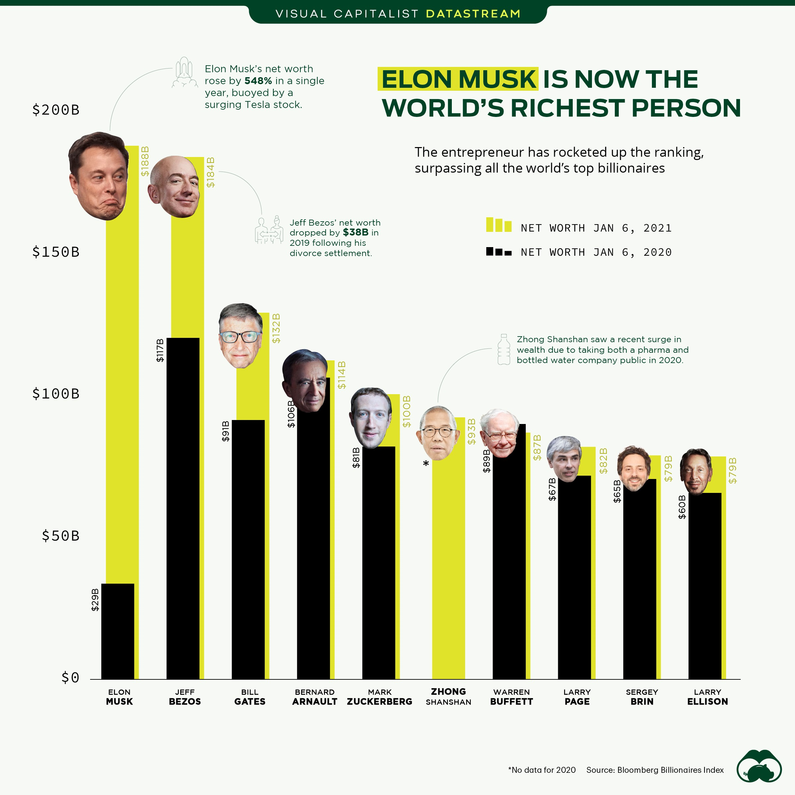
Notes:
Well, let’s get some bearings first. We know that Solomon was King in Jerusalem. We also might remember a few other facts about him but let’s first take a look at some comparisons of today. Jeff Bezos and Musk have a combine net worth of around 400 Billion dollars. These guys are loaded… One just hung out in space for a bit (didn’t get his Astronaut Wings). These guys are super powerful in our world. So, how does this compare to Solomon?
Well, Solomons net worth by comparison is estimated to be about 2.2 TRILLION! The combined network of everyone on this page doesn’t add up to half of King Solomons net worth. Next Car we’re going to buy. I mean, this guy had it all. There was nothing he desired he couldn’t have.
According to 1 Kings 4:21 ”Solomon ruled over all the kingdoms from the Euphrates to the land of the Philistines and to the border of Egypt. They brought tribute and served Solomon all the days of his life.”

Slide 7
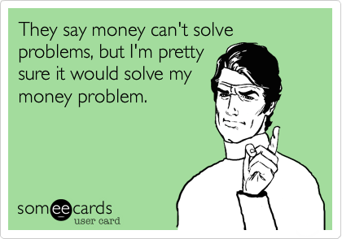
Notes:
Ok, so some rich guy is telling me that everything vapor, like chasing after the wind…
Who is this guy to tell me what is good?

Slide 8
Why Should We Listen to Solomon?

Slide 9
Then David comforted his wife, Bathsheba, and went in to her and lay with her, and she bore a son, and he called his name Solomon. And the Lord loved him and sent a message by Nathan the prophet. So he called his name Jedidiah, because of the Lord.
2 Samuel 12:24–25
ESV
Notes:
Jedidiah means “beloved of the Lord”.

Slide 10
At Gibeon the Lord appeared to Solomon in a dream by night, and God said, “Ask what I shall give you.”
1 Kings 3:5
ESV
Notes:
God loved him so much he came to him in a dream and asked ”tell me what you want”. Well that’s pretty powerful and scary question. Imagine being asked that question. What would you ask for? Money? For some problems to go away? A promotion?

Slide 11
Give your servant therefore an understanding mind to govern your people, that I may discern between good and evil, for who is able to govern this your great people?”
1 Kings 3:9
ESV
Notes:
Even in Solomons finite wisdom he humbled himself before the Lord and asked for the wisdom to properly govern God’s people.

Slide 12
It pleased the Lord that Solomon had asked this. And God said to him, “Because you have asked this, and have not asked for yourself long life or riches or the life of your enemies, but have asked for yourself understanding to discern what is right, behold, I now do according to your word. Behold, I give you a wise and discerning mind, so that none like you has been before you and none like you shall arise after you. I give you also what you have not asked, both riches and honor, so that no other king shall compare with you, all your days.
1 Kings 3:10–13
ESV
Notes:
God was pleased!

Slide 13
Solomon had God given wisdom, judgement, riches, and honor.
Notes:
So, he has some authority in this conversation. There’s something behind this guy. He’s not Bezos or Elon telling us what is good. This is a man so beloved by God that He poured great things into his life. He gave him not only a “wise and discerning mind”, but also riches and honor beyond anyone before him or anyone after him.
He was so wise people would come from all over, “from all nations”, to hear his wisdom. He spoke 3000 proverbs and over a 1000 songs.
And God gave Solomon wisdom and understanding beyond measure, and breadth of mind like the sand on the seashore, so that Solomon’s wisdom surpassed the wisdom of all the people of the east and all the wisdom of Egypt. For he was wiser than all other men, wiser than Ethan the Ezrahite, and Heman, Calcol, and Darda, the sons of Mahol, and his fame was in all the surrounding nations. He also spoke 3,000 proverbs, and his songs were 1,005. He spoke of trees, from the cedar that is in Lebanon to the hyssop that grows out of the wall. He spoke also of beasts, and of birds, and of reptiles, and of fish. And people of all nations came to hear the wisdom of Solomon, and from all the kings of the earth, who had heard of his wisdom. ~ 1 Kings 4:29–34

Slide 14
Solomons’ Grand Experiment
Notes:
So, Solomon has some authority. He had everything and decided to set out on what I’m calling a “Grand Experiment.”

Slide 15
And I applied my heart to seek and to search out by wisdom all that is done under heaven. It is an unhappy business that God has given to the children of man to be busy with.
Ecclesiastes 1:13a
ESV
Notes:
And I applied my heart to know wisdom and to know madness and folly. I perceived that this also is but a striving after wind. ~Ecclesiastes 1:17a
He said he’s going to find out what’s of value here on Earth. Why are we here? What’s the point of it all?

Slide 16
I said in my heart, “Come now, I will test you with pleasure; enjoy yourself.” But behold, this also was vanity.
Ecclesiastes 2:1a
ESV

Slide 17
And whatever my eyes desired I did not keep from them. I kept my heart from no pleasure, for my heart found pleasure in all my toil, and this was my reward for all my toil.
Ecclesiastes 2:10
ESV
Notes:
I said in my heart, “Come now, I will test you with pleasure; enjoy yourself.” But behold, this also was vanity. ~ Ecclesiastes 2:1a
He planned to test himself with pleasure. Literally, whatever he wanted he got it. He says ”2:10”

Slide 18
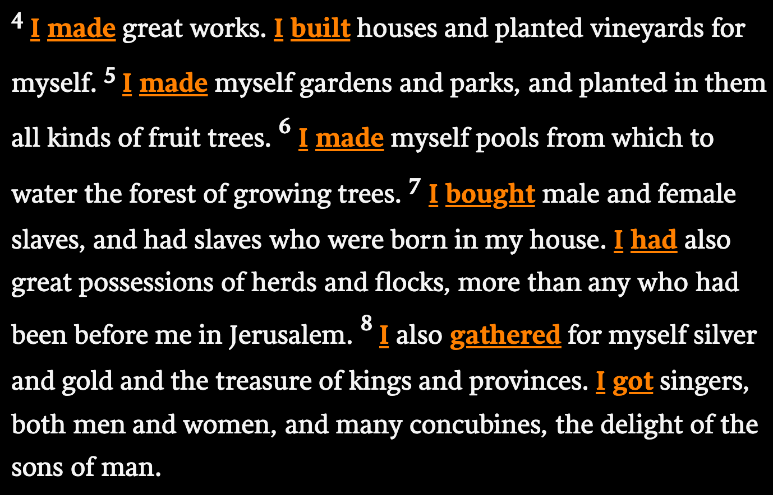
Ecclesiastes 2:4-9
ESV
Notes:
So He…
made
built
bought
gathered

Slide 19
So I became great and surpassed all who were before me in Jerusalem. Also my wisdom remained with me.
Ecclesiastes 2:9
ESV
Notes:
He goes on to says that he became great and surpass all who were before me.
But what he’s saying here is that he kept himself of sound mind. He didn’t stray from the plan. He stayed true to the experiment. Setting out to figure out what this life was all about. Man, wouldn’t you need God given talents to achieve that. The temptation here would be powerful. How easy would it be to slip into a world without God.

Slide 20
What Was His Conclusion?
Notes:
So… What did he discover?

Slide 21
Then I considered all that my hands had done and the toil I had expended in doing it, and behold, all was vanity and a striving after wind, and there was nothing to be gained under the sun.
Ecclesiastes 2:11
ESV
Notes:
We invest in things that have no meaning to our existence
“Go climb a mountain and see if it cares” “No one will care what you did 100 years from now, but the mountain will still be there”
Wisdom doesn’t work the way you think it should all the time
All the ways we try to find meaning apart from God

Slide 22
The wise person has his eyes in his head, but the fool walks in darkness. And yet I perceived that the same event happens to all of them. Then I said in my heart, “What happens to the fool will happen to me also. Why then have I been so very wise?” And I said in my heart that this also is vanity. For of the wise as of the fool there is no enduring remembrance, seeing that in the days to come all will have been long forgotten. How the wise dies just like the fool! So I hated life, because what is done under the sun was grievous to me, for all is vanity and a striving after wind.
Ecclesiastes 2:14-17
ESV
Notes:
Death is the great equalizer
Wise and the foolish
The rich and the poor
Good people die tragically
bad people live long and prosper

Slide 23
I hated all my toil in which I toil under the sun, seeing that I must leave it to the man who will come after me, and who knows whether he will be wise or a fool? Yet he will be master of all for which I toiled and used my wisdom under the sun. This also is vanity. So I turned about and gave my heart up to despair over all the toil of my labors under the sun, because sometimes a person who has toiled with wisdom and knowledge and skill must leave everything to be enjoyed by someone who did not toil for it. This also is vanity and a great evil. What has a man from all the toil and striving of heart with which he toils beneath the sun? For all his days are full of sorrow, and his work is a vexation. Even in the night his heart does not rest. This also is vanity.
Ecclesiastes 2:18–23
ESV

Slide 24
For in much wisdom is much vexation, and he who increases knowledge increases sorrow.
Ecclesiastes 1:18
ESV
Notes:
I told you these books of wisdom don’t come without warning labels.
Vexation = worry, frustration, annoyed
Sorrow = disappointment
The more you know, the more you realize you don’t know.
The higher you climb the ladder, the more you realize you’re not at the top.

Slide 25
Everyone has the same fate
Everything is out of our control
Nothing you own will come with you
…all is hevel and a striving after wind.

Slide 27
Then I saw that there is more gain in wisdom than in folly, as there is more gain in light than in darkness.
Ecclesiastes 2:13
ESV
Notes:
Be wise and fear God

Slide 28
There is nothing better for a person than that he should eat and drink and find enjoyment in his toil. This also, I saw, is from the hand of God, for apart from him who can eat or who can have enjoyment?
Ecclesiastes 2:24–25
ESV
Notes:
These gifts are not gauranteed and you should enjoy them when given the chance
How about the relief of solving a problem, the delight of reading a book to your children, the blessing of easing your husband’s troubles? The fresh breeze through the open windows on carpool morning, the delightful lunch with friends, the sweet feeling of a comfortable bed at night — all of these moments of enjoyment in our work are gifts from the gracious hand of God.

Slide 29
When you start to look for God’s gifts of joy, the ratio of troubles to joys becomes astonishingly unbalanced, leaning heavily in favor of joy. As my husband likes to say, good gifts are raining down upon us from the hand of God, every day, all day long. We can find enjoyment in our toil if only we would take the time to see and give thanks to God. Consider: what is one way you can remind yourself to enjoy the gifts from God’s hand today? You will find that it is a happy unhappy business that God has given to those who please him.
Carolyn Mahaney
Desiring God

Slide 30
Give your requests and your worries to God through Prayer
Acknowledge God has control. Stop chasing the wind; trying to control the vapor.
Be Thankful and enjoy God’s daily gifts. They’re often small and subtle but are more powerful than everything else under the sun.
Notes:
So, what do we do with all of this?
How hard is it to give your requests and worries to God?
Acknowledging our reality and releasing of control is the silver bullet to enjoying your life. Just because I can’t see meaning doesn’t mean there isn’t meaning. It just means I don’t have the perspective. Don’t expect everything is going to work out for you. Life is full of paradoxes under the sun.
Be Humble and feared of God
The key of true enjoyment… Accept the Hevel
Everything in your life is out of your control
Enjoy simple good things in life
Good meal
Sunny day
Total trust in God is freedom
Simply enjoy life and experiencing, not as I think it ought to be.
instead of fearing poverty and chasing success
Instead of fearing loneliness and grasping at pleasure and escape
Instead of fearing being foolish and burying yourself in book
Fear God, pray, acknowledge His control, and enjoy what He has given you. Because it is great!

Slide 31
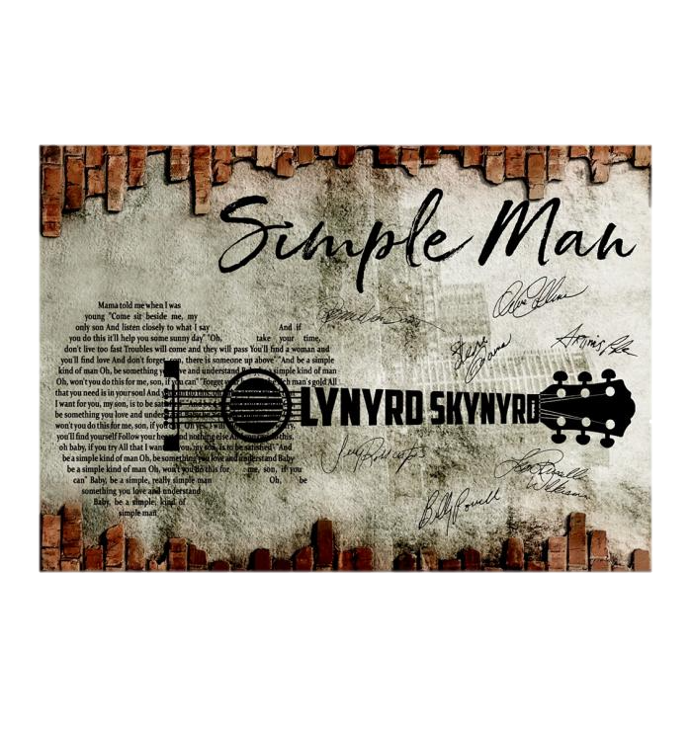
Oh take your time don't live too fast Troubles will come and they will pass Go find a woman yeah and you'll find love And don't forget son there is someone up above
And be a simple kind of man Oh be something you love and understand Baby be a simple kind of man Oh won't you do this for me son if you can
Forget your lust for the rich man's gold All that you need is in your soul And you can do this oh babe if you try All that I want for you my son is to be satisfied
Notes:
While we were preparing for this lesson one of the ideas that came up was the song “satisfaction.” Funny and catchy, but the other day I was driving to the airport and this song came on and man, doesn’t it sound like what God is asking of us. To be a Simple Man. To stop striving after the wind.

Slide 32
Rejoice in the Lord always; again I will say, rejoice. Let your reasonableness be known to everyone. The Lord is at hand; do not be anxious about anything, but in everything by prayer and supplication with thanksgiving let your requests be made known to God. And the peace of God, which surpasses all understanding, will guard your hearts and your minds in Christ Jesus.
Philippians 4:4–7
ESV
Notes:
I’ll leave you with this.

Slide 33
NOTES

Slide 51
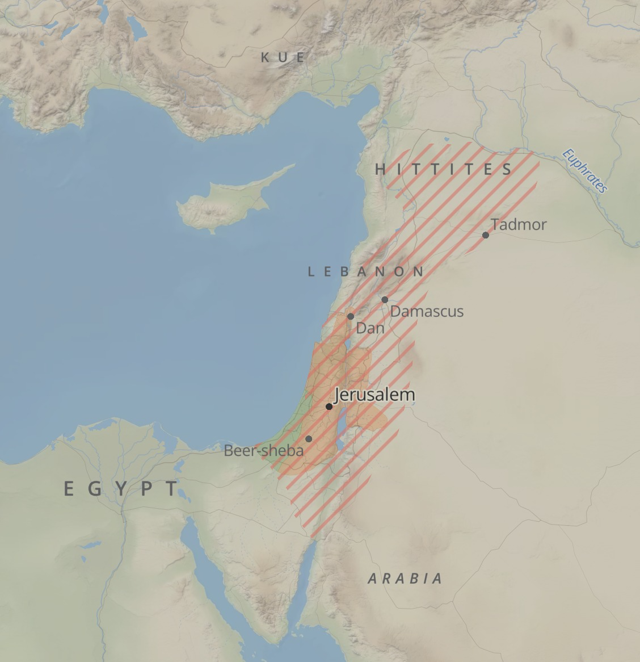

Slide 59
