Slide 1
Fiery Furnace
Daniel 3

Slide 2
If you never step up; God will not have the chance to step in.
Notes:
Many have already heard the story of the Fiery Furnace – why should they listen to your take?
Maybe you feel like you’re not feeling God’s presence anymore?
You’re not seeing Miracles anymore, or maybe you never have?
Some Questions: Am I fulfilling God’s plan for my life? Am I stepping up and giving God an opportunity?
Have Faith; Trust in God's plan
Miracles are happening all the time; especially when you step up
God is always with you; even in the darkest of times

Slide 3
Background
Daniel 1: Education & Attempted Indoctrination
Daniel 2: Daniel’s Revelation of Nebuchadnezzar’s Dream
Daniel 3: Fiery Furnace
Meshach; original name was Mishael
Who is like God
Shadarach; original name was Hananiah
Yahweh is Gracious
Abednego; original name was Azariah
Yahweh has Helped
Notes:
Daniel resisted being indoctrinated
Skipped over Daniel’s revelation –Nebuchadnezzar’s response to Daniel's revelation: “Truly, your God is God of gods and Lord of kings, and a revealer of mysteries, for you have been able to reveal this mystery.”
Fast forward some period of time and we’re here, at the story of the Fiery Furnace.
Neb’s requirements and building of the statue

Slide 4
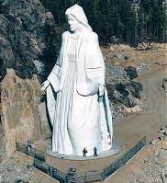
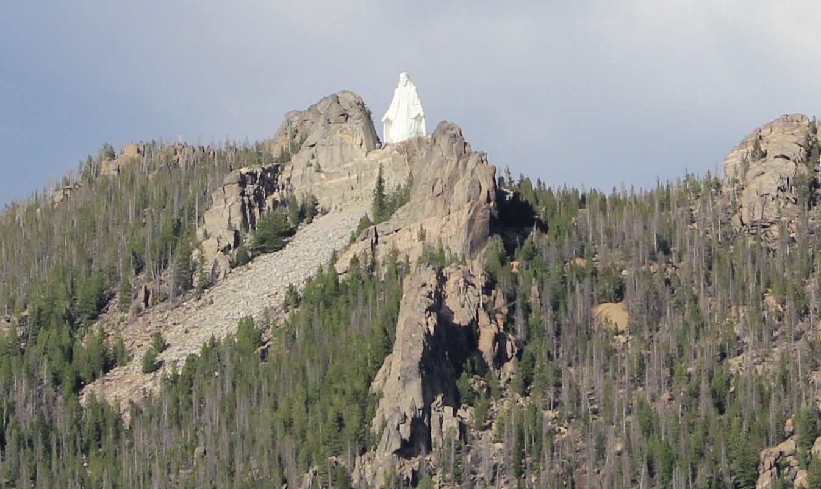
Our Lady of the Rockies 90 feet tall Made of Steel 80 Tons
Nebuchadnezzar’s Statue
60 cubits, or 90 feet tall
Made of gold
Notes:
Nebuchadnezzar commanded all the Babylonians to bow down and worship this statue upon the sound of music.
3 King Nebuchadnezzar made an image of gold, whose height was sixty cubits and its breadth six cubits. He set it up on the plain of Dura, in the province of Babylon. “You are commanded, O peoples, nations, and languages, ⁵ that when you hear the sound of the horn, pipe, lyre, trigon, harp, bagpipe, and every kind of music, you are to fall down and worship the golden image that King Nebuchadnezzar has set up. ⁶ And whoever does not fall down and worship shall immediately be cast into a burning fiery furnace.” ⁷ Therefore, as soon as all the peoples heard the sound of the horn, pipe, lyre, trigon, harp, bagpipe, and every kind of music, all the peoples, nations, and languages fell down and worshiped the golden image that King Nebuchadnezzar had set up.
The Holy Bible: English Standard Version (Da 3:4–7). (2016). Crossway Bibles.

Slide 5
¹⁴ Nebuchadnezzar answered and said to them, “Is it true, O Shadrach, Meshach, and Abednego, that you do not serve my gods or worship the golden image that I have set up? ¹⁵ Now if you are ready when you hear the sound of the horn, pipe, lyre, trigon, harp, bagpipe, and every kind of music, to fall down and worship the image that I have made, well and good. But if you do not worship, you shall immediately be cast into a burning fiery furnace. And who is the god who will deliver you out of my hands?”
Daniel 3:14-15 (ESV)
Notes:
The Country was on edge. People were frustrated and quick to cast stones. In this case, some peopl came forward to accuse some Jew’s of not worshipping the golden image.
Neb is testing God here.
Neb is proud
Neb gives them a second chance
⁻⁻
⁸ Therefore at that time certain Chaldeans came forward and maliciously accused the Jews.
The Holy Bible: English Standard Version (Da 3:8). (2016). Crossway Bibles.
¹² There are certain Jews whom you have appointed over the affairs of the province of Babylon: Shadrach, Meshach, and Abednego. These men, O king, pay no attention to you; they do not serve your gods or worship the golden image that you have set up.”
The Holy Bible: English Standard Version (Da 3:12). (2016). Crossway Bibles.

Slide 6
¹⁶ Shadrach, Meshach, and Abednego answered and said to the king, “O Nebuchadnezzar, we have no need to answer you in this matter. ¹⁷ If this be so, our God whom we serve is able to deliver us from the burning fiery furnace, and he will deliver us out of your hand, O king. ¹⁸ But if not, be it known to you, O king, that we will not serve your gods or worship the golden image that you have set up.”
Daniel 3:16-18 (ESV)
Notes:
You know us – You appointed us positions of importance.
And who is the god who will deliver you out of my hands?”

Slide 7
Trust that…
God is able
God will deliver
God has a plan for me
Faith honors God, and God loves to honor Faith
Notes:
This is FAITH!
Faith is a type of trust that affirms the power of God and the wisdom of God at the same time. It is a firm conviction that god always can, but He might not because in His wisdom, he may have some other purposes in store.
We are constantly being nudged away from God and our faith challenged. It's easier sometimes to go with the flow. It's easy to look at a story and say, "I would stand firm, I would be like them three."
Are we standing firm in our faith?
---
There is no sin too great; no failure too big; no problem too complicated for God to step in. But I’d also change that around: There is no sin too small; no failure little; or problem too easy for God to step in.
Sometimes we go rogue because we think God has enough problems. Afterall, “I’m not on my way to a fiery furnace right now.
God wants Faith at all times; Faith Honors God, and God LOVES to honor Faith

Slide 8
¹⁹ Then Nebuchadnezzar was filled with fury, and the expression of his face was changed against Shadrach, Meshach, and Abednego. He ordered the furnace heated seven times more than it was usually heated. ²⁰ And he ordered some of the mighty men of his army to bind Shadrach, Meshach, and Abednego, and to cast them into the burning fiery furnace. ²¹ Then these men were bound in their cloaks, their tunics, their hats, and their other garments, and they were thrown into the burning fiery furnace. ²² Because the king’s order was urgent and the furnace overheated, the flame of the fire killed those men who took up Shadrach, Meshach, and Abednego. ²³ And these three men, Shadrach, Meshach, and Abednego, fell bound into the burning fiery furnace.
Daniel 3:19-23 (ESV)
Notes:
Imagine what that might have been like: how much faith must you have to go through every step before being thrown into the furnace.
How much Their faith was tested here: They were thrown INTO the fiery furnace
Do you feel you’re in a fiery furnace right now? Maybe wondering why God hasn’t rescued you? You have been faithful, but maybe God hasn’t show up?

Slide 9
God does not always mitigate our circumstances when we choose faith, but just because life gets “hotter” does not mean that He has abandoned us.
Notes:
Bad stuff can still happen to children of God
Trust in God’s power and trust in God’s plan; He’s working on you; not your circumstances
God is more concerned with developing you and I into people he’s called us to be than showing off His power
Oftentimes, God permits what He might not prefer in order to accomplish what He loves even more.

Slide 10
Notes:
Playing a snippet from a documentary made by my Army Chaplain;
We are in Afghanistan
33m 25s
36m

Slide 11
⁴ Even though I walk through the valley of the shadow of death, I will fear no evil, for you are with me; your rod and your staff, they comfort me. ⁵ You prepare a table before me in the presence of my enemies; you anoint my head with oil; my cup overflows.
Psalm 23:4–5
Notes:
God is with you, always
He is in the fiery furnace
He is preparing a table IN the presence of your enemies

Slide 12
If you never step up; God will not have the chance to step in.
Notes:
Miracles do happen; they’re happing ALL the time.
We must trust God’s plan for us and step up. Give God the chance to step in to your life
And know, that sometimes that plan might be a struggle for you, but the miracle is for someone else.

Slide 13
²⁴ Then King Nebuchadnezzar was astonished and rose up in haste. He declared to his counselors, “Did we not cast three men bound into the fire?” They answered and said to the king, “True, O king.” ²⁵ He answered and said, “But I see four men unbound, walking in the midst of the fire, and they are not hurt; and the appearance of the fourth is like a son of the gods.”
Daniel 3:24-25 (ESV)
Notes:
Everyone saw this
Everyone was amazed

Slide 14
²⁸ Nebuchadnezzar answered and said, “Blessed be the God of Shadrach, Meshach, and Abednego, who has sent his angel and delivered his servants, who trusted in him, and set aside the king’s command, and yielded up their bodies rather than serve and worship any god except their own God.”
Daniel 3:28
Notes:
Trust in God’s power and trust in God’s plan; He’s working on you; not your circumstances
God is more concerned with developing you and I into people he’s called us to be than showing off His power

Slide 15
Do you have Faith in His Wisdom and believe “God Can”?
Do you have Faith in His Power that “God Will”?
When “God Doesn’t”, do you still have Faith in His Plan?
Notes:
God might being doing things in your life to impact others
God never promises an easy life for believers
If you don’t step into the furnace God will never have a chance to show you his great power
Are you listening when God speaks?
Are you going when God says go?
Are you taking Godly risks?
Have Faith; Trust in God's plan
Miracles are happening all the time; especially when you step up
God is always with you; even in the darkest of times

Slide 16
Miracles are happening; especially when you step up
God is always with you; even in the darkest of times
Have Faith; Trust in God's plan
Notes:
God might being doing things in your life to impact others
God never promises an easy life for believers
If you don’t step into the furnace God will never have a chance to show you his great power
Are you listening when God speaks?
Are you going when God says go?
Are you taking Godly risks?
Have Faith; Trust in God's plan
Miracles are happening all the time; especially when you step up
God is always with you; even in the darkest of times

Slide 17
If you never step up; God will not have the chance to step in.
Notes:
If you’re not ‘feeling’ God’s presence anymore, ask yourself: Are you living out God’s plan? Are you going where God is calling you?
Have Faith; Trust in God's plan
Miracles are happening all the time; especially when you step up
God is always with you; even in the darkest of times

Slide 18
The End

Slide 19
Sometimes, we believe “God can” but not sure if “God will,” leading to skepticism in His wisdom.
Sometimes, we believe “God will” but not sure if “God can,” leading to a doubtfulness in His power.
Notes:
Are you going where God wants you to go?
Are you not ‘feeling’ God’s presence anymore?
Do you sometimes look at others and just wish you could have such faith?
I wish I could trust God more
I wish I could believe God more
I see other people and they seem to be praising God and praying more even when life is crazy – what do they have that I don’t?

Slide 20
¹⁰ The thief comes only to steal and kill and destroy. I came that they may have life and have it abundantly.
John 10:10 (ESV)
Notes:
Your faith will be tested
The devil tempts us to destroy our faith, but Got tests us to develop our faith,
because a faith that cannot be tested cannot be trusted

Slide 21
God might being doing things in your life to impact others
God never promises an easy life for believers
If you don’t step into the furnace God will never have a chance to show you his great power

Slide 22
²⁶ Then Nebuchadnezzar came near to the door of the burning fiery furnace; he declared, “Shadrach, Meshach, and Abednego, servants of the Most High God, come out, and come here!” Then Shadrach, Meshach, and Abednego came out from the fire. ²⁷ And the satraps, the prefects, the governors, and the king’s counselors gathered together and saw that the fire had not had any power over the bodies of those men. The hair of their heads was not singed, their cloaks were not harmed, and no smell of fire had come upon them.
Daniel 3:26-27

Slide 23
⁶ And without faith it is impossible to please him, for whoever would draw near to God must believe that he exists and that he rewards those who seek him.
Hebrews 11:6 (ESV)

Slide 24
The devil tempts us to destroy our faith, but Got tests us to develop our faith, because a faith that cannot be tested cannot be trusted

Slide 25
Faith is a type of trusting that affirms the power of God and the widsom of God at the same time. It is a firm conviction that god always can, but He might not because in His wisdom, he may have some other purposes in store. Oftentimes, God permits what He might not prefer in order to accomplish what He loves even more.
“God can” and “God may not”
God allows them to be thrown into the flames even though they honored Him with bold, tenacious faith.

Slide 26
God never says being a Christian will be easy

Slide 27
https://podcasts.apple.com/us/podcast/fiery-furnace/id1469259027?i=1000527992363
I wish I could trust God more
I wish I could believe God more
I see other people and they seem to be praising God and praying more even when life is crazy – what do they have that I don’t?
Religious Persecution – people being martyred for worshipping Christ
Faith is not a contract with God – I’m going to trust you ‘so that’ my life will be better
If Faith is a deal, then what happens when you’re not getting when life falls apart – it means someone is not be keeping up with their end of the deal – either God is failing you; or you are failing him.
Matthew 18:1-4
Faith is depending on Jesus in my weakness – God get’s me through everything
I don’t breath unless God gives me breath
Faith is in weakness
My nothingness vs your everything
You may think you’re alone, you’re not a lone in the fire
In your weakness lean in the power of God

Slide 28
https://podcasts.apple.com/us/podcast/fiery-furnace/id1561500428?i=1000515645167
They didn’t say God will put out the fire or prevent the entry into the furnace
They were prepared to go into the furnace – They knew they had to go into the furnace
Bad stuff can still happen to children of God
Trust in God’s power and trust in God’s plan
Sometimes it’s a Fiery Furnace
Isaiah 55:8
James 1
God is more concerned with developing you and I into people he’s called us to be than showing off His power
I’m working on you; not your circumstances

Slide 29
https://podcasts.apple.com/us/podcast/fiery-furnace-the-book-of-daniel/id1532099060?i=1000507720868
You have perfection ‘in’ you, ‘with’ you, always – through the Holy Spirit

