Slide 1
Colossians 2:4-15
Foundation in Salvation
Notes:
Salvation is the undertone here, but we’re going to see other things as we dig in.

Slide 2
Background: Colossians
Paul is in Jail (the first time), in Rome
Likely written around the same time period as Ephesians
Man named Epaphras began the Colossian Church
Epaphras brought word to Paul
Threats to the Colossian Church
Notes:
PRAY AT THE END!
Let’s start with getting a bit caught up. Paul is likely in Jail, in Rome during this writing. Scholars believe it was likely written around the same time as Ephesians. There was a man named Epaphras who was running the Colossian church is

Slide 3
Threats against the Church
Gnostics: Systems of knowledge; additional god’s
Philosophers: Love of Wisdom
Ascetism: Self-deprivation; self-denial
Hellenistic’s: Greco-Roman Tradition, Alexander the Great
Judaizers: Legalism, Circumcision…
Angelolatry: Worshipping of Angel’s; archangel Michael
Notes:
Gnostics:
The true God is pure spirit and dwells in the realm of pure light totally separated from this dark world
This world is evil for it is made of matter and matter is evil. The true God will have nothing to do with it for it was created by a lesser god and was a mistake
Only those with the spark of spirit can receive the knowledge and be reunited with the true God.
Philosopher: “a man who spends his life trying to understand what he knows before he begins to realize that he cannot understand”
Hellenistic’s – Pretty much Philosophy, Tradition, etc.
Taught by Aristotle
Superiority of the Greek way of life
Homer’s Iliad and Odyssey
Judaizers: Legalism

Slide 4
Christ, ³ in whom are hidden all the treasures of wisdom and knowledge. ⁴ I say this in order that no one may delude you with plausible arguments. ⁵ For though I am absent in body, yet I am with you in spirit, rejoicing to see your good order and the firmness of your faith in Christ.
Colossians 3:2b-5
⁸ See to it that no one takes you captive by philosophy and empty deceit, according to human tradition, according to the elemental spirits of the world, and not according to Christ.
Colossians 3:8
Notes:
Everything you need is in Christ alone.
He is preparing the Colossians for the battle they’re about to face against the world around them.
He is holding them up in honor, showing joy for their “good order”, military grade discipline and firmness in their faith in Christ.
He’s lifting them up right now. Start off with an attaboy, you got this. You’re doing amazing.
Here’s how Paul address’s the problem. Really, it could be all summarized here, but Paul doesn’t stop here.
Is this much different than the world we’re in today? Aren’t we still threatened daily by all of these things, if not more?
How do we go about combating these things today?

Slide 5
Notes:
Strong foundation - if you don't have a strong foundation

Slide 6
DECEPTION
Notes:
Explain the background of the video
Deception: It’s everywhere
Emma and her friends we’re building a dance routine this week and the song her friends chose was Demi Lavato’s – Confident. They picked it because of a recent movie, Leap. About an orphan ballet dancer and they're telling her to find her confidence and they play this song at some key moments in the movie. If you don't know some of the words: ”
What's wrong with being
What's wrong with being
What's wrong with being confident?
”
Nothing, but where do you get your confidence? Where is your foundation of confidence built from? See the world will lead you to believe the world of the flesh is confidence
Ephesians 3:12
¹² in whom we have boldness and access with confidence through our faith in him.
At the surface level there's deception, but if you dig even furhter into the lyrics. There's very much a very sexual undertone to the song. I'm not going to go to do an in-depth analysis of her lyrics here, but give them a quick review for yourself.

Slide 7
¹⁰ The thief comes only to steal and kill and destroy. I came that they may have life and have it abundantly.
John 10:10
Notes:
We know this. The devil is active, constantly trying to tempt, to steal, kill and destroy your foundation. Jesus went through this, and he set a great example for us.

Slide 8
The Temptation of Jesus
4 Then Jesus was led up by the Spirit into the wilderness to be tempted by the devil. ² And after fasting forty days and forty nights, he was hungry. ³ And the tempter came and said to him, “If you are the Son of God, command these stones to become loaves of bread.” ⁴ But he answered,
“It is written, ‘Man shall not live by bread alone,
but by every word that comes from the mouth of God.’ ”
⁵ Then the devil took him to the holy city and set him on the pinnacle of the temple ⁶ and said to him, “If you are the Son of God, throw yourself down, for it is written, “ ‘He will command his angels concerning you,’ and ‘On their hands they will bear you up, lest you strike your foot against a stone.’ ”
⁷ Jesus said to him,
“Again it is written, ‘You shall not put the Lord your God to the test.’ ”
⁸ Again, the devil took him to a very high mountain and showed him all the kingdoms of the world and their glory. ⁹ And he said to him, “All these I will give you, if you will fall down and worship me.” ¹⁰ Then Jesus said to him,
“Be gone, Satan! For it is written,
“ ‘You shall worship the Lord your God
and him only shall you serve.’ ”
¹¹ Then the devil left him, and behold, angels came and were ministering to him.
Notes:
Jesus Set an example for us in Matthew 4. Jesus turned to the word as he being tempted out in the wilderness.

Slide 9
Jesus Foretells His Death and Resurrection
²¹ From that time Jesus began to show his disciples that he must go to Jerusalem and suffer many things from the elders and chief priests and scribes, and be killed, and on the third day be raised. ²² And Peter took him aside and began to rebuke him, saying, “Far be it from you, Lord! This shall never happen to you.” ²³ But he turned and said to Peter, “Get behind me, Satan! You are a hindrance to me. For you are not setting your mind on the things of God, but on the things of man.”
Matthew 16:21–23

Slide 10
⁷ rooted and built up in him and established in the faith, just as you were taught, abounding in thanksgiving. ⁹ For in him the whole fullness of deity dwells bodily, ¹⁰ and you have been filled in him, who is the head of all rule and authority.
Colossians 3:7-10
Notes:
Rooted – Take nourishment from
Built up – Imagery of a building – Under Construction
Jesus is God and you have been filled, completed, in him – he is ALL you need!! None of these other things these people are saying are necessary or truth…
Paul says, make no mistake about it, Jesus is God – ‘the whole fullness of deity dwells bodily’

Slide 11
Deception is everywhere, how do I deal with it?

Slide 12
¹¹ In him also you were circumcised with a circumcision made without hands, by putting off the body of the flesh, by the circumcision of Christ, ¹² having been buried with him in baptism, in which you were also raised with him through faith in the powerful working of God, who raised him from the dead.
Colossians 3:11-12
Notes:
Paul say- know this!
Paul starts to get clever here to combat words being used against the church by the Judaizers, Circumcision. As he says you were separated from the needs of this world, from the body of the flesh. You are different now. Circumicision Is symbolizing and separation from this world, this body.

Slide 13
¹³ And you, who were dead in your trespasses and the uncircumcision of your flesh, God made alive together with him, having forgiven us all our trespasses, ¹⁴ by canceling the record of debt that stood against us with its legal demands. This he set aside, nailing it to the cross. ¹⁵ He disarmed the rulers and authorities and put them to open shame, by triumphing over them in him.
Colossians 3:13-15

Slide 14
⁸Formerly, when you did not know God, you were enslaved to those that by nature are not gods.
Galatians 4:8

Slide 15
CHRIST
Circumcision
SALVATION
Food Laws
Sacrifice
By Grace Alone
Through Faith Alone
In Christ Alone
Regulations
Debt
Legalism
Ceremonial Laws
Notes:
So, what is Paul saying here? Salvation!
It’s continuous, never-ending Salvation. It’s always there

Slide 16
⁶ Therefore, as you received Christ Jesus the Lord, so walk in him,
Galatians 4:6
Notes:
Becoming a Christian means receiving Christ. Being a Christian means living in fellowship with Christ, not merely holding some beliefs about Him. – he says WALK in him

Slide 17
GET

Slide 18
¹¹ Put on the whole armor of God, that you may be able to stand against the schemes of the devil.
Ephesians 6:11

Slide 19
Put on the whole armor of God, that you may be able to stand against the schemes of the devil.
Know HIS Promise!
Know HIS Sacrifice!
Ephesians 6:11
Know HIS Love!
Know HIS Word!
Trust HIS Word!
Know HIS Relationship!
Ephesians 6:10-20

Slide 20
So, how do we get to know these things to have trust?

Slide 21
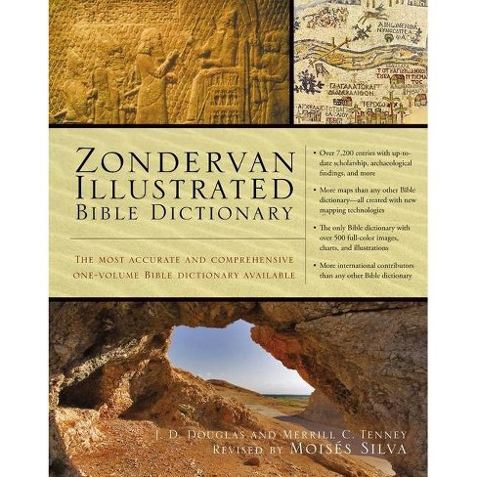
Study His Word
Spend 15 minutes a day with God
Daily Devotionals
Prayer
The Bible App
Pick up a Bible Dictionary

Slide 22
Now, don’t just take my word for it, Fact Check Me!

Slide 23
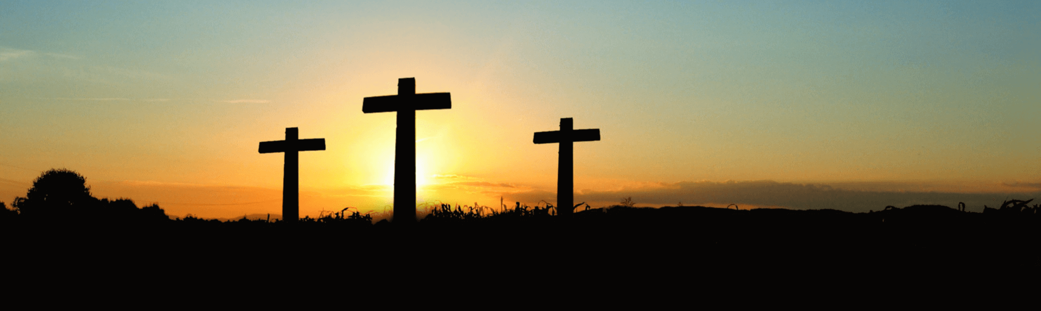
SALVATION
Notes:
What Paul is leading into here, is God’s Salvation.

Slide 24
Outline
Background
Deception
Salvation
Active

Slide 25
Me-We-God-You-We
What do they need to know?
The thief comes only to steal and kill and destroy. I came that they may have life and have it abundantly John 10:10
Jesus is God
Jesus has everything you need
Stand firm, be alert and on constantly on guard – the enemy attacks when you least expect it
Jesus saved us all and removed all our sins – This is our foundation
Why do they need to know it?
So that we may not be taken captive and fall astray of the Lord’s path.
What do they need to do?
Ephesians 6:10-20 - Put on the full armor of God
Study God’s Word
Fact Check
Pray
Why do they need to do it?
Salvation
How can I help them remember?

Slide 26
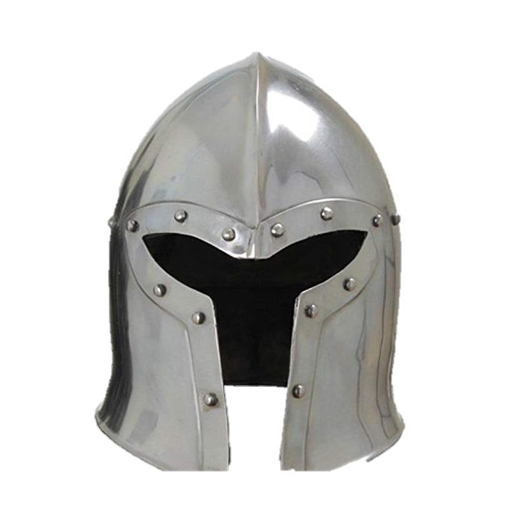
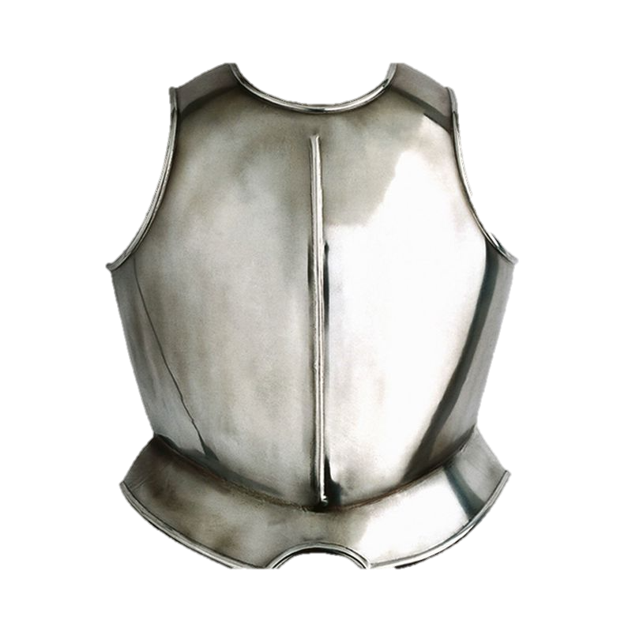
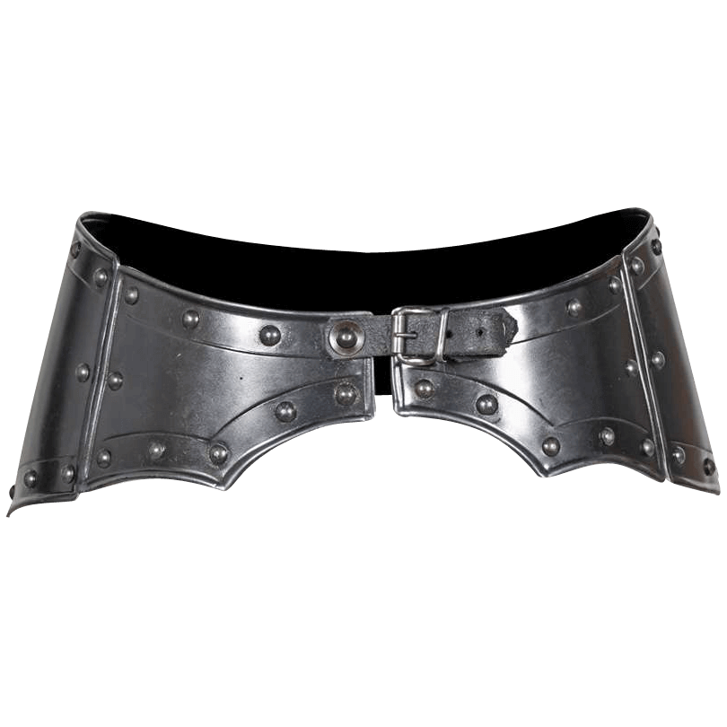
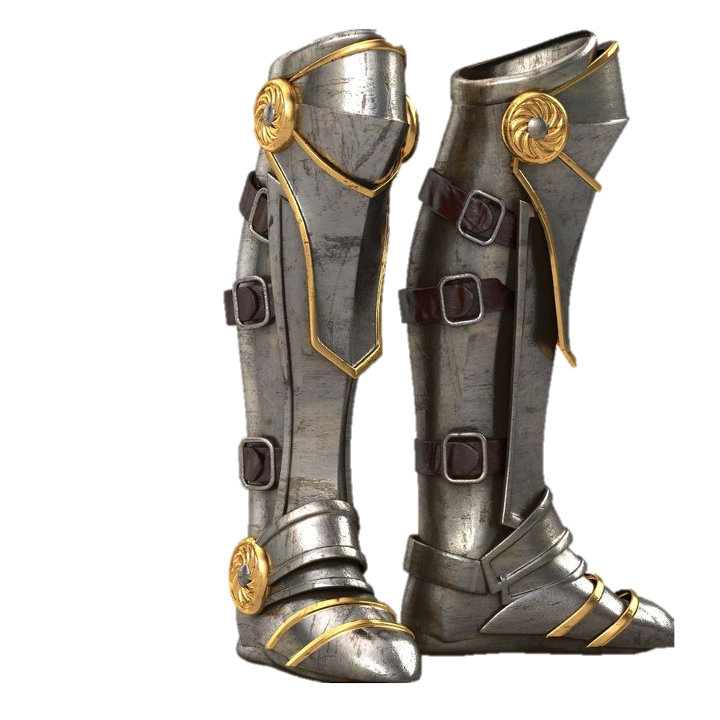
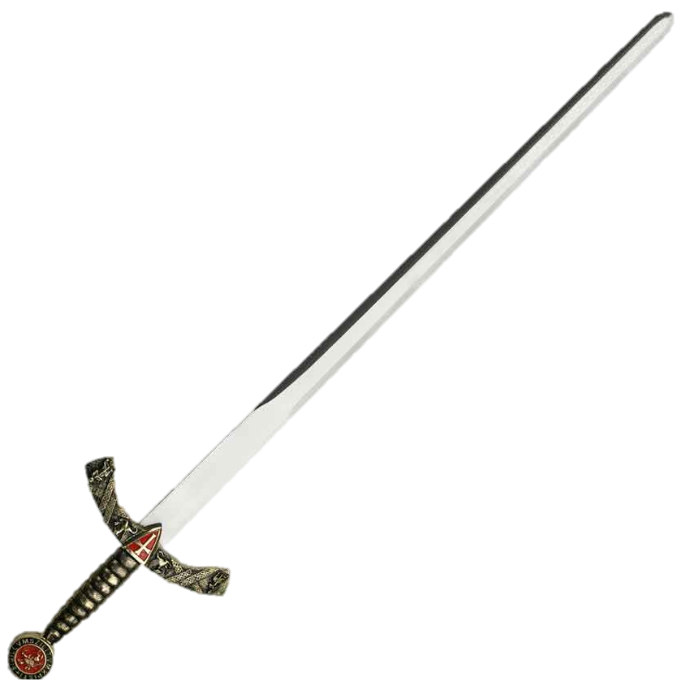
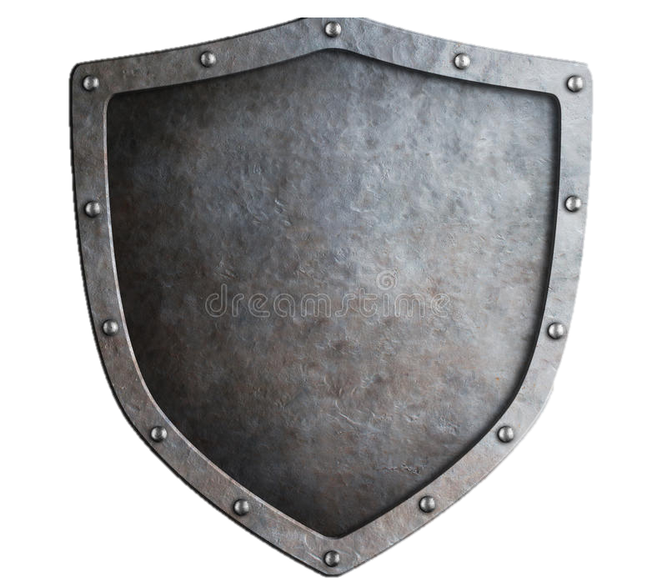

Slide 27
⁴ I say this in order that no one may delude you with plausible arguments. ⁵ For though I am absent in body, yet I am with you in spirit, rejoicing to see your good order and the firmness of your faith in Christ.
Alive in Christ
⁶ Therefore, as you received Christ Jesus the Lord, so walk in him, ⁷ rooted and built up in him and established in the faith, just as you were taught, abounding in thanksgiving.
⁸ See to it that no one takes you captive by philosophy and empty deceit, according to human tradition, according to the elemental spirits of the world, and not according to Christ. ⁹ For in him the whole fullness of deity dwells bodily, ¹⁰ and you have been filled in him, who is the head of all rule and authority. ¹¹ In him also you were circumcised with a circumcision made without hands, by putting off the body of the flesh, by the circumcision of Christ, ¹² having been buried with him in baptism, in which you were also raised with him through faith in the powerful working of God, who raised him from the dead. ¹³ And you, who were dead in your trespasses and the uncircumcision of your flesh, God made alive together with him, having forgiven us all our trespasses, ¹⁴ by canceling the record of debt that stood against us with its legal demands. This he set aside, nailing it to the cross. ¹⁵ He disarmed the rulers and authorities and put them to open shame, by triumphing over them in him.

Slide 28
¹⁰ Finally, be strong in the Lord and in the strength of his might. ¹¹ Put on the whole armor of God, that you may be able to stand against the schemes of the devil. ¹² For we do not wrestle against flesh and blood, but against the rulers, against the authorities, against the cosmic powers over this present darkness, against the spiritual forces of evil in the heavenly places. ¹³ Therefore take up the whole armor of God, that you may be able to withstand in the evil day, and having done all, to stand firm. ¹⁴ Stand therefore, having fastened on the belt of truth, and having put on the breastplate of righteousness, ¹⁵ and, as shoes for your feet, having put on the readiness given by the gospel of peace. ¹⁶ In all circumstances take up the shield of faith, with which you can extinguish all the flaming darts of the evil one; ¹⁷ and take the helmet of salvation, and the sword of the Spirit, which is the word of God, ¹⁸ praying at all times in the Spirit, with all prayer and supplication. To that end, keep alert with all perseverance, making supplication for all the saints, ¹⁹ and also for me, that words may be given to me in opening my mouth boldly to proclaim the mystery of the gospel, ²⁰ for which I am an ambassador in chains, that I may declare it boldly, as I ought to speak.
Ephesians 6:10-20

Slide 29
Abundance of Christ
How do we deal with Sin apart from Jesus?
Are we turning to God?
Are we denying ourselves?
Are we punishing ourselves?
Salvation happens to our heart, not our body.

Slide 30
Angelolatry
Hellenistic
Gnostic
God’s Mystery
Legalistic
Judaizers
Essenism
Asceticism
Philosopher

Slide 31
Hellenistic
Greek
Classical Scholars: “Chronological Designation covering the period of Alexander to the beginnings of the Roman Empire.”
Biblical Scholars: Other Roughly equivalent to Greco-Roman
Alexander the Great
Taught by Aristotle
Superiority of the Greek way of life
Homer’s Iliad and Odyssey
“the Koine” (Greek Language) – The common Greek Language
Jewish resistance to Hellenization lead to the Maccabean (maccabee) War in 168
Acts 6:1 – Dispute between Hebrews and Hellenists (Grecians / Grecian Jews)
Widows of the Hellenistic group were being neglected

Slide 32
Ascetism
Word not used in the Bible but concept is found frequently
Positive
Self-Discipline
Old Testament
Repentance (1 Sam 7:6)
Religious Regulations (Lev 10:9, Num 6:1-8)
New Testament: Renunciation of everything that hinders discipleship
Discipleship (Matt 19:21-22, MK 10:29-30)
Self-control “fruit of the Spirit” (Gal 5:23)
Demanded of Contestant (1 Cor 9:25), Elders (Tit 1:8) and Christians (2 Pet 1:6)
”Don’t let the good things of this world rob you of the best thing.”
Negative (More Frequent)
Sever Self-Denial and austerity
Hard treatment of the body (Col 3:20-23, 1 Tim 4:3)
Fueled by nonbiblical, dualistic philosophy that views the body in a negative term – a prison which the soul needs to be released

Slide 33
Philosophers
“a man show spends his life trying to understand what he knows before he begins to realize that he cannot understand”
Greek: Philosophia ~ “the love of wisdom”
Worldly, hollow, and deceptive philosophy – based on human tradition, not Christ focused.
Col 2:8 and 1 Corinthians 1:18-2:16 & 3:18-21
Wisdom Doctrine
Job
Ecclesiastes: “all is hevel” answer to modern philosophical naturalism
Some Psalms
Proverbs
Acts 17:18 -> see Epicurean and Stoic

Slide 34
Legalistic

Slide 35
Gnostic
Derived from Greek gnosis “knowledge”
Systems of knowledge in opposition to orthodox Christianity in the second and third centuries
Linked aspects of traditional Christianity with attractive ideas taken from Greek philosophy and Eastern religion, magic, and astrology
Main Themes
The true God is pure spirit and dwells in the realm of pure light totally separated from this dark world
This world is evil for it is made of matter and matter is evil. The true God will have nothing to do with it for it was created by a lesser god and was a mistake
People in this world are normally made of body and mind, but in a few there is a spark of pure spirit. Such “spiritual” people need to be rescued from this evil world; thus there is a need for a Savior. Jesus. Only those with the spark of spirit can receive the knowledge and be reunited with the true God.

Slide 36
Bible Verse or Not

Slide 37
Bible Verse?
Jacob ate his fill; Jeshurun grew fat, and kicked. You grew fat, bloated and gorged!
Deuteronomy 32:15

Slide 38
Bible Verse?
Love takes up where knowledge leaves off.
T.S. Eliot

Slide 39
Bible Verse?
Prayer is not asking. It is a longing of the soul. It is daily admission of one's weakness. It is better in prayer to have a heart without words than words without a heart.
Mahatma Gandhi

Slide 40
Bible Verse?
Death and life are in the power of the tongue: and they that love it shall eat the fruit thereof.
Proverbs 18:21

Slide 41
Bible Verse?
God answers all prayers, but sometimes his answer is 'no'.
Dan Brown
“Angels and Demons”

Slide 42
Bible Verse?
A friend loves at all times, and a brother is born for a time of adversity.
Proverbs 17:17

Slide 43
Bible Verse?
Dan shall be a snake by the roadside, a viper along the path that bites the horse’s heels, so that the rider falls backward.
Genesis 49:16

Slide 44
Bible Verse?
All we have to decide is what to do with the time given to us.
J.R.R. Tolkien

Slide 45
Bible Verse?
All that glitters is not gold.
Shakespeare
“The Merchant of Venice”

Slide 46
Bible Verse?
The darker the night, the brighter the stars, The deeper the grief, the closer is God!
Fyodor Dostoyevsky
“Crime and Punishment”

Slide 47
Bible Verse?
When Peleg had lived thirty years, he became the father of Reu, and Peleg lived after the birth of Reu two hundred and nine years.
Genesis 11:18

Slide 48
Bible Verse?
If in thirst you drink water from a cup, you see God in it. Those who are not in love with God will see only their own faces in it.
Rumi
13th century Muslim Persian poet

Slide 49
Bible Verse?
Go placidly amid the noise and haste, and remember what peace there may be in silence.
Max Ehrmann
“Desiderata”

Slide 50
Bible Verse?
Love is the only future God offers.
Victor Hugo
“Les Miserables"

Slide 51
Bible Verse?
Hope is the thing with feathers that perches in the soul.
Emily Dickinson
“Hope is the Thing With Feathers”

Slide 52
Bible Verse?
If you know yourself and know your enemy, you can win a hundred battles without jeopardy.
Sun Tzu
“The Art of War”

