Slide 1
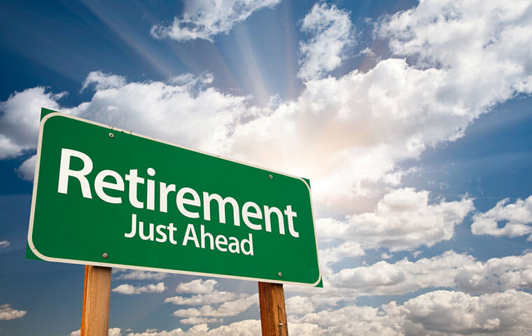
Work 2 Thessalonians 3:6-15
Notes:
2 Thessalonians 3:6-15
Lately, for some reason, retirement has been top of mind for me. How can I make it come sooner?
Going to dig into that a bit today
Before that, let’s get up to speed…

Slide 2
¹⁵ The Lord God took the man and put him in the garden of Eden to work it and keep it.
Genesis 2:15
Notes:
Work is good; from the beginning we were built to work
But without the right foundation…
Arthur Winston - Employee of the Century - 1906-2006

Slide 3
Notes:
https://www.youtube.com/watch?v=wXaPB7slzNE

Slide 4
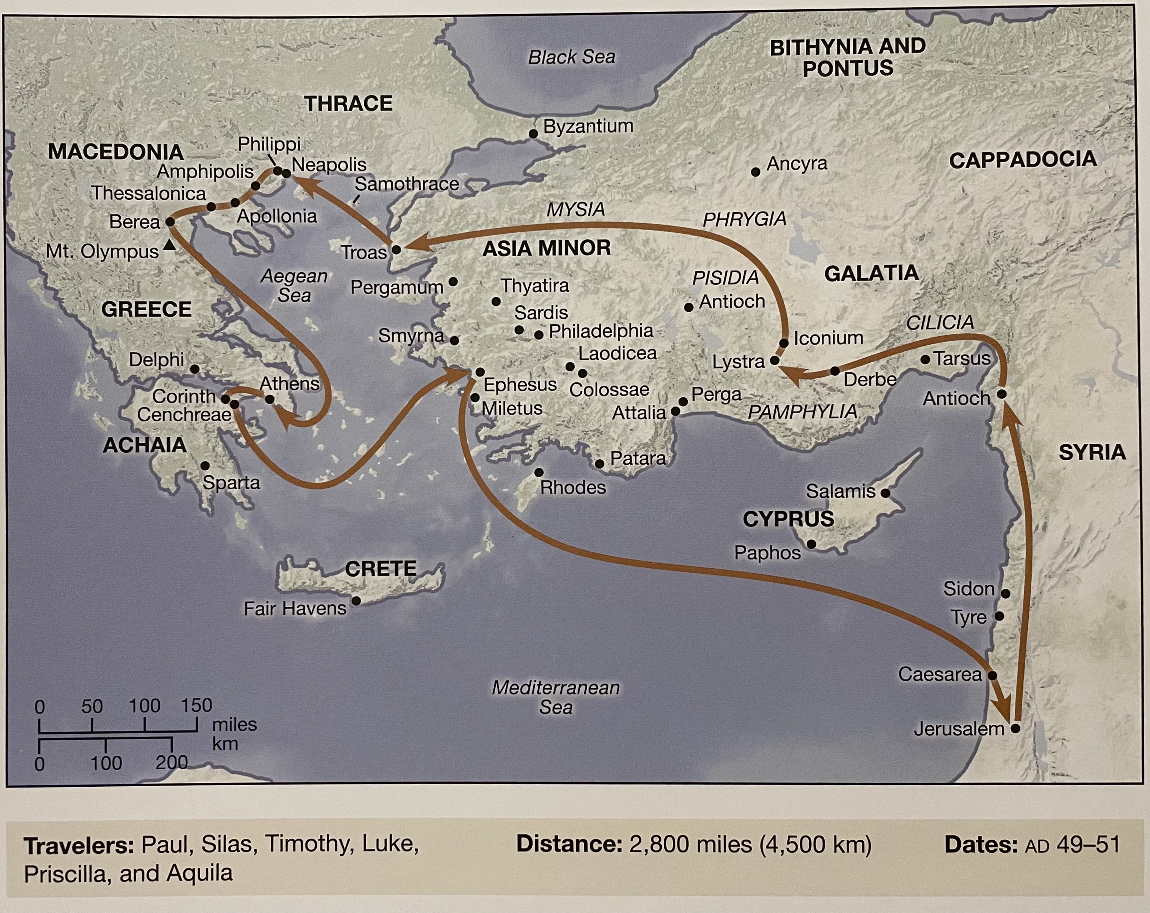
Notes:
PRAY!!!
Where is Paul coming from?
Acts 17 – Traveling preacher going door-to-door, country-to-country spreading the word for the gospel
What happened in Thessalonica?
We’ve talked about Serving, Reading, Praying, Memorizing verses
Just before Easter we covered going to heaven if you die before Christ comes
2 Thessalonians was written a few months after 1 Thessalonians – why?

Slide 5
2 Thessalonians 3:6–15
⁶ Now we command you, brothers, in the name of our Lord Jesus Christ, that you keep away from any brother who is walking in idleness and not in accord with the tradition that you received from us. ⁷ For you yourselves know how you ought to imitate us, because we were not idle when we were with you, ⁸ nor did we eat anyone’s bread without paying for it, but with toil and labor we worked night and day, that we might not be a burden to any of you. ⁹ It was not because we do not have that right, but to give you in ourselves an example to imitate. ¹⁰ For even when we were with you, we would give you this command: If anyone is not willing to work, let him not eat. ¹¹ For we hear that some among you walk in idleness, not busy at work, but busybodies. ¹² Now such persons we command and encourage in the Lord Jesus Christ to do their work quietly and to earn their own living.
¹³ As for you, brothers, do not grow weary in doing good. ¹⁴ If anyone does not obey what we say in this letter, take note of that person, and have nothing to do with him, that he may be ashamed. ¹⁵ Do not regard him as an enemy, but warn him as a brother.
Notes:
PRAY!!
Let’s see what Paul has to say about it. Open up to 2 Thessalonians 3:6-15
When thinking about the world we live in today, I find verse 13 to stand out…

Slide 6
Burnout
⁶ Now we command you, brothers, in the name of our Lord Jesus Christ, that you keep away from any brother who is walking in idleness and not in accord with the tradition that you received from us. ⁷ For you yourselves know how you ought to imitate us, because we were not idle when we were with you, ⁸ nor did we eat anyone’s bread without paying for it, but with toil and labor we worked night and day, that we might not be a burden to any of you. ⁹ It was not because we do not have that right, but to give you in ourselves an example to imitate. ¹⁰ For even when we were with you, we would give you this command: If anyone is not willing to work, let him not eat. ¹¹ For we hear that some among you walk in idleness, not busy at work, but busybodies. ¹² Now such persons we command and encourage in the Lord Jesus Christ to do their work quietly and to earn their own living.
¹³ As for you, brothers, do not grow weary in doing good. ¹⁴ If anyone does not obey what we say in this letter, take note of that person, and have nothing to do with him, that he may be ashamed. ¹⁵ Do not regard him as an enemy, but warn him as a brother.
Notes:
Paul says here: don’t grow weary in doing good
A word that comes to mind for me is…
Today, burnout is a popular term right up there with the great resignation.
God says through Paul, don’t grow weary of doing good…
What does burnout, what does growing weary look like?

Slide 7
Weary
wear·y [ˈwirē]
adjective
feeling or showing tiredness, especially as a result of excessive exertion or lack of sleep:
Synonyms: tired, tired out, worn out, exhausted, fatigued, overtired, sleepy, drowsy, wearied, sapped, dog-tired, spent, drained, …

Slide 8
What are the symptoms of burnout?
Emotional Exhaustion
Depersonalization
Diminished Sense of Accomplishment
Loss of Motivation
Emotional Depletion
Cynicism
Fatigue
Notes:
Pacing around the house at the beginning of COVID
So what are some signs of burnout?
does anyone know the top industry’s for burnout?

Slide 9
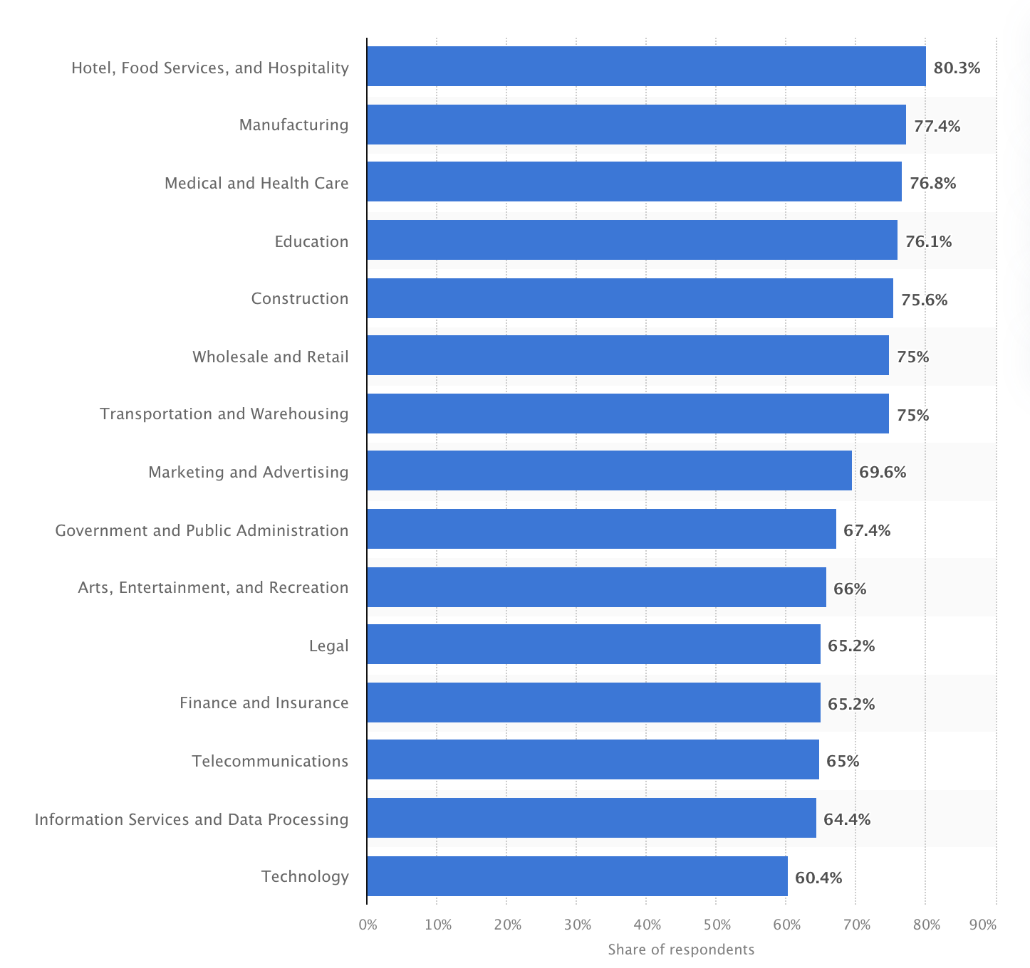
3 of top 5 industries with the highest employee burnout
are service-focused jobs.
People who do good for people are growing weary!
https://www.statista.com/statistics/1274617/industries-burnout-globally/
Notes:
Leisure and hospitality
Both of my daughters teachers left this year
55 percent of educators are thinking about leaving the profession earlier than they had planned, according to a National Education Association (NEA) survey.

Slide 10
Notes:
Herbert Froydenburger
Pacing around my house

Slide 11
Christian approach to combating burnout
“Lord Jesus Christ, Son of God, have mercy on me, a sinner.”
Breath In
“Lord Jesus Christ, Son of God,…”
fills us up, holding on
Breath Out
“…have mercy on me, a sinner.”
empties us, lets go of guilt, shame, and anxiety
Daily Examen
Twice a day, prayerful reflection recognizing God’s active, loving presence.
5 steps:
Notice God’s presence
Reflect on the day with gratitude
Notice your subjective experience
Pick one part of the day; pray from that experience
Ask God to prepare you for tomorrow, taking what was learned from today’s experience.
Prayer of Consideration
Creation, find in God in the beauty of nature,
People, reflect on encounters throughout the day,
Work, focus on colleagues, tasks, projects, and skills as reflecting God’s image,
Children, focus on what they teach us about entering God’s Kingdom
Notes:
Research suggests that practicing the Jesus Prayer positively impacts mood).
Further, some practitioners have reported a deepened sense of peace and calm, furthering their relationship with the transcendent other (Rubinart et al. 2016).

Slide 12
There’s more!
Pomodoro – work/break cycles (25/5, 50/10, etc.)
Stand up, move around – Get blood flowing
Drink water – stay hydrated
Go for walks – rest
Notes:
I started going for walks – initially with headphone, then I was reminded of Afghanistan
Pomodoro – work smarter
We never shut off… That’s the difference

Slide 13
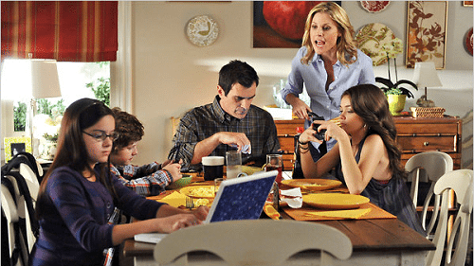
PUT DOWN YOUR PHONES!

Slide 14
Christian Work Ethic
⁶ Now we command you, brothers, in the name of our Lord Jesus Christ, that you keep away from any brother who is walking in idleness and not in accord with the tradition that you received from us. ⁷ For you yourselves know how you ought to imitate us, because we were not idle when we were with you, ⁸ nor did we eat anyone’s bread without paying for it, but with toil and labor we worked night and day, that we might not be a burden to any of you. ⁹ It was not because we do not have that right, but to give you in ourselves an example to imitate. ¹⁰ For even when we were with you, we would give you this command: If anyone is not willing to work, let him not eat. ¹¹ For we hear that some among you walk in idleness, not busy at work, but busybodies. ¹² Now such persons we command and encourage in the Lord Jesus Christ to do their work quietly and to earn their own living.
¹³ As for you, brothers, do not grow weary in doing good. ¹⁴ If anyone does not obey what we say in this letter, take note of that person, and have nothing to do with him, that he may be ashamed. ¹⁵ Do not regard him as an enemy, but warn him as a brother.
Notes:
With “Burnout” breathing down our necks how hard should we work?
Paul set the example, and he works hard!

Slide 15
²² Bondservants, obey in everything those who are your earthly masters, not by way of eye-service, as people-pleasers, but with sincerity of heart, fearing the Lord. ²³ Whatever you do, work heartily, as for the Lord and not for men, ²⁴ knowing that from the Lord you will receive the inheritance as your reward. You are serving the Lord Christ.
Colossians 3:22–24
Notes:
Work Hard! Work as if working for the Lord and not for men.
Be the example
Why has God put you there?
American Work Culture – ”I’m Busy” == “I’m Important”

Slide 16
² And on the seventh day God finished his work that he had done, and he rested on the seventh day from all his work that he had done. ³ So God blessed the seventh day and made it holy, because on it God rested from all his work that he had done in creation.
Genesis 2:2–3
Notes:
God made rest Holy
God Made work Holy
Take the break, take the walk – It’s OK

Slide 17
Fellowship
⁶ Now we command you, brothers, in the name of our Lord Jesus Christ, that you keep away from any brother who is walking in idleness and not in accord with the tradition that you received from us. ⁷ For you yourselves know how you ought to imitate us, because we were not idle when we were with you, ⁸ nor did we eat anyone’s bread without paying for it, but with toil and labor we worked night and day, that we might not be a burden to any of you. ⁹ It was not because we do not have that right, but to give you in ourselves an example to imitate. ¹⁰ For even when we were with you, we would give you this command: If anyone is not willing to work, let him not eat. ¹¹ For we hear that some among you walk in idleness, not busy at work, but busybodies. 12 Now such persons we command and encourage in the Lord Jesus Christ to do their work quietly and to earn their own living.
¹³ As for you, brothers, do not grow weary in doing good. ¹⁴ If anyone does not obey what we say in this letter, take note of that person, and have nothing to do with him, that he may be ashamed. ¹⁵ Do not regard him as an enemy, but warn him as a brother.

Slide 18
You are the average of the five people you spend the most time with.
Who are you spending your time with?
Notes:
Are they holding you Accountable?
Are you holding them accountable?
How are you raising your averages?
Work analogies

Slide 19
¹⁷ “You shall not hate your brother in your heart, but you shall reason frankly with your neighbor, lest you incur sin because of him
Leviticus 19:17.
Notes:
Accountability isn’t hate.
have nothing to do with a brother doesn’t mean you hate them
Paul says; do not regard him as an enemy, but warn him as a brother.
Story about Emma... Teaching this to kids -> Block, starting to learn surround yourself with certain peoplel they do things differently than.

Slide 20
Summary
Combat Burnout
Prayer, Reflection, Mindfulness, Put Down Your Phones
Christian Work Ethic
Set the Example, Work for the Lord, Take Breaks
Surround Yourself with Believers
Fellowship, Accountability, Level-up Your Average

Slide 21
The End

Slide 22
Emotional Exhaustion > Depersonalization > Diminished Sense of Personal Accomplishment
Distribution of Work: Moses / Jethro
Spirituality combats burnout
Self-care implies not only caring for one’s body as the temple of the Holy Spirit (1 Corinthians 6:19-20) by getting proper exercise, sleep, and nutrition; it also means taking time to laugh, to engage in hobbies, to be with friends, to be alone, to go for a hike, to soak in a bath, to read a book, to journal, in essence to actually enjoy those things that God has made to be life-giving to you.
As burnout is experienced as a diminished sense of personal accomplishment, emotional exhaustion, and depersonalization, Christian spiritual practices enable reconnecting with the empowering, living spirit of God.
Burnout is an international problem that has been attributed to perceived high workloads, inadequate communication, demanding physical conditions, lack of managerial support, conflicting values, absence of fairness, breakdown of community, decline of available workforce, and low financial rewards
Taken together, burnout’s effects of emotional exhaustion, depersonalization, and a depleted sense of personal accomplishment on employees leads to a sense of stagnation. When one’s sense of meaning in one’s work is diminished due to burnout or compassion fatigue, stagnation or lack of caring takes hold. In other words, one’s psychological resources to meaningfully engage in work are depleted, leading to lower levels of job satisfaction, higher levels of intent to turnover, higher absenteeism, lower morale, and a deterioration in the quality of care provided.

Slide 23
The main difference between compassion fatigue and burnout is whether the focus is on psychological factors (compassion fatigue) or workplace environment (burnout)
When one’s sense of meaning in one’s work is diminished due to burnout or compassion fatigue, stagnation or lack of caring takes hold. In other words, one’s psychological resources to meaningfully engage in work are depleted, leading to lower levels of job satisfaction, higher levels of intent to turnover, higher absenteeism, lower morale, and a deterioration in the quality of care provided.

