Slide 1
Our Expectations vs God’s will
2 Kings 5:1-14
Notes:
Often we have expectations for how God is going to deliver an outcome.

Slide 2
Elijah or Elisha?

Slide 3
The Call of Elisha
¹⁹ So he departed from there and found Elisha the son of Shaphat, who was plowing with twelve yoke of oxen in front of him, and he was with the twelfth.
1 Kings 19:19a
Notes:
Should anoint a couple kings – one over Syria and one over Israel
And a prophet to take your place, his name is Elisha

Slide 4
THE BIG BUD 747

Slide 5
Elijah passed by him and cast his cloak upon him. ²⁰ And he left the oxen and ran after Elijah and said, “Let me kiss my father and my mother, and then I will follow you.” And he said to him, “Go back again, for what have I done to you?” ²¹ And he returned from following him and took the yoke of oxen and sacrificed them and boiled their flesh with the yokes of the oxen and gave it to the people, and they ate. Then he arose and went after Elijah and assisted him.
1 Kings 19:19b–21
Notes:
1Kings 19-22
Not again until 2 Kings 2

Slide 6
Notes:
Elisha is an apprentice
Qui-Gon Jinn
Kwy gon jinn
And hearing nothing of obiwan

Slide 7
⁹ When they had crossed, Elijah said to Elisha, “Ask what I shall do for you, before I am taken from you.” And Elisha said, “Please let there be a double portion of your spirit on me.” ¹⁰ And he said, “You have asked a hard thing; yet, if you see me as I am being taken from you, it shall be so for you, but if you do not see me, it shall not be so.” ¹¹ And as they still went on and talked, behold, chariots of fire and horses of fire separated the two of them. And Elijah went up by a whirlwind into heaven. ¹² And Elisha saw it and he cried, “My father, my father! The chariots of Israel and its horsemen!” And he saw him no more.
Then he took hold of his own clothes and tore them in two pieces. ¹³ And he took up the cloak of Elijah that had fallen from him and went back and stood on the bank of the Jordan. ¹⁴ Then he took the cloak of Elijah that had fallen from him and struck the water, saying, “Where is the Lord, the God of Elijah?” And when he had struck the water, the water was parted to the one side and to the other, and Elisha went over.
2 Kings 2:9–14

Slide 8
What happened next?
Parts the Jordan River - 2 Kings 2:13-14 ail
Makes Jericho spring drinkable - 2 Kings 2:19-22
Sends bears to punish disrespectful youths - 2 Kings 2:23-25
Floods ditches to confuse Moabites - 2 Kings 3:1-27
Multiplies widow's oil - 2 Kings 4:1-7
Shunammite woman bears a son - 2 Kings 4:8-17
Resurrects Shunammite's son - 2 Kings 4:18-37
Purifies poisoned stew - 2 Kings 4:38-44
Heals Naaman's leprosy - 2 Kings 5:1-14
…

Slide 9
5 Naaman, commander of the army of the king of Syria, was a great man with his master and in high favor, because by him the Lord had given victory to Syria. He was a mighty man of valor, but he was a leper. ² Now the Syrians on one of their raids had carried off a little girl from the land of Israel, and she worked in the service of Naaman’s wife. ³ She said to her mistress, “Would that my lord were with the prophet who is in Samaria! He would cure him of his leprosy.” ⁴ So Naaman went in and told his lord, “Thus and so spoke the girl from the land of Israel.” ⁵ And the king of Syria said, “Go now, and I will send a letter to the king of Israel.”
2 Kings 5:1–5a ESV
Notes:
“If only my master would see the prophet who is in Samaria! He would cure him of his leprosy.”
God has a purpose and a plan for us.
Maybe it’s to speak truth into someone’s life
Maybe it’s to bare witness to God’s miracle.
Military life – comparison to Naaman. God was not a primary focus on my life during those times.

Slide 10
So he went, taking with him ten talents of silver, six thousand shekels of gold, and ten changes of clothing. ⁶ And he brought the letter to the king of Israel, which read, “When this letter reaches you, know that I have sent to you Naaman my servant, that you may cure him of his leprosy.” ⁷ And when the king of Israel read the letter, he tore his clothes and said, “Am I God, to kill and to make alive, that this man sends word to me to cure a man of his leprosy? Only consider, and see how he is seeking a quarrel with me.”
2 Kings 5:5b-7 ESV

Slide 11
⁸ But when Elisha the man of God heard that the king of Israel had torn his clothes, he sent to the king, saying, “Why have you torn your clothes? Let him come now to me, that he may know that there is a prophet in Israel.” ⁹ So Naaman came with his horses and chariots and stood at the door of Elisha’s house. ¹⁰ And Elisha sent a messenger to him, saying, “Go and wash in the Jordan seven times, and your flesh shall be restored, and you shall be clean.” ¹¹ But Naaman was angry and went away, saying, “Behold, I thought that he would surely come out to me and stand and call upon the name of the Lord his God, and wave his hand over the place and cure the leper. ¹² Are not Abana and Pharpar, the rivers of Damascus, better than all the waters of Israel? Could I not wash in them and be clean?” So he turned and went away in a rage.
2 Kings 5:8-12
Notes:
We often have our own expectations for God’s healing. You ask God for something and he says, “yes, I want that for you too, but here’s how we’re going to do it.”

Slide 12
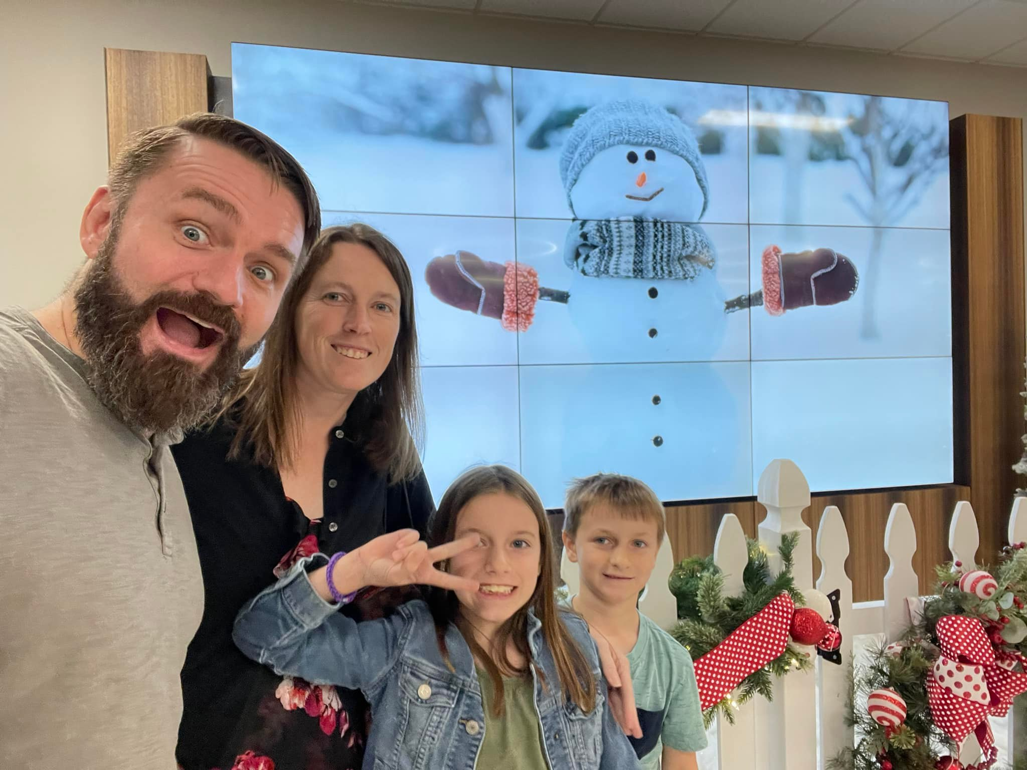
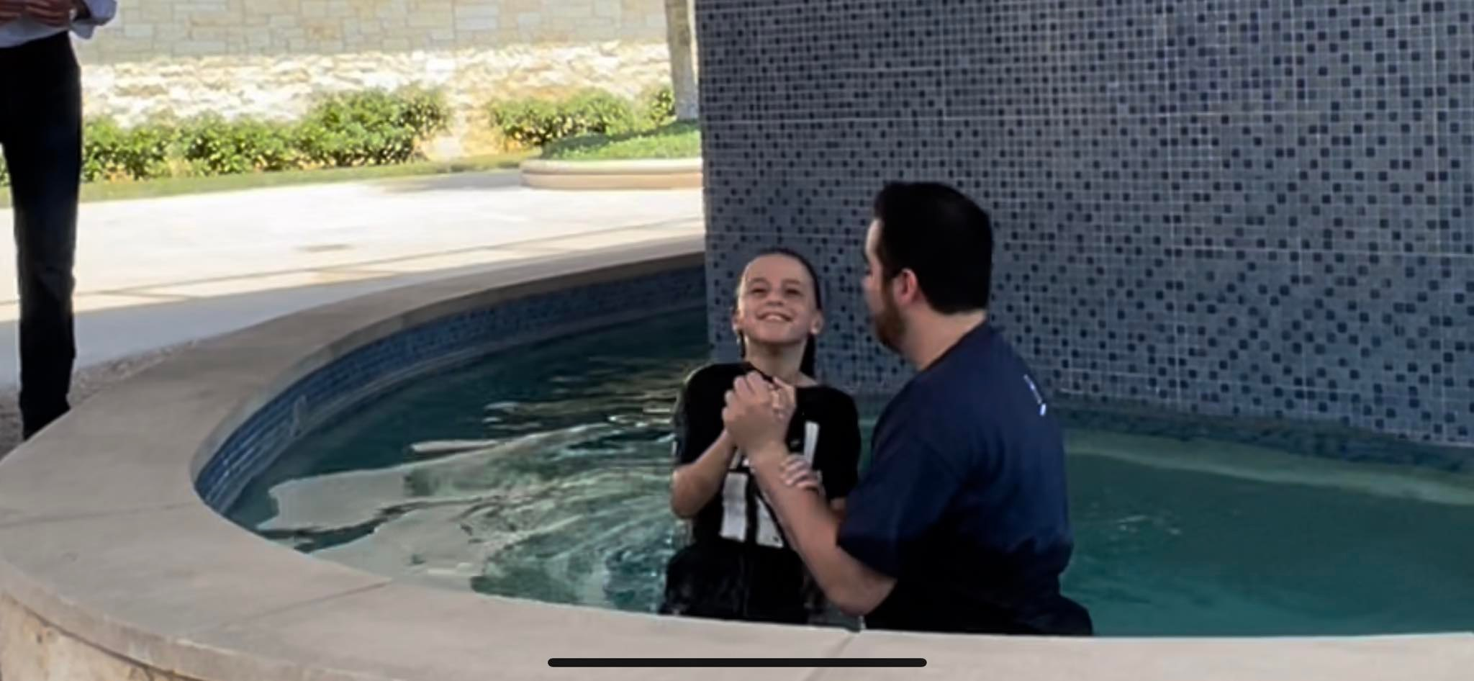
Notes:
It’s been a tough few months at work. Things haven’t been going exactly as I would have liked. I’m working on releasing a new service and have been running into friction along the way. We have had quite a bit of attrition on a single team because of market conditions and eventually, working conditions. I’ve been praying for a win. God gave them to me, but not in a way I was expecting:
Gavin got his grey and whitebelt… His excitement was contagious.
Emma got baptized, I had never seen her smile so much. It was Stephanie and my 13 Anniversary, a solid reminder of who loves me. God was letting me know what mattered. He was saying, “Tom, you’re winning; you’re winning everyday.”
Don’t we miss out on some of those wins. Those things that are happening everyday?
Sometimes; it comes just the way you ask – Casey’s new job.

Slide 13
¹³ But his servants came near and said to him, “My father, it is a great word the prophet has spoken to you; will you not do it? Has he actually said to you, ‘Wash, and be clean’?” ¹⁴ So he went down and dipped himself seven times in the Jordan, according to the word of the man of God, and his flesh was restored like the flesh of a little child, and he was clean.
2 Kings 5:13-14
Notes:
Humility
Our pride can get in the way of our healing.
What’s God asking you to do?

Slide 14
Overview
God puts you in places for a reason; he has a purpose and a plan for you
2 Kings 5:2
Our expectations vs God’s delivery
2 Kings 5:11
Surrounding ourselves with a community who will hold us accountable
2 Kings 5:13
Humility – God said 7 times, not 1, or 2, or 3, or 4…7
2 Kings 5:10; 5:14a

Slide 15
The End

Slide 16
5 Naaman, commander of the army of the king of Syria, was a great man with his master and in high favor, because by him the Lord had given victory to Syria. He was a mighty man of valor, but he was a leper. ² Now the Syrians on one of their raids had carried off a little girl from the land of Israel, and she worked in the service of Naaman’s wife. ³ She said to her mistress, “Would that my lord were with the prophet who is in Samaria! He would cure him of his leprosy.” ⁴ So Naaman went in and told his lord, “Thus and so spoke the girl from the land of Israel.” ⁵ And the king of Syria said, “Go now, and I will send a letter to the king of Israel.”
So he went, taking with him ten talents of silver, six thousand shekels of gold, and ten changes of clothing. ⁶ And he brought the letter to the king of Israel, which read, “When this letter reaches you, know that I have sent to you Naaman my servant, that you may cure him of his leprosy.” ⁷ And when the king of Israel read the letter, he tore his clothes and said, “Am I God, to kill and to make alive, that this man sends word to me to cure a man of his leprosy? Only consider, and see how he is seeking a quarrel with me.”
⁸ But when Elisha the man of God heard that the king of Israel had torn his clothes, he sent to the king, saying, “Why have you torn your clothes? Let him come now to me, that he may know that there is a prophet in Israel.” ⁹ So Naaman came with his horses and chariots and stood at the door of Elisha’s house. ¹⁰ And Elisha sent a messenger to him, saying, “Go and wash in the Jordan seven times, and your flesh shall be restored, and you shall be clean.” ¹¹ But Naaman was angry and went away, saying, “Behold, I thought that he would surely come out to me and stand and call upon the name of the Lord his God, and wave his hand over the place and cure the leper. ¹² Are not Abana and Pharpar, the rivers of Damascus, better than all the waters of Israel? Could I not wash in them and be clean?” So he turned and went away in a rage. ¹³ But his servants came near and said to him, “My father, it is a great word the prophet has spoken to you; will you not do it? Has he actually said to you, ‘Wash, and be clean’?” ¹⁴ So he went down and dipped himself seven times in the Jordan, according to the word of the man of God, and his flesh was restored like the flesh of a little child, and he was clean.
2 Kings 5:1–14

Slide 17
God puts you in places for a reason
Sometimes it could be to speak truth into someone else’s life. Others, it could be to be a witness to god’s miracles.
Our expectations vs God’s delivery
It’s been a tough few months at work. Things haven’t been going exactly as I would have liked. I’m working on releasing a new service and have been running into friction along the way. We have had quite a bit of attrition on a single team because of market conditions and eventually, working conditions. I’ve been praying for a win. God gave them to me, but not in a way I was expecting: Gavin got his grey and whitebelt… His excitement was contagious. Emma got baptized, I had never seen her smile so much. It was Stephanie and my 13 Anniversary, a solid reminder of who loves me. God was letting me know what mattered. He was saying, “Tom, you’re winning; you’re winning everyday.”
Don’t we miss out on some of those wins. Those things that are happening everyday?
Surrounding ourselves with people who will hold us accountable
…
Humility – 7 times, not 1, or 2, or 3, or 4…7
…

Slide 19
Notes:
We can all clearly see a white triangle that has its tips inside the black circles, even though the triangle is not actually outlined. However, because our brain is used to seeing full shapes, what we see instinctively is an image of a white triangle on top of another triangle and three circles. Now try to convince yourself that the image is simply three Pacman-shapes and three V-shapes. This simple task is very difficult because our brains keep constructing the white triangle.

Slide 20
GREEN – RED – ORANGE – RED – PURPLE – GREEN
YELLOW – RED –BLUE – PURPLE – GREEN – RED
Notes:
You will find that it is much harder to say the colours of the words as opposed to just reading them. This is because we do not usually have to pay attention to the colour of words. For that reason, our brains will instinctively rate the meaning of the word as more important than the colour of the word. When we then have to pay attention to the colour of the word, we have to bypass the brain’s prioritization, which is not such an easy thing to do.

