Slide 1
God’s Warnings & Judgements
2 Kings 17:7-20
Notes:
Good morning; today we’re digging in 2 Kings 17:7-20. We’ll be taking a look at God’s Warnings and Judgements for the people of Israel and Judah.
I also learned that God has a tremendous of patience for us. It’s huge, it’s massive, but it doesn’t come without limits.
We’re not all that different from the people back then. Just like the people of Israel and Judah; we face circumstance of worldly views attacking our Biblical truths. The world is pulling at you. Trying to get you to adhere to it’s culture. Trying to get you to worship false idols. Trying to skew your perspective of God’s sovereignty. That’s the world we live in and that’s the world the people of Israel and Judah lived in.
Staying with those similarities… we can be quite dumb sometimes and

Slide 2
What do they need to know?
God’s Grace and Patience is huge, but it has its limits. God gives multiple warnings, but His judgement will come.
Why do they need to know it?
Know the history of the Israelites. The warnings they received from God; their lack of response to those warnings; and God’s response to their neglect of God’s word.
What do they need to do?
Read God’s word; understand His will
Be watchful for idolatry and for actions that go against God’s will
To be mindful to His warnings & act accordingly
Why do they need to do it?
God has a purpose and plan for all of us. Following God’s plan is the fastest way to achieve His purpose. If you want God’s best; listen to His plan.
How can I help them remember?
We warn our children over, and over, and over again.

Slide 3


Slide 4


Slide 5


Slide 6

Notes:
Why is it that these road signs warnings can be so easy to understand and obey, but the warnings in our life be so difficult for us?
Here’s how bad I am at recognizing these signs of danger. Talk about the time I saw a robbery

Slide 7


Slide 8
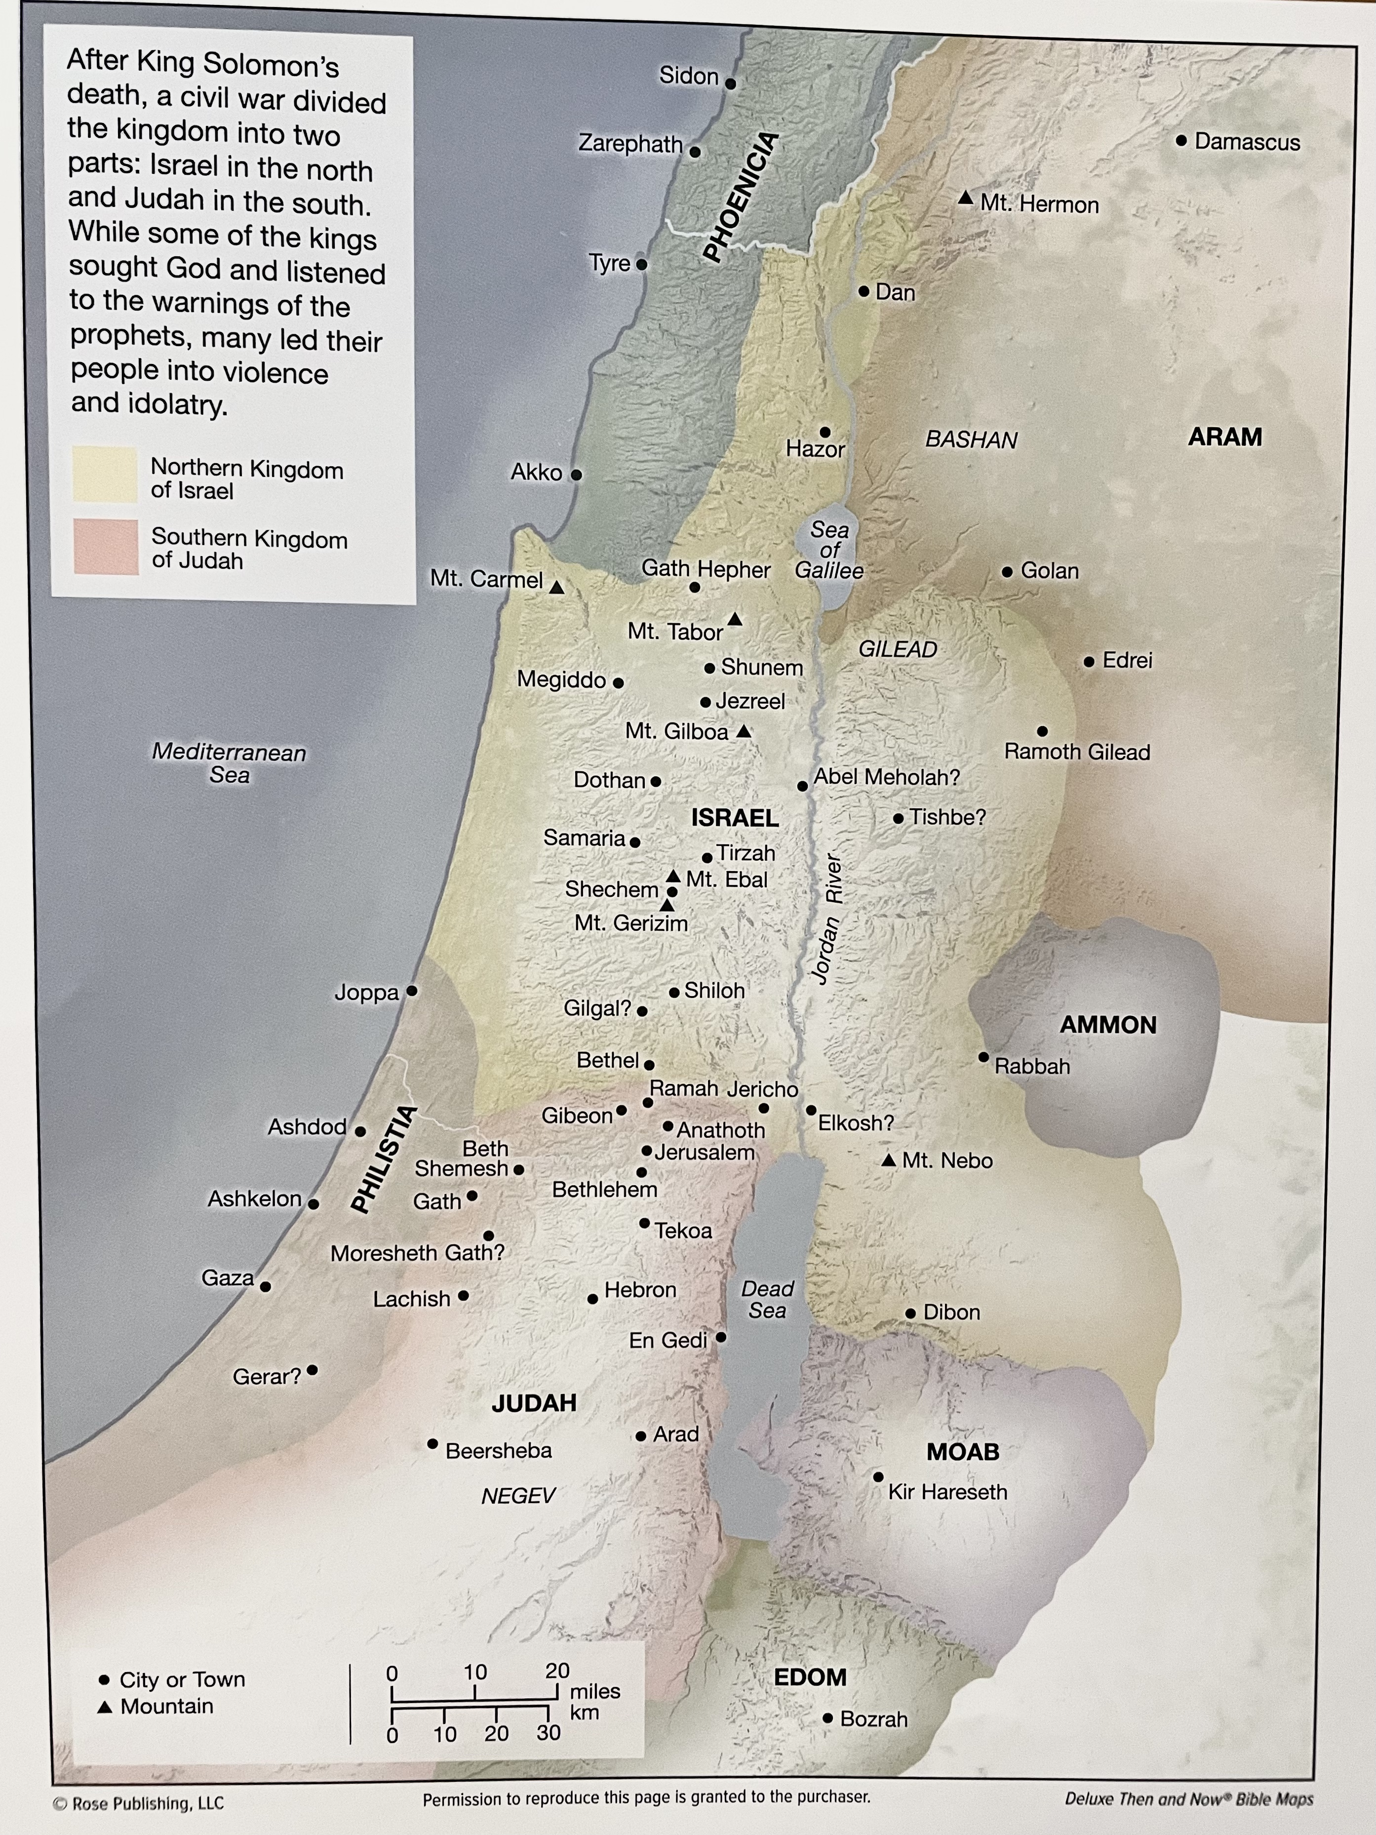
Notes:
At this point the kingdom is divided. We have Israel to the north and Judah to the South.

Slide 9
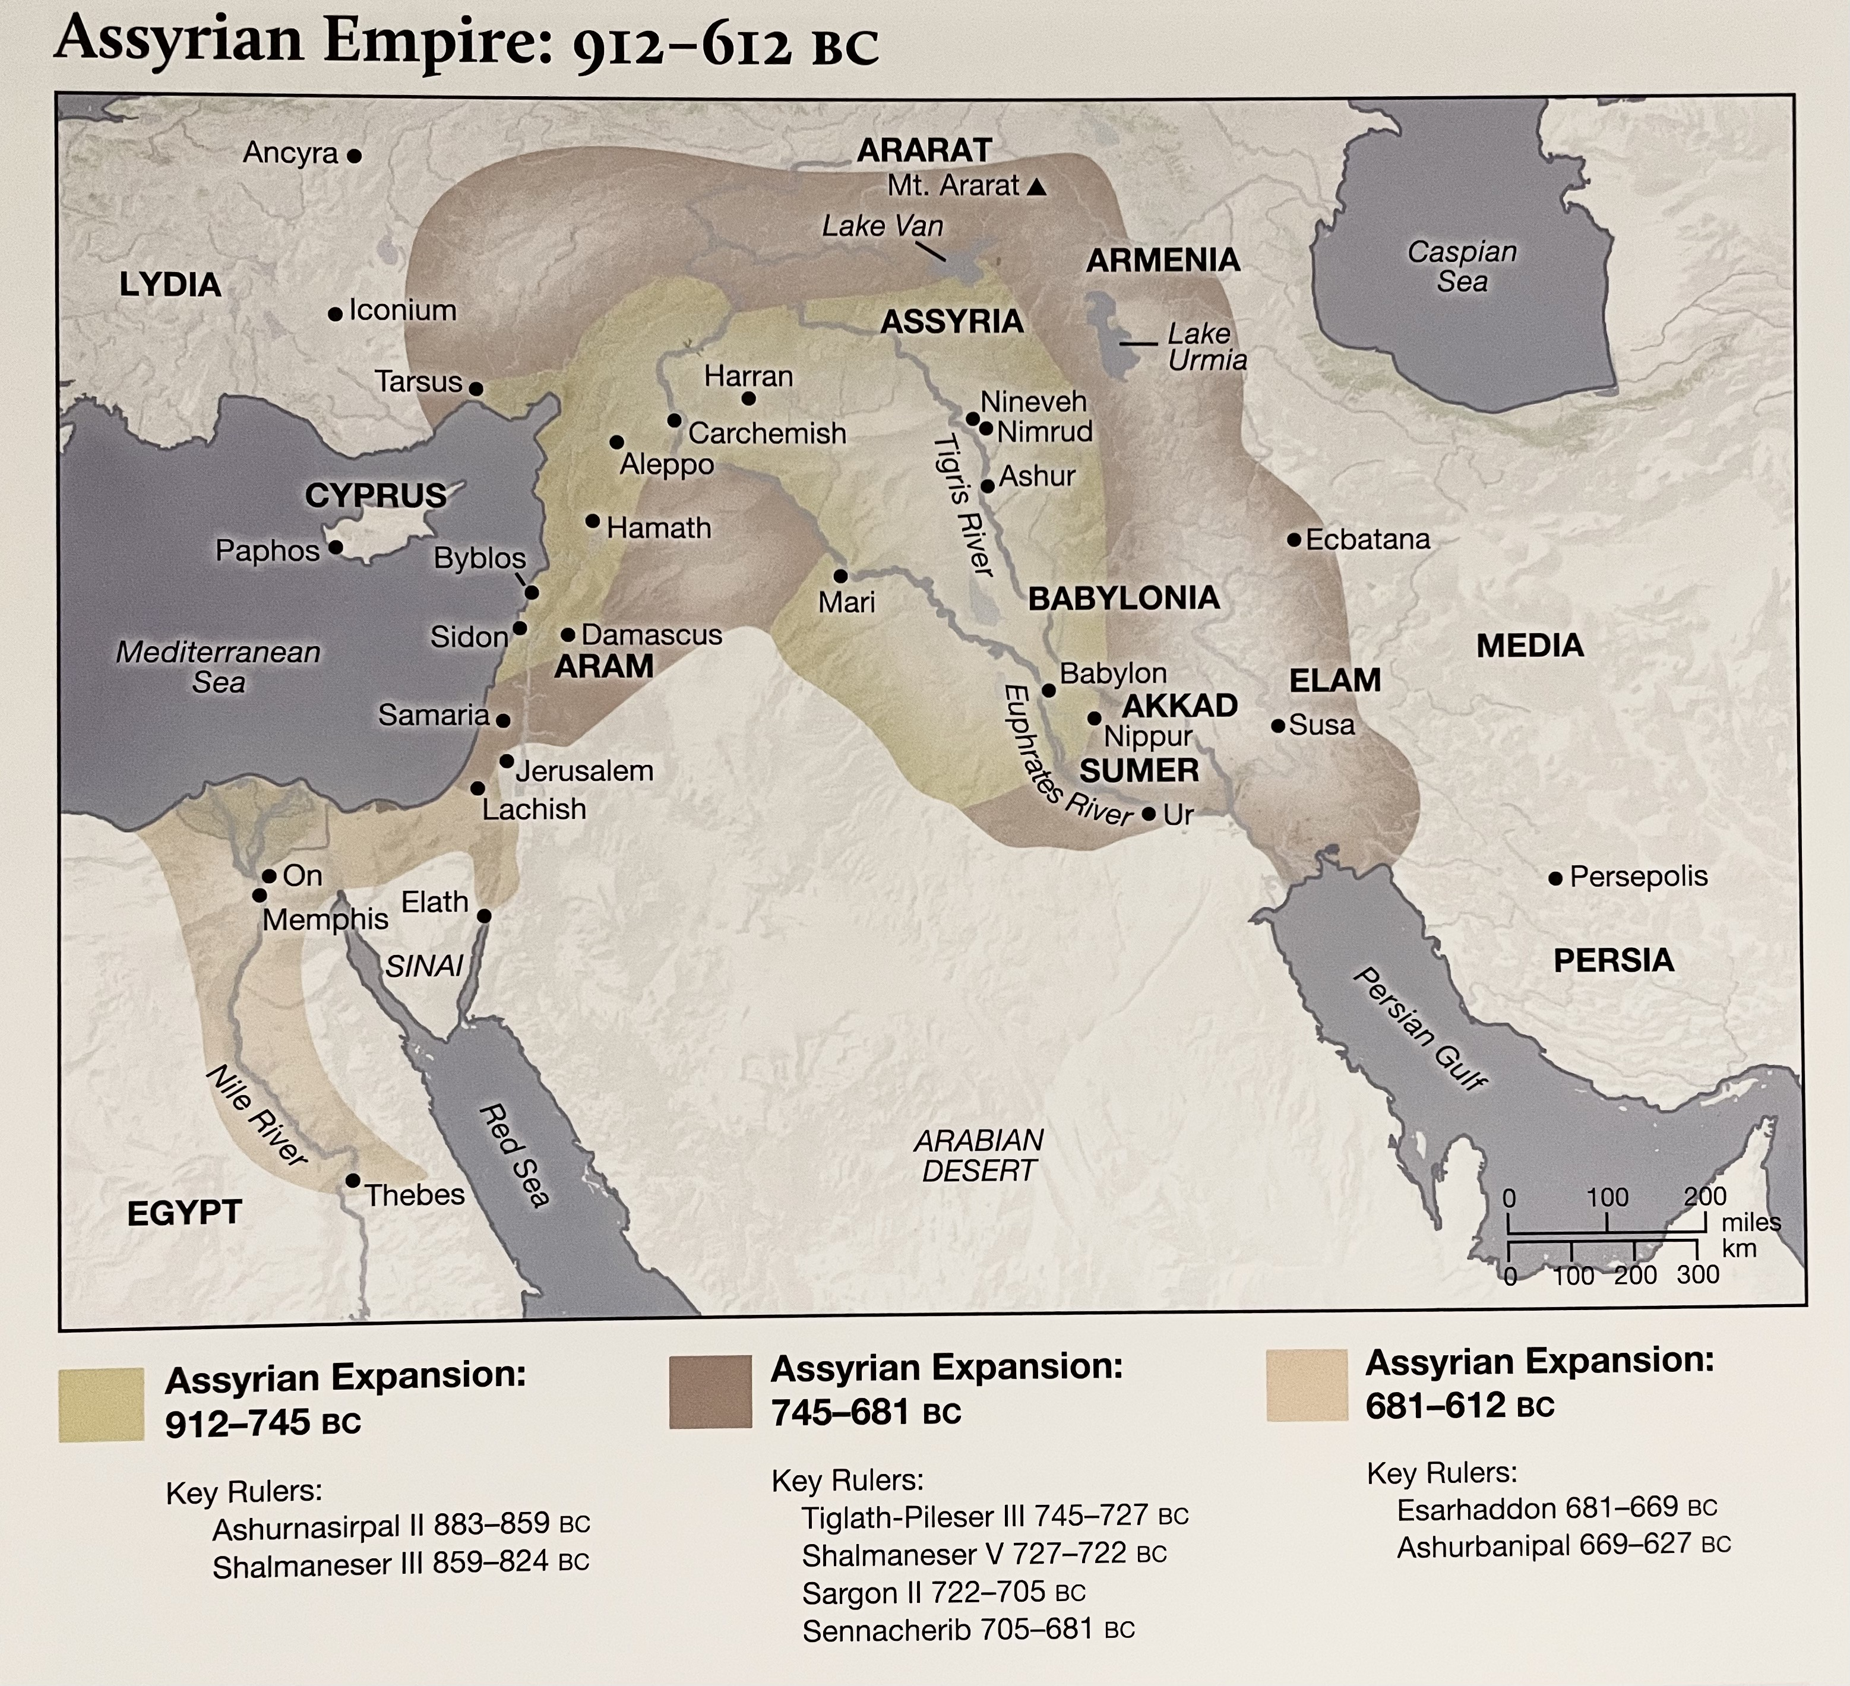
Notes:
Let’s talk about what happened to Israel and Judah’s experience with ignoring warning signs.

Slide 10
Foreshadowing
¹³ However, I will not tear away all the kingdom, but I will give one tribe to your son, for the sake of David my servant and for the sake of Jerusalem that I have chosen.”
1 Kings 11:13

Slide 11
Rise of Assyria: Israel & Judah’s Warnings
Assyria begins to expand its territory.
912BC
Norther Kingdom of Israel is forced to pay tribute to Assyria.
841BC
Southern Kingdom of Judah falls to Babylon. 586BC
Israel falls to Assyria. 722BC
Samuel
Prophet to Israel
1060-1020BC
Elijah
Prophet to Israel
870-845BC
Amos
Prophet to Israel
760-753BC
Isiah
Prophet to Judah
740-661BC
Zephaniah
Prophet to Judah
641-628BC
Habakkuk
Prophet to Judah
609-598BC
1100BC
500BC
Nathan
Prophet to King David
990-971BC
Hosea
Prophet to Israel
752-722BC
Micah
Prophet to Judah
738-698BC
Jeremiah
Prophet to Judah
626-582BC
Notes:
100’s of years of warnings to the people of Israel.
Exodus
Deuteronomy
Leviticus
Jeremiah
1 Samuel
Proverbs

Slide 12
Israel's Sin
⁷ And this occurred because the people of Israel had sinned against the Lord their God, who had brought them up out of the land of Egypt from under the hand of Pharaoh king of Egypt, and had feared other gods ⁸ and walked in the customs of the nations whom the Lord drove out before the people of Israel, and in the customs that the kings of Israel had practiced. ⁹ And the people of Israel did secretly against the Lord their God things that were not right. They built for themselves high places in all their towns, from watchtower to fortified city. ¹⁰ They set up for themselves pillars and Asherim on every high hill and under every green tree, ¹¹ and there they made offerings on all the high places, as the nations did whom the Lord carried away before them. And they did wicked things, provoking the Lord to anger,
2 Kings 17:7–11
Notes:
Why did the people of Israel think they would be treated any differently?
Learning from people in front of you; your parents, elders, etc.

Slide 13
Warning I have experienced
  How did I respond?
  How did it work out for me?
  Should I have handled it differently?
Warning I’ve given my kids
  How did the kids respond?
  How did it turn out for them?
  What did they miss out on?

Slide 14
God’s Warning
¹² and they served idols, of which the Lord had said to them, “You shall not do this.” ¹³ Yet the Lord warned Israel and Judah by every prophet and every seer, saying, “Turn from your evil ways and keep my commandments and my statutes, in accordance with all the Law that I commanded your fathers, and that I sent to you by my servants the prophets.”
2 Kings 17:12–13

Slide 15
Rise of Assyria: Israel & Judah’s Warnings
Assyria begins to expand its territory.
912BC
Norther Kingdom of Israel is forced to pay tribute to Assyria.
841BC
Southern Kingdom of Judah falls to Babylon. 586BC
Israel falls to Assyria. 722BC
Samuel
Prophet to Israel
1060-1020BC
Elijah
Prophet to Israel
870-845BC
Amos
Prophet to Israel
760-753BC
Isiah
Prophet to Judah
740-661BC
Zephaniah
Prophet to Judah
641-628BC
Habakkuk
Prophet to Judah
609-598BC
1100BC
500BC
Nathan
Prophet to King David
990-971BC
Hosea
Prophet to Israel
752-722BC
Micah
Prophet to Judah
738-698BC
Jeremiah
Prophet to Judah
626-582BC
Notes:
100’s of years of warnings to the people of Israel.
Exodus
Deuteronomy
Leviticus
Jeremiah
1 Samuel
Proverbs

Slide 16
Warning: Idols & Other Gods
³ “You shall have no other gods before me.
⁴ “You shall not make for yourself a carved image, or any likeness of anything that is in heaven above, or that is in the earth beneath, or that is in the water under the earth.
Exodus 20:3–4

Slide 17
Warning: Worldly Views
³ You shall not do as they do in the land of Egypt, where you lived, and you shall not do as they do in the land of Canaan, to which I am bringing you. You shall not walk in their statutes. ⁴ You shall follow my rules and keep my statutes and walk in them. I am the Lord your God. ⁵ You shall therefore keep my statutes and my rules; if a person does them, he shall live by them: I am the Lord.
Leviticus 18:3–5

Slide 18
Warning
¹⁰ and if it does evil in my sight, not listening to my voice, then I will relent of the good that I had intended to do to it. ¹¹ Now, therefore, say to the men of Judah and the inhabitants of Jerusalem: ‘Thus says the Lord, Behold, I am shaping disaster against you and devising a plan against you. Return, every one from his evil way, and amend your ways and your deeds.’
Jeremiah 18:10–11

Slide 19
Israel's Sin
⁷ And this occurred because the people of Israel had sinned against the Lord their God, who had brought them up out of the land of Egypt from under the hand of Pharaoh king of Egypt, and had feared other gods ⁸ and walked in the customs of the nations whom the Lord drove out before the people of Israel, and in the customs that the kings of Israel had practiced. ⁹ And the people of Israel did secretly against the Lord their God things that were not right. They built for themselves high places in all their towns, from watchtower to fortified city. ¹⁰ They set up for themselves pillars and Asherim on every high hill and under every green tree, ¹¹ and there they made offerings on all the high places, as the nations did whom the Lord carried away before them. And they did wicked things, provoking the Lord to anger,
2 Kings 17:7–11
Notes:
Why did the people of Israel think they would be treated any differently?
Learning from people in front of you; your parents, elders, etc.

Slide 20
Stiff Necked People
¹⁴ But they would not listen, but were stubborn, as their fathers had been, who did not believe in the Lord their God. ¹⁵ They despised his statutes and his covenant that he made with their fathers and the warnings that he gave them. They went after false idols and became false, and they followed the nations that were around them, concerning whom the Lord had commanded them that they should not do like them. ¹⁶ And they abandoned all the commandments of the Lord their God, and made for themselves metal images of two calves; and they made an Asherah and worshiped all the host of heaven and served Baal. ¹⁷ And they burned their sons and their daughters as offerings and used divination and omens and sold themselves to do evil in the sight of the Lord, provoking him to anger.
2 Kings 17:14–17

Slide 21
Stiff Necked
29 He who is often reproved, yet stiffens his neck,
will suddenly be broken beyond healing.
Proverbs 29:1

Slide 22
God Judges
¹⁸ Therefore the Lord was very angry with Israel and removed them out of his sight. None was left but the tribe of Judah only.
¹⁹ Judah also did not keep the commandments of the Lord their God, but walked in the customs that Israel had introduced. ²⁰ And the Lord rejected all the descendants of Israel and afflicted them and gave them into the hand of plunderers, until he had cast them out of his sight.
2 Kings 17:18–20
Notes:
This spanned 200 years of disobedience – This wasn’t just some angry reaction by God.

Slide 23
Idol
⁴ Therefore, as to the eating of food offered to idols, we know that “an idol has no real existence,” and that “there is no God but one.” ⁵ For although there may be so-called gods in heaven or on earth—as indeed there are many “gods” and many “lords”— ⁶ yet for us there is one God, the Father, from whom are all things and for whom we exist, and one Lord, Jesus Christ, through whom are all things and through whom we exist.
1 Corinthians 8:4–6

Slide 24
Become Worthless/False
²¹ For although they knew God, they did not honor him as God or give thanks to him, but they became futile in their thinking, and their foolish hearts were darkened. ²² Claiming to be wise, they became fools, ²³ and exchanged the glory of the immortal God for images resembling mortal man and birds and animals and creeping things.
Romans 1:21–23

Slide 25
Read, Pray, Confess, and Fellowship
Read – Understand what God expects
Pray – Speak with Him; hear His commands
Confess – Realize & Acknowledge your shortcomings
Fellowship – We need others to help us realize the warning signs

Slide 26
The End

Slide 27
Idol
³ but he walked in the way of the kings of Israel. He even burned his son as an offering, according to the despicable practices of the nations whom the Lord drove out before the people of Israel. ⁴ And he sacrificed and made offerings on the high places and on the hills and under every green tree.
2 Kings 16:3–4

Slide 28
Warning: Leviticus
26 “You shall not make idols for yourselves or erect an image or pillar, and you shall not set up a figured stone in your land to bow down to it, for I am the Lord your God.
Leviticus 26:1

Slide 29
Warning: Deuteronomy
²⁹ “When the Lord your God cuts off before you the nations whom you go in to dispossess, and you dispossess them and dwell in their land, ³⁰ take care that you be not ensnared to follow them, after they have been destroyed before you, and that you do not inquire about their gods, saying, ‘How did these nations serve their gods?—that I also may do the same.’ ³¹ You shall not worship the Lord your God in that way, for every abominable thing that the Lord hates they have done for their gods, for they even burn their sons and their daughters in the fire to their gods.
Deuteronomy 12:29–31

Slide 30
Warning: Deuteronomy
²¹ “You shall not plant any tree as an Asherah beside the altar of the Lord your God that you shall make. ²² And you shall not set up a pillar, which the Lord your God hates.
Deuteronomy 16:21–22

Slide 31
Warning: Deuteronomy
⁹ “When you come into the land that the Lord your God is giving you, you shall not learn to follow the abominable practices of those nations. ¹⁰ There shall not be found among you anyone who burns his son or his daughter as an offering, anyone who practices divination or tells fortunes or interprets omens, or a sorcerer ¹¹ or a charmer or a medium or a necromancer or one who inquires of the dead, ¹² for whoever does these things is an abomination to the Lord. And because of these abominations the Lord your God is driving them out before you. ¹³ You shall be blameless before the Lord your God, ¹⁴ for these nations, which you are about to dispossess, listen to fortune-tellers and to diviners. But as for you, the Lord your God has not allowed you to do this.
Deuteronomy 18:9–14

Slide 32
Warning: Jeremiah
⁵ saying, ‘Turn now, every one of you, from his evil way and evil deeds, and dwell upon the land that the Lord has given to you and your fathers from of old and forever. ⁶ Do not go after other gods to serve and worship them, or provoke me to anger with the work of your hands. Then I will do you no harm.’ ⁷ Yet you have not listened to me, declares the Lord, that you might provoke me to anger with the work of your hands to your own harm.
Jeremiah 25:5–7

Slide 33
Warning: Jeremiah
¹⁵ I have sent to you all my servants the prophets, sending them persistently, saying, ‘Turn now every one of you from his evil way, and amend your deeds, and do not go after other gods to serve them, and then you shall dwell in the land that I gave to you and your fathers.’ But you did not incline your ear or listen to me.
Jeremiah 35:15.

Slide 34
Provoke
²¹ They have made me jealous with what is no god;
they have provoked me to anger with their idols.
So I will make them jealous with those who are no people;
I will provoke them to anger with a foolish nation.
²² For a fire is kindled by my anger,
and it burns to the depths of Sheol,
devours the earth and its increase,
and sets on fire the foundations of the mountains.
Deuteronomy 32:21–22

Slide 35
Idol
³⁷ For they have committed adultery, and blood is on their hands. With their idols they have committed adultery, and they have even offered up to them for food the children whom they had borne to me. ³⁸ Moreover, this they have done to me: they have defiled my sanctuary on the same day and profaned my Sabbaths. ³⁹ For when they had slaughtered their children in sacrifice to their idols, on the same day they came into my sanctuary to profane it. And behold, this is what they did in my house.
Ezekiel 23:36–39

Slide 36
God’s Judgement
⁸ She saw that for all the adulteries of that faithless one, Israel, I had sent her away with a decree of divorce. Yet her treacherous sister Judah did not fear, but she too went and played the whore. ⁹ Because she took her whoredom lightly, she polluted the land, committing adultery with stone and tree. ¹⁰ Yet for all this her treacherous sister Judah did not return to me with her whole heart, but in pretense, declares the Lord.”
Jeremiah 3:8–10

Slide 37
God’s Judgement
³ And the anger of the Lord was kindled against Israel, and he gave them continually into the hand of Hazael king of Syria and into the hand of Ben-hadad the son of Hazael
2 Kings 13:3

Slide 38
God’s Judgement
²⁹ In the days of Pekah king of Israel, Tiglath-pileser king of Assyria came and captured Ijon, Abel-beth-maacah, Janoah, Kedesh, Hazor, Gilead, and Galilee, all the land of Naphtali, and he carried the people captive to Assyria. ³⁰ Then Hoshea the son of Elah made a conspiracy against Pekah the son of Remaliah and struck him down and put him to death and reigned in his place, in the twentieth year of Jotham the son of Uzziah.
2 Kings 15:29–30

Slide 39
Sin
³ but he walked in the way of the kings of Israel. He even burned his son as an offering, according to the despicable practices of the nations whom the Lord drove out before the people of Israel. ⁴ And he sacrificed and made offerings on the high places and on the hills and under every green tree.
2 Kings 16:3–4

Slide 40
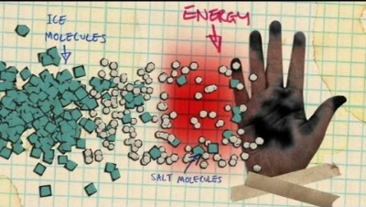

Slide 41
