Slide 1
encouragement
1 Thessalonians 3:4-14

Slide 2
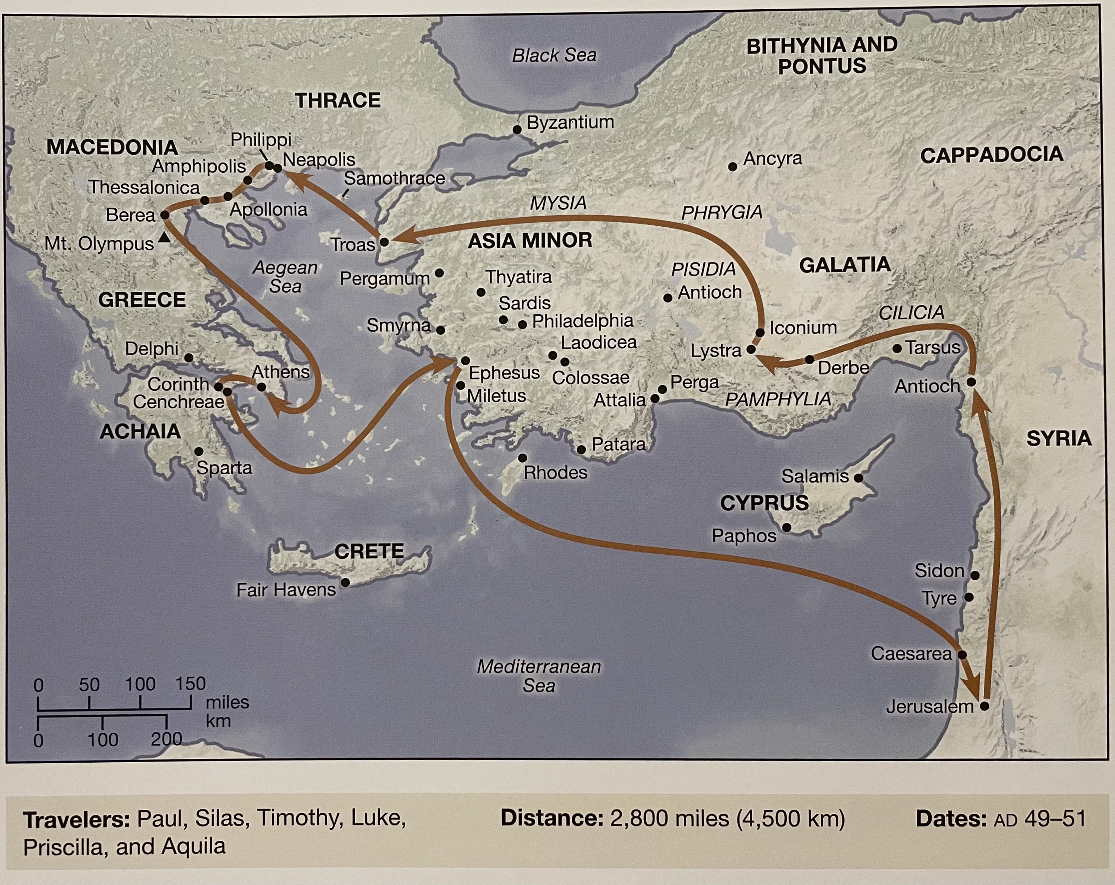
Backstory
Where is Paul coming from?
What happened in Thessalonica?
Acts 17
What’s happened so far in Thessalonians (the letter)?

Slide 3
⁴ For when we were with you, we kept telling you beforehand that we were to suffer affliction, just as it has come to pass, and just as you know. ⁵ For this reason, when I could bear it no longer, I sent to learn about your faith, for fear that somehow the tempter had tempted you and our labor would be in vain.
Timothy’s Encouraging Report
⁶ But now that Timothy has come to us from you, and has brought us the good news of your faith and love and reported that you always remember us kindly and long to see us, as we long to see you— ⁷ for this reason, brothers, in all our distress and affliction we have been comforted about you through your faith. ⁸ For now we live, if you are standing fast in the Lord. ⁹ For what thanksgiving can we return to God for you, for all the joy that we feel for your sake before our God, ¹⁰ as we pray most earnestly night and day that we may see you face to face and supply what is lacking in your faith?
¹¹ Now may our God and Father himself, and our Lord Jesus, direct our way to you, ¹² and may the Lord make you increase and abound in love for one another and for all, as we do for you, ¹³ so that he may establish your hearts blameless in holiness before our God and Father, at the coming of our Lord Jesus with all his saints.
1 Thessalonians 3:4–13 (ESV)
Notes:
Celebration of Faithfulness

Slide 4
What should Christians expect?
⁴ For when we were with you, we kept telling you beforehand that we were to suffer affliction, just as it has come to pass, and just as you know.
1 Thessalonians 3:4 (ESV)
One In Eight Christians Worldwide Live In Countries Where They May Face Persecution
In the last year…
5,898 Christians Kills | 5,100 Churches Attacked
Notes:
https://www.forbes.com/sites/ewelinaochab/2021/01/13/one-in-eight-christians-worldwide-live-in-countries-where-they-would-be-persecuted/?sh=de368c650162
https://www.opendoorsuk.org/persecution/world-watch-list/
Around the world, 5,898 Christians were killed for their faith last year. Of these, 4,650 were in Nigeria – yet again, more believers are murdered for following Jesus in Nigeria than the rest of the world combined.
In the past year, more than 5,000 churches and church buildings were bombed, attacked, destroyed, looted, burned down or forcibly closed – to try to stop people meeting together to worship Jesus.
Basic examples of persecution.

Slide 5
Uncertainty, fear, Distress, Affliction
⁵ For this reason, when I could bear it no longer, I sent to learn about your faith, for fear that somehow the tempter had tempted you and our labor would be in vain.
1 Thessalonians 3:5 (ESV)
Notes:
Paul’s wondering, did I do enough? Are they ok?
Paul, knowing what to expect, was in distress…
Is ignite prepared for persecution?
Am I as nervous as Paul?
Made me think; what is it I’m doing here?

Slide 6
Notes:
Iraq - Land mine story

Slide 7
Encourage
Study the word
Live the word
Teach the word
To get us comfortable being uncomfortable
Notes:
Prepare us for persecution.
Reading the Bible
Pray For One Another
Memorizing Scripture
Serving Together

Slide 8
Relief
⁶ But now that Timothy has come to us from you, and has brought us the good news of your faith and love and reported that you always remember us kindly and long to see us, as we long to see you— ⁷ for this reason, brothers, in all our distress and affliction we have been comforted about you through your faith. ⁸ For now we live, if you are standing fast in the Lord. ⁹ For what thanksgiving can we return to God for you, for all the joy that we feel for your sake before our God, ¹⁰ as we pray most earnestly night and day that we may see you face to face and supply what is lacking in your faith?
1 Thessalonians 3:6-10 (ESV)
Notes:
I want this!

Slide 9
Serving
¹⁰ As each has received a gift, use it to serve one another, as good stewards of God’s varied grace
1 Peter 4:10.
Notes:
Find a place you feel God calling you toward
Ask questions
Pray about it
If you’re not sure, pick one

Slide 10
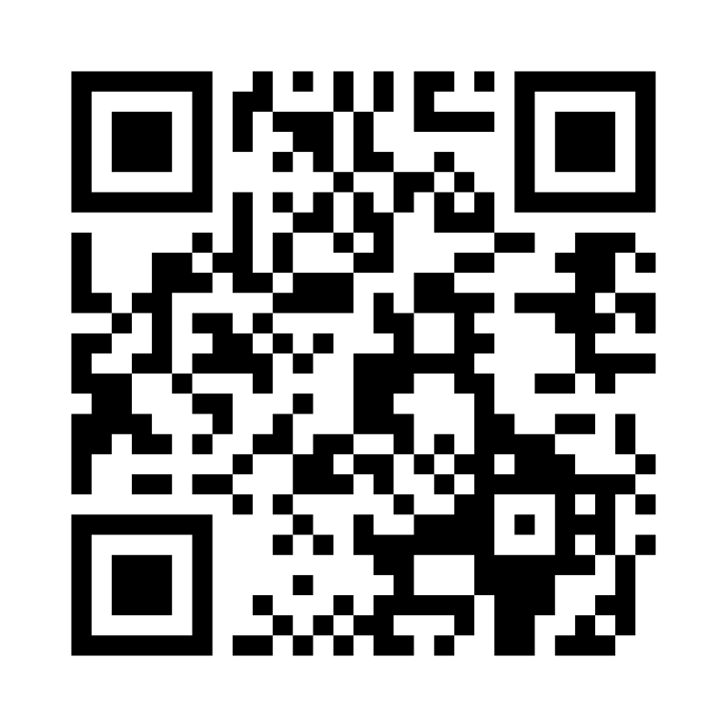
Reading
1 Thessalonians 4:1-12
³¹ So Jesus said to the Jews who had believed him, “If you abide in my word, you are truly my disciples, ³² and you will know the truth, and the truth will set you free.”
John 8:31–32
Notes:
The Bible is Gods word
Do we believe it?
2500 prophecies
2000 proven true
500 yet to occur
How many of you have the Bible App on your phone?
Keep your hands up. How many use a different Bible app?

Slide 11
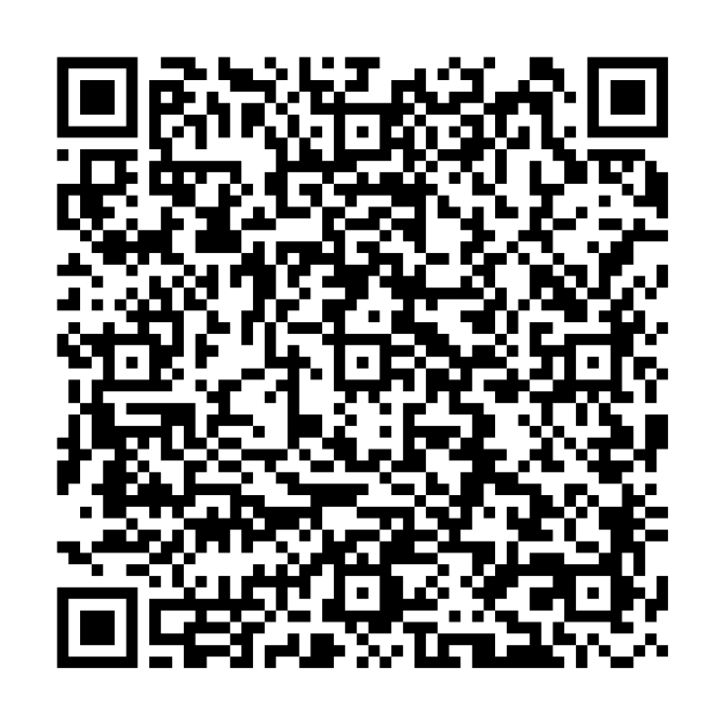
Praying
Ignite Prayer Requests
² Bear one another’s burdens, and so fulfill the law of Christ.
Galatians 6:2
Notes:
Pray and be prayed for.
You or a family member might be going through a tough time right now. Let us pray with you!
Great things might be happening in your life, celebrate them with others.
We’re really good at pray for strength in the bad times but often forget to thank God for the good.

Slide 12
Memorizing
¹⁸ “You shall therefore lay up these words of mine in your heart and in your soul, and you shall bind them as a sign on your hand, and they shall be as frontlets between your eyes.
Deuteronomy 11:18
Ignite Bible Study
Notes:
When we come into trials have the word in our hearts and souls allows the Holy Spirit to tap into them.

Slide 13
Paul’s Prayer
¹¹ Now may our God and Father himself, and our Lord Jesus, direct our way to you, ¹² and may the Lord make you increase and abound in love for one another and for all, as we do for you, ¹³ so that he may establish your hearts blameless in holiness before our God and Father, at the coming of our Lord Jesus with all his saints.
1 Thessalonians 3:11-13 (ESV)

Slide 14
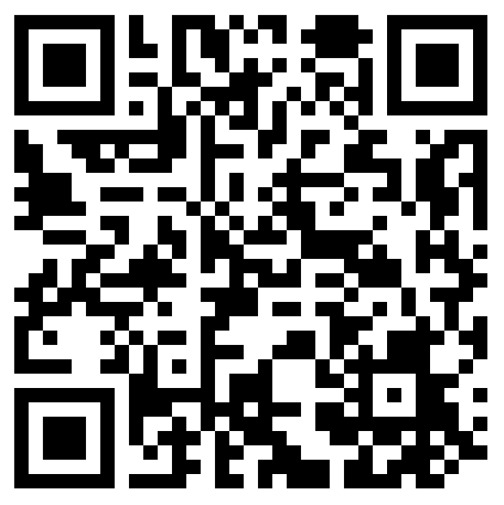
Serving, Reading, Praying, Memorizing
Ignite Bible Study Group
1 Thessalonians 4:1-12
Ignite Prayer Requests
Notes:
used to form the present participle

